Slide 1
COPD Exacerbation Rescue therapy
(Antibiotics)
Ysobel Gourlay
Lead Antimicrobial Pharmacist GGC
8 Oct 2020

Slide 2
Summary
What is Rescue therapy ?
Who ?
Benefits
GGC resistance
Doxycycline
Amoxicillin

Slide 3
Antibiotics for COPD Exacerbation
(Steroids And or)
Doxycycline 200mg as a single dose then 100mg orally for 5 days or
Amoxicillin 500mg 8 hourly for 5 days

Slide 4
COPD
3rd leading cause of death in the world (WHO)
Airflow obstruction in the lungs
Deterioration of lung function over time
Diagnosed – Pulmonary Function Tests
Smoking- major risk factor

Slide 5
NICE Definition of Acute Exacerbation of COPD
A sustained acute-onset worsening of the person’s symptoms from their usual stable state, which goes beyond their normal day-to-day variations. Commonly reported symptoms are worsening breathlessness, cough, increased sputum production and change in sputum colour. The change in these symptoms often necessitates a change in medication.

Slide 7
Rescue therapy
NICE COPD guidelines
Improves quality of life
Reduces hospital admission

Slide 8
Who
Patients will be identified by
respiratory clinics or
GP practices
As suitable for having home rescue
5 day course of antibiotics and or oral steroids

Slide 9
Who
> 18 years
Has COPD management plan in place
Ability to self manage

Slide 10
Limit of supply
Maximum 2 orders from pharmacy in 3 months or
Maximum 3 orders in 12 months
If more required
Patient must contact their own practice or NHS24 OOH

Slide 11
Antibiotics — guidance from NICE, GOLD and the Lung Foundation Australia
Antibiotic therapy considered
where an infective exacerbation of COPD is suspected
change in clinical features such as
increased sputum volume
change in sputum colour
consistency of sputum

Slide 12
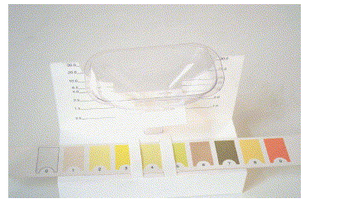
Changes in Sputum Colour
Yellowish to brownish colour change
More associated with G –ve infection
P. aeruginosa, Enterobacteriacae
Severe Functional impairment
Allegra L, Resp Medicine June 2005

Slide 13
Advantages of Antibiotic Therapy
Reduces
recovery time,
risk of early relapse,
treatment failure
hospital admission
hospital duration of stay

Slide 14
Disadvantages of Antibiotics
Side effects of specific antibiotics
Development of Antimicrobial resistance with repeated courses

Slide 15
Antibiotic Resistance
Antibiotic Prescribed in Primary Care
Respiratory tract Infection or Urinary tract infection
Develop resistance to that antibiotic
Effect greatest immediately after antibiotic prescribed
Can persist for 12 months
BMJ 2010;340:2096

Slide 16
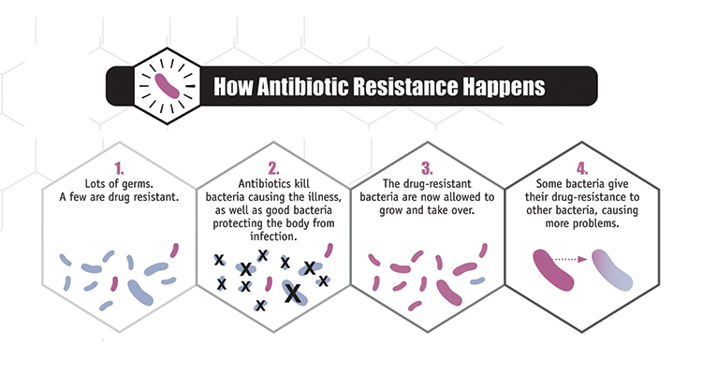
“Survival of the fittest” for bacteria
CDC 2017

Slide 17
Antibiotic Therapy
If an antibiotic is prescribed, give advice on:
Potential adverse effects, including diarrhoea.
When to seek medical help, for example if:
Symptoms worsen rapidly or significantly or
Symptoms do not start to improve within 2–3 days (or other agreed time) or
They become systemically very unwell.

Slide 20
Amoxicillin
C/I true penicillin allergy
Allergic reactions in 1-10%
Anaphylaxis 0.05%
N+ V is not penicillin allergy
NB glandular fever, ALL, CLL, CMV – erythematous rash common
eGFR

Slide 21
Drug interactions with Amoxicillin
Allopurinol — increased risk of rash
Warfarin — INR may be increased. Monitor the international normalized ratio (INR) closely during concomitant use. Dosage adjustments may be necessary.
Methotrexate — amoxicillin may reduce methotrexate clearance, causing an increased risk of toxicity. Consider measuring platelet and white cell counts twice weekly for 2 weeks initially, and measure methotrexate levels if toxicity is suspected.

Slide 22
Drug Interactions with Amoxicillin
Oral hormonal contraception — additional contraceptive precautions are not required during or after courses of amoxicillin.
However, women should be advised about the importance of correct contraceptive practice if they experience vomiting or diarrhoea.
Vomiting within 3 hours of taking a combined oral contraceptive (COC),
take another pill as soon as possible.

Slide 23
Doxycycline
Photosensitivity
Even on a cloudy day
Swallowed whole with plenty of fluid while sitting/ standing (i.e. not lying in bed)
Common side effects
Diarrhoea, headache, hypersensitivity reactions, photosensitivity, nausea, vomiting
Oesophageal ulceration

Slide 24
Doxycycline
Do not take indigestion remedies or medicines containing zinc or iron 2-3 hours before or after
See Medicines Update re COPD antibiotic failure due to Fe + doxycycline interaction
Other drug interactions
Doxycycline ↓ by phenytoin, carbamazepine, rifampicin

Slide 25
Oral corticosteroids
If there are no contraindications, consider oral corticosteroids for people with a significant increase in breathlessness that interferes with daily activities.
Offer 30 mg oral prednisolone once daily for 5 days — discuss adverse effects of prolonged therapy.
Consider the need for osteoporosis prophylaxis for people requiring frequent courses of oral corticosteroids (3–4 courses per year).

Slide 26
Other
Inhaler technique
Stop smoking
Influenza vaccine annually
Pneumococcal vaccine

Slide 27
Summary
Amoxicillin or Doxycycline can be used for COPD exacerbation
If change in sputum colour and volume or thickness
Amoxicillin
GGC~30% resistance to H. influenzae
Penicillin allergy
Doxycycline
GGC Low resistance
Drug interactions
Photosensitivity
Swallow with large glass of water

