Slide 1
Exacerbation Management of COPD
David Anderson
Respiratory Consultant
Clinical Lead GG+C Resp MCN

Slide 2
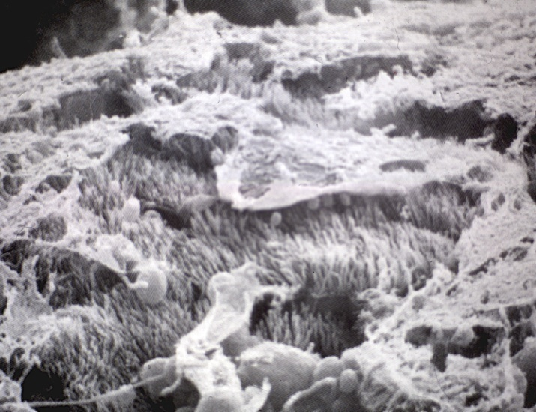
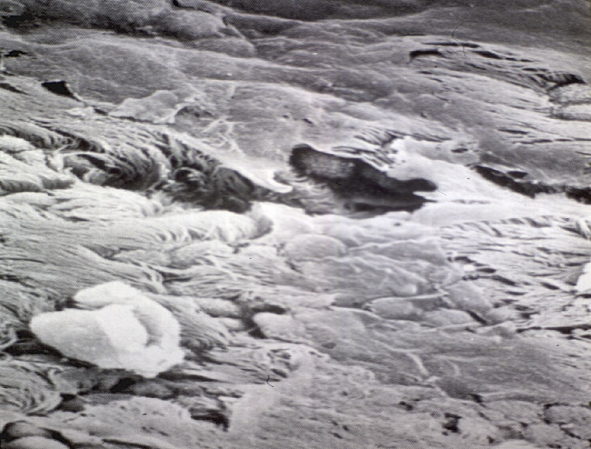
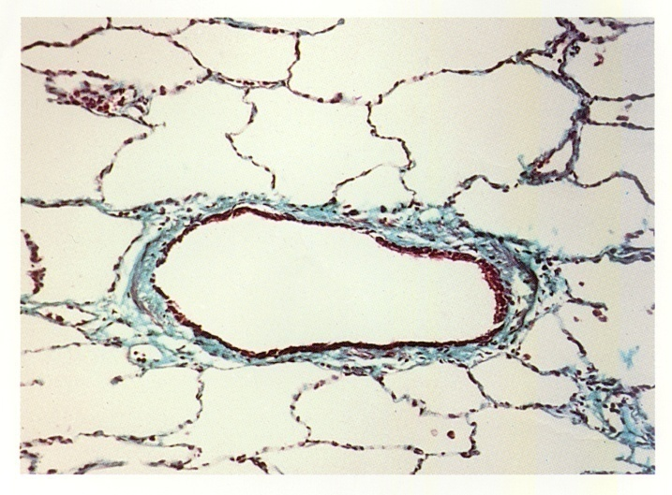
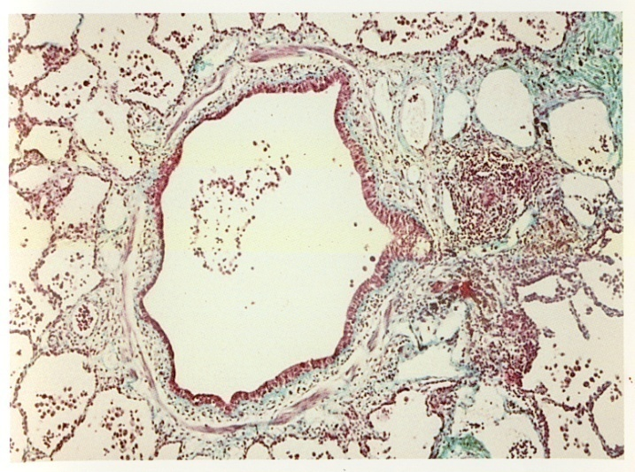
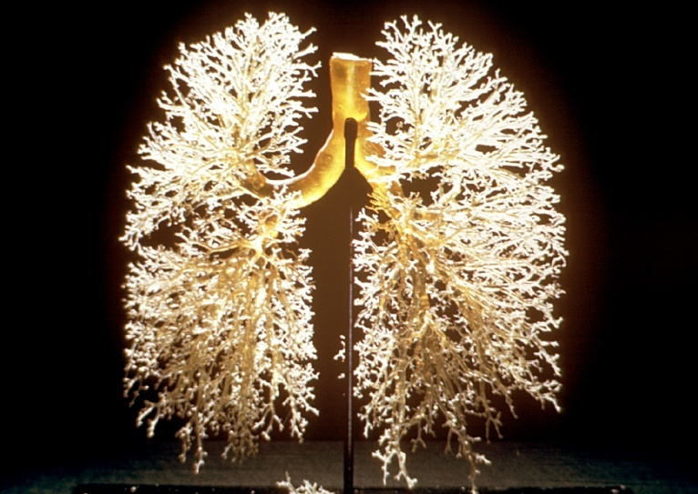
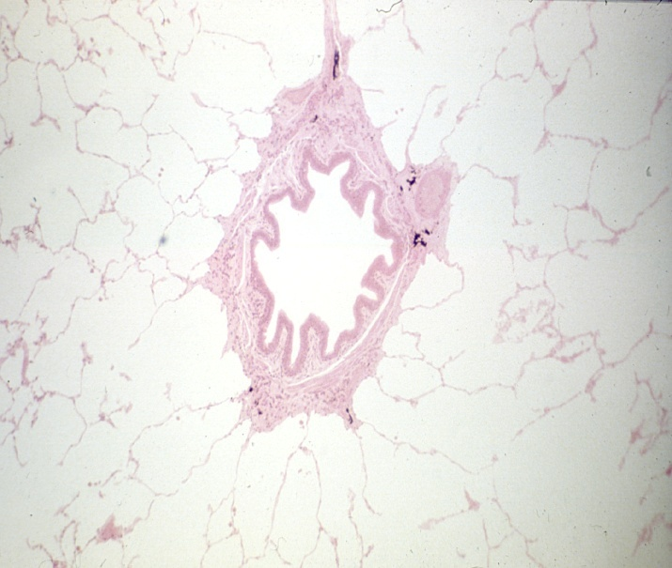
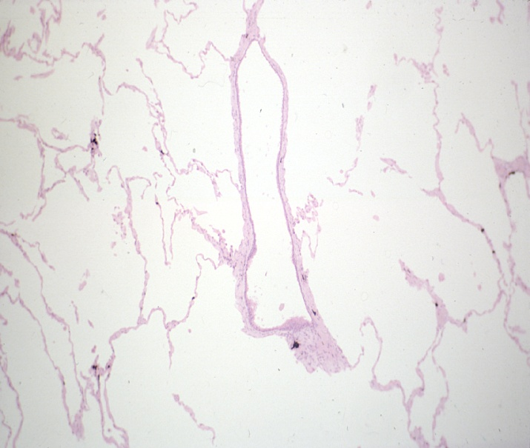
Chronic
Bronchitis
Bronchiolitis
Small airways disease
Emphysema

Slide 3
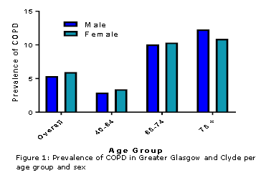
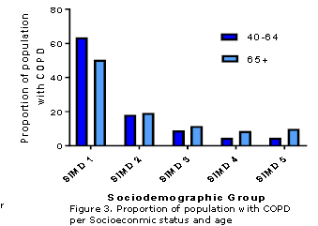
Changing Demographics

Slide 4
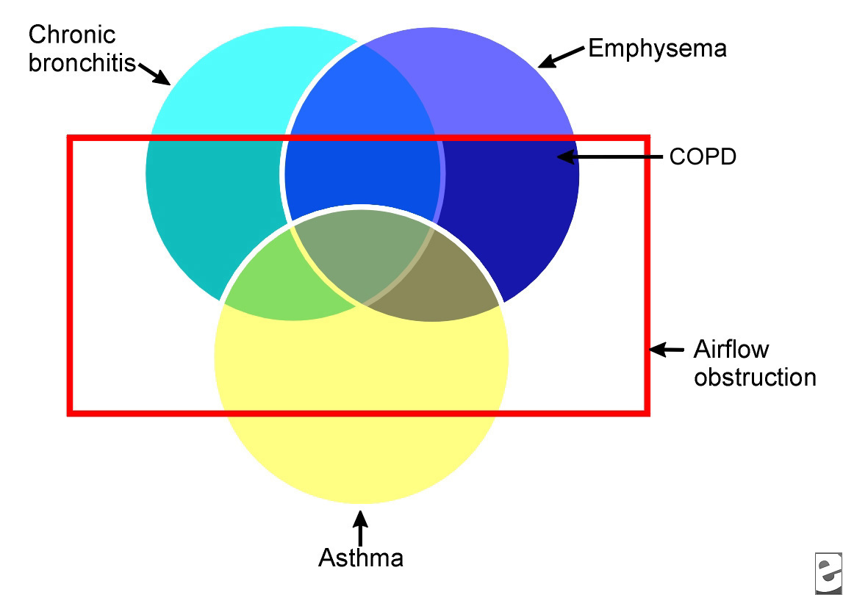
COPD vs Asthma

Slide 5
Prednisolone Rx in COPD
Osteoporosis
  Female, immobile, smoker, low BMI
Adrenal Insufficiency
Predisposition to infection
Muscle Weakness
Mood

Slide 6
Exacerbation Management
Treatable Traits
  Asthmatic Component
  Recurrent Exacerbations
  Bronchiectasis

Slide 7
COPD vs Asthma
77 year old male
Non productive cough, worse at night
Significant variation in symptoms day to day
Triggers include dust and perfumes
Ex smoker of 20 years
Background of nasal congestion
Clinical examination normal
CXR normal

Slide 8
COPD versus asthma
 | Predicted | Pre Bronchodilator | Post Bronchodilator
Forced Expiratory Volume ₁ | 2.71 | 1.53 (57%) | 1.94 (72%)
Forced Vital Capacity | 3.62 | 2.93 (81%) | 3.29(91%)
Ratio | 76 |  | 59
Gas Transfer | 22.9 | 18.7

Slide 9
Asthma vs COPD
a large (> 400 ml) response to bronchodilators
a large (> 400 ml) response to 30 mg oral prednisolone daily for 2 weeks
serial peak flow measurements showing 20% or greater diurnal or day-to-day variability.
Clinically significant COPD is not present if the FEV1 and FEV1/FVC ratio return to normal with drug therapy

Slide 10
COPD with recurrent exacerbations
74 year old female
100 yards on flat, struggles on incline
Cough most days
Purulent sputum and wheeze
One exacerbation per month
4 kg weight loss
Ex smoker

Slide 11
COPD with recurrent exacerbations
Clinical examination- mild wheeze
Low BMI
 | Predicted | Pre Bronchodilator | Post Bronchodilator
Forced Expiratory Volume ₁ | 1.93 | 0.70 | 0.72 (37%)
Forced Vital Capacity | 2.34 | 2.39 | 2.62(112%)
Ratio | 75 |  | 27
Gas Transfer | 20.5 | 10.1 (48%)

Slide 12
COPD with recurrent exacerbations
Multiple potential factors
  Element of asthma
  Bacterial colonisation
  Hypoxia
  Reflux
  Underlying bronchiectasis
  Alternative Diagnosis

Slide 13
JS 67 year old male
Label of COPD
Ex smoker of 30 years
20 pack year history
6 course of antibiotics per year
Preserved lung volumes, normal gas transfer
Bilateral crackles on exam

Slide 14
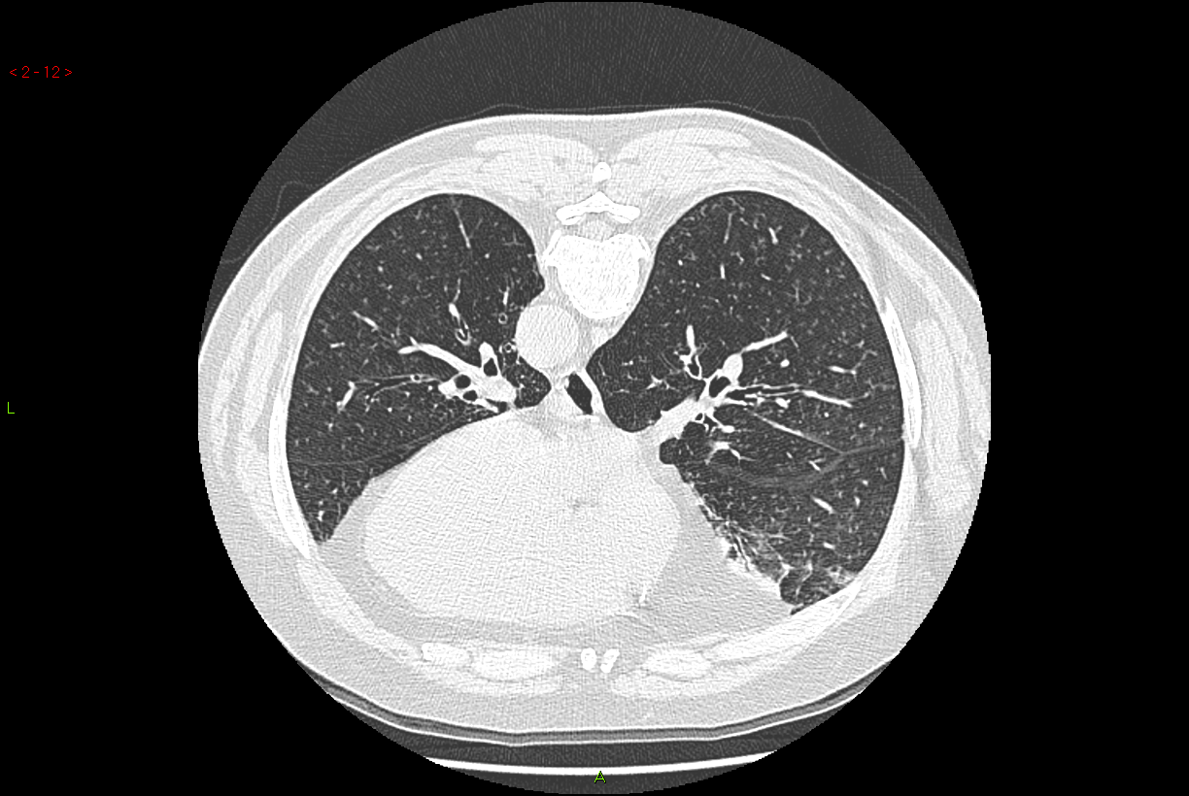

Slide 15
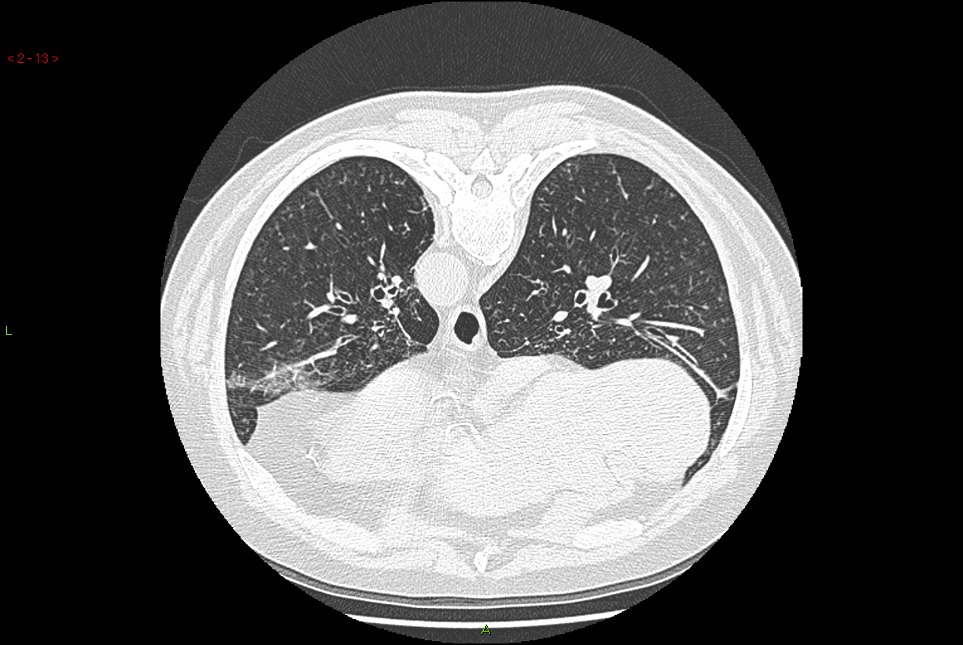
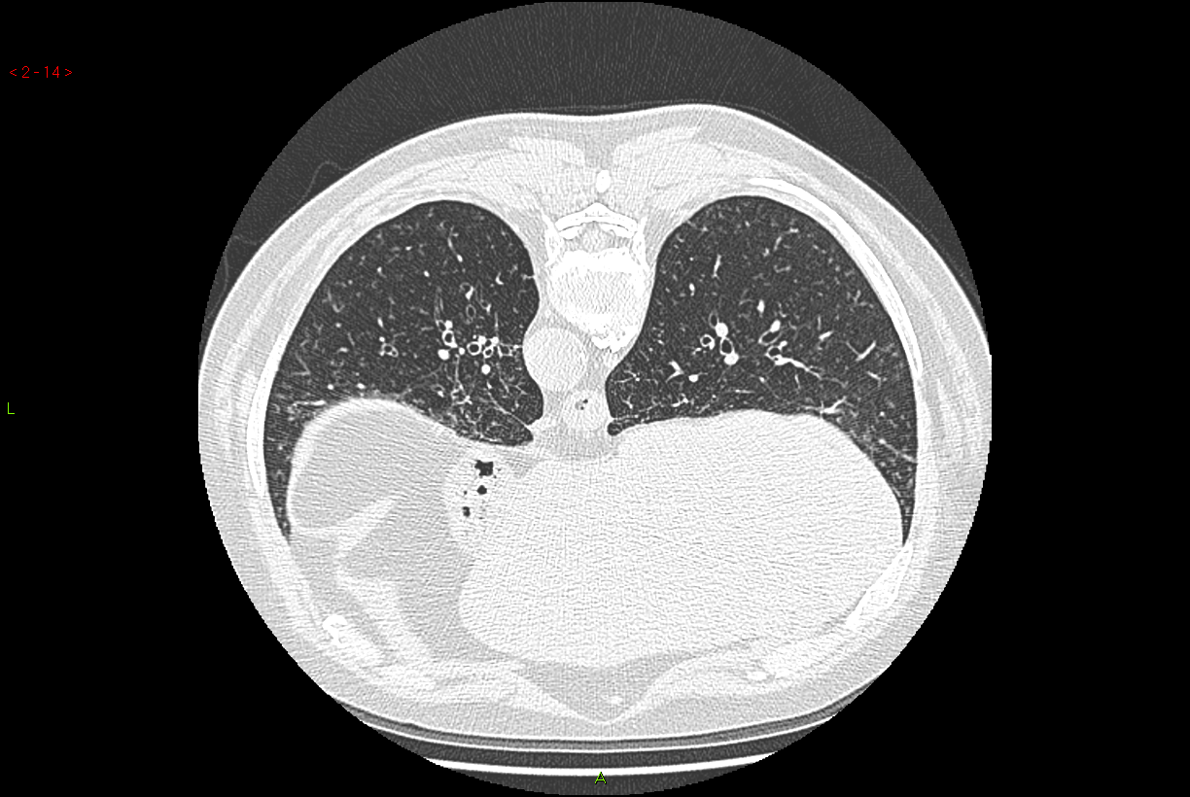

Slide 16
Bronchiectasis
Purulent daily sputum
50% idiopathic
Recurrent infection
Crackles on exam

Slide 17
COPD versus asthma
 | Predicted | Pre Bronchodilator | Post Bronchodilator
Forced Expiratory Volume ₁ | 2.71 | 1.53 (57%) | 1.94 (72%)
Forced Vital Capacity | 3.62 | 2.93 (81%) | 3.29(91%)
Ratio | 76 |  | 59
Gas Transfer | 22.9 | 18.7

Slide 18
Recurrent Exacerbations
Exacerbation frequency
  ACOS
  Bronchiectasis
  Hypogammaglobulinaemia
  Bacterial Colonisation
  Aspergillus sensitisation
  Hypoxia

Slide 19
Red Flags
Weight loss
Haemoptysis
Failure to respond
Signpost to CXR

Slide 20
Exacerbations of COPD
Treatable Traits
Alternative Diagnosis
Signpost positive interventions
  Pulmonary Rehab
  Smoking Cessation

Slide 21
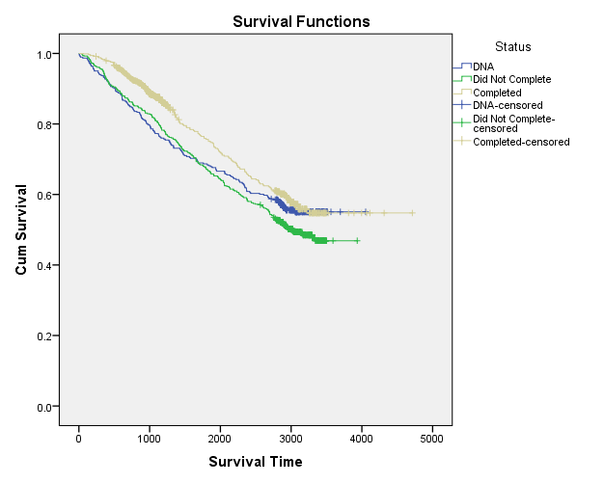
Impact of Pulmonary Rehabilitation on Survival
Variable | P-Value | Hazard Ratio | Confidence Interval | Significant/Not Significant
Disease | <0.001 | 4.419 | (2.034, 8.464) | Significant
Status | <0.001 |  |  | Significant
DNA vs Completed | <0.001 | 1.492 | (1.149, 1.936) | Significant
Did not complete vs Completed | <0.001 | 1.629 | (1.305, 2.034) | Significant
Age | <0.001 | 1.063 | (1.052, 1.075) | Significant
Gender | 0.065 | 1.205 | (0.988, 1.468) | Not Significant
FEV1 | <0.001 | 0.986 | (0.980, 0.992) | Significant
Variable | P-Value | Hazard Ratio | Confidence Interval | Significant/Not Significant
Disease | <0.001 | 4.419 | (2.034, 8.464) | Significant
Status | <0.001 |  |  | Significant
DNA vs Completed | <0.001 | 1.492 | (1.149, 1.936) | Significant
Did not complete vs Completed | <0.001 | 1.629 | (1.305, 2.034) | Significant
Age | <0.001 | 1.063 | (1.052, 1.075) | Significant
Gender | 0.065 | 1.205 | (0.988, 1.468) | Not Significant
FEV1 | <0.001 | 0.986 | (0.980, 0.992) | Significant
Variable | P-Value | Hazard Ratio | Confidence Interval | Significant/Not Significant
Disease | <0.001 | 4.419 | (2.034, 8.464) | Significant
Status | <0.001 |  |  | Significant
DNA vs Completed | <0.001 | 1.492 | (1.149, 1.936) | Significant
Did not complete vs Completed | <0.001 | 1.629 | (1.305, 2.034) | Significant
Age | <0.001 | 1.063 | (1.052, 1.075) | Significant
Gender | 0.065 | 1.205 | (0.988, 1.468) | Not Significant
FEV1 | <0.001 | 0.986 | (0.980, 0.992) | Significant

Slide 22
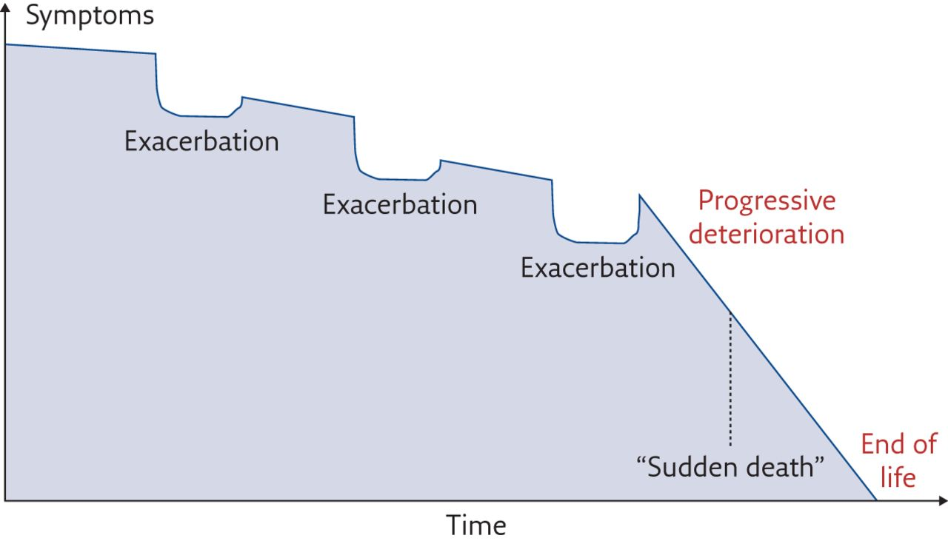
The disease trajectory expected in a patient with COPD
Improving the Journey
Early diagnosis
Smoking Cessation
Manage Exacerbations
Pulmonary
Rehabilitation
Manage Hypoxia
Anxiety and Depression
Palliative
Review
Dietetic Input
Community
Resp Teams
Financial Support
Palliative
Review
Lung Volume Reduction Surgery
Transplantation
Dom NIV
Amanda Landers et al. Breathe 2017;13:310-316
©2017 by European Respiratory Society
Notes:
The disease trajectory expected in a patient with COPD. Adapted from [5].

