Slide 1
Summer Sufferings
Dr Craig Masson
GP, Clarkston, East Renfrewshire

Slide 2
Prescribing and non-prescribing options in:
Hay Fever
Sinusitis
Prickly Heat
Urticaria
Lyme Disease

Slide 3
Hay Fever
Grass and/or pollens
Seasonal rather than perennial, but difficult to avoid unlike dog/cat
Conjunctivitis – redness, itchiness, stringy discharge, oedema
Rhinitis – sneezing, dripping, blockage
Often a combination of systemic and localise control measures needed
Compliance/adherence can be big issues – patients prefer "quick fix"

Slide 4
Non-Pharmacological Options
Avoiding the allergens is trickier than in other cases of rhinitis such as dander allergy
If allergic to tree pollen, that is usually dispersed at dawn and dusk, so sleeping with the window open can increase exposure
Avoid garden after mowing
Avoid eye-rubbing as that breaks pollen into smaller chunks with more antigen surface area (easier said than done!)

Slide 5
OTC/Pharmacy 1st Options
Conjunctivitis:
Sodium cromoglicate eye drops (OTC,all ages)
Rhinitis:
Xylometazoline drops/spray (> 6yo), Beclometasone spray (>18yo) (unless a prescriber)
Systemic:
Chlorphenamine (>1mo), Cetirizine, Loratadine (>2yo for liquids and 6yo for tablets)
Therefore, without prescription, any child can have an appropriate antihistamine + eye drops, and anyone over 6 can also have a nasal spray/drops.

Slide 6
Hay Fever Prescribing
Conjunctivitis – Olopatadine eye drops 1mg/ml eye drops
Age 3+
Slow onset of action and duration limited to 4 months
Rhinitis – stronger steroids
Mometasone, Budesonide, Fluticasone sprays
Betametasone, Fluticasone drops
Dymista – steroid + antihistamine
Systemic – stronger antihistamine
Fexofenadine 120mg daily (>12),30mg BD (6-11yo)
Licensed but not in guidelines – Kenalog 40mg IM / month
Unlicensed – Cetirizine 10mg 2 – 4 times daily (ECG required)

Slide 7
Sinusitis
Most patients using the term mean an uncomfortably stuffed up nose with headache
Viral illness, polyps, allergy
Usually resolves within 14 days with self-help measures and OTC meds
Same as for seasonal rhinitis – xylometazoline, beclometasone
Prescribing for non-infected sinusitis also the same as for seasonal rhinitis e.g. stronger nasal steroids

Slide 8
Infected Sinusitis
Congested nasal symptoms plus:
Duration > 10 days
Acute facial / dental pain (“tingling teeth”)
Tender maxilla
Purulent discharge
Fever
Rx either:
Doxycycline 200mg stat then 100mg daily, 5 days
Amoxicillin 500mg TDS, 5 days
Suggest urgent GP/OOH if appears unwell e.g. drowsy/confused/face visibly swollen

Slide 9
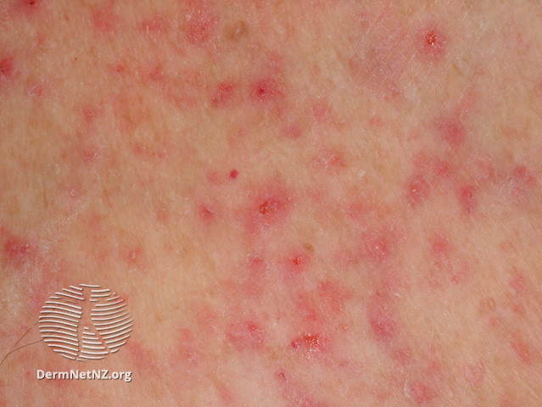
“Prickly Heat”
Miliaria Rubra is the proper name. There are three types of miliaria, but the one referred to as prickly heat and seen in the summer is m.rubra.

Slide 10
“Prickly Heat”
Normally healthy skin is exposed to excessive sweating through unexpected heat/humidity, travel to hot climates, exercise or fever.
Often seen in primary care after a hot spell or on return from holiday
Can be made worse by synthetic clothing against the skin
The sweat glands get clogged up with sweat not clearing away
Differentials to consider:
Recent new meds/chemotherapy = drug induced hyperhidrosis
Recent illness e.g. throat infection = Stevens-Johnson syndrome
Also assess for similarity to/presence of:
Herpes
Superimposed bacterial infection

Slide 11
Non-Pharmacological Treatment
Work in an air-conditioned office for at least a few hours a day
Sleep in a ventilated, cool bedroom
Move away from a tropical climate, avoiding humid weather
Avoid excessive clothing and tight clothing
Avoid excessive soap and irritants
Wear shirts and blouses made of breathable synthetic fabrics or cotton
Remove wet clothing
Cool water compresses and taking a cool bath

Slide 12
Prescribing Options
Calamine lotion to relieve discomfort; because calamine lotion is drying, an emollient may be required.
Treatment of fever with antipyretic such as paracetamol
Mild topical steroids
Antiseptics and anti-staphylococcal antibiotics for secondary infection.

Slide 13
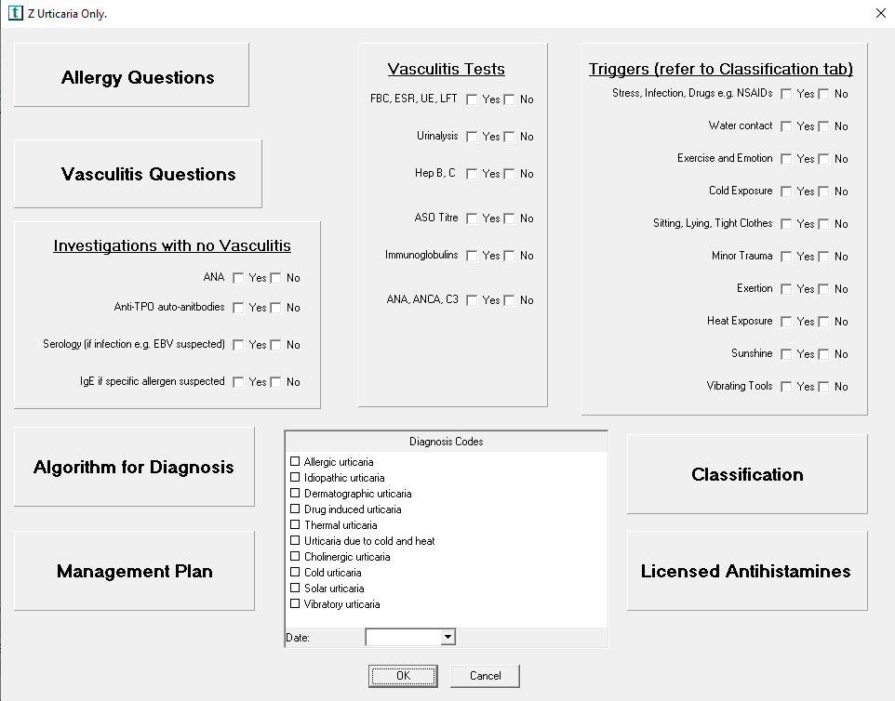
Urticaria
Complex, as can be allergic or non-allergic and even spontaneous/idiopathic
I use an EMIS template at work to help me!
So, let’s keep it simple:
Is it urticaria and angioedema or urticaria alone?
Is it widespread or localised?
Can the patient connect it with an external factor e.g. touching a plant/bee sting?

Slide 14
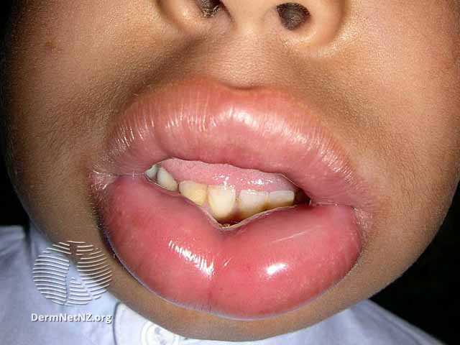
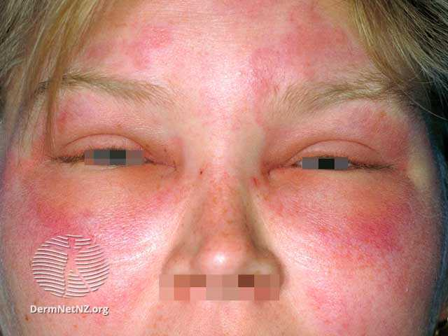
Urticaria & Angioedema
Make sure not struggling to breathe (obviously)
Check if known allergies/carries adrenaline
Advise to discontinue any ACEi or AIIR
Discontinue any antibiotics
Refer to GP for urgent appointment
Give chlorphenamine to get started

Slide 15
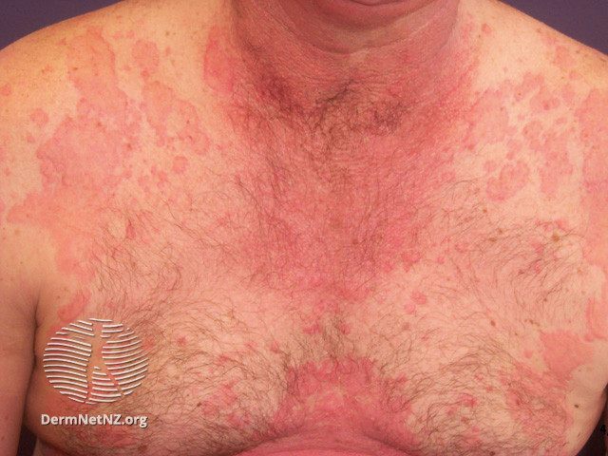
Widespread Urticaria
Suggestive of a more systemic aetiology e.g. illness, ingestion, spontaneous
If chronic - > 6 weeks – routine appointment GP for investigation
If acute - < 6 weeks – you can prescribe antihistamines e.g chlorphenamine, cetirizine. Sedative antihistamine useful if sleep disturbed
Bad cases often require unlicensed dosing e.g. cetirizine 10mg QDS
Sometimes give prednisolone 20mg OD for 3-5 days if severe
Advise to see GP if fails to clear up within a week or worsens

Slide 16
Localised Urticaria
If isolated to one area, enquire about:
Insect bites/stings
Handling plants/working in garden
Jewellery/make up if pattern fits
Heat/Cold contact
Tight clothing
Appropriate for topical steroids e.g. hydrocortisone 1% or standard antihistamines depending on patient preference, or both.
Likely to resolve in days if related to something as acute as a bite/sting, no need for GP appointment if clear history
No need for “tests” – what are we going to say with a positive result, “NOW try to avoid wasps?”!

Slide 17
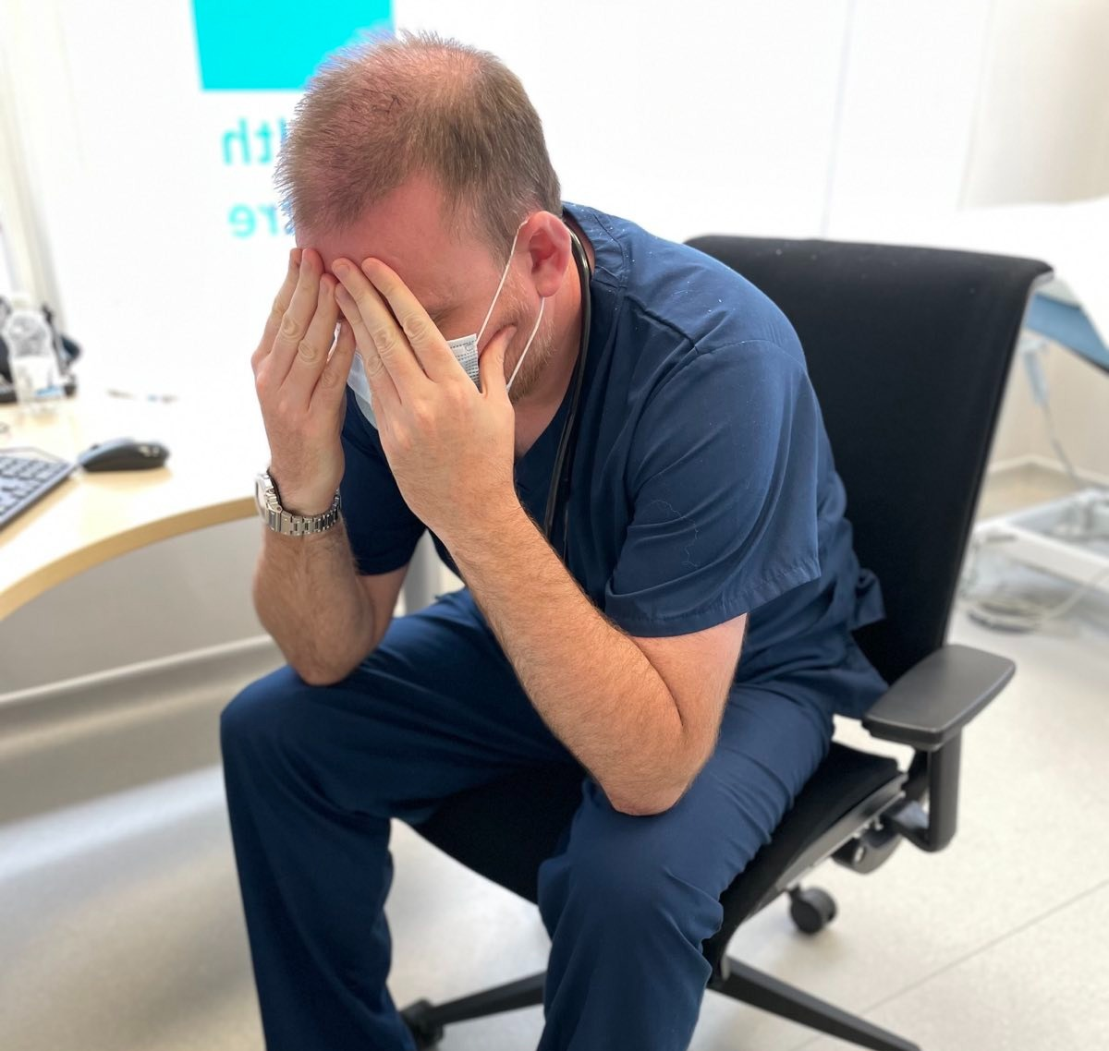
Lyme Disease
Fig 1: Alopecia chronica migrans, the tell-tale sign of being told the patient has self-diagnosed Lyme disease more than you’d care to count…

Slide 18
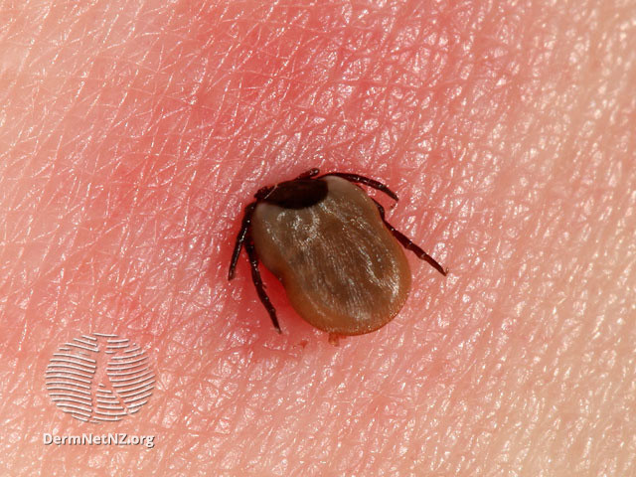
What is it?
A systemic condition with multiple symptoms, mostly flu-like at presentation, with huge crossover with multiple differential diagnoses
The pathognomic feature present in >70% of cases is a rash called erythema chronica migrans
Caused by borellia burgdorferei, a bacterium transmitted by ticks
Treatable, especially when caught early

Slide 19
Why tear your hair out?
“I had a tick bite. Well, maybe. Something bit me. I don’t know. If it was a tick, I have Lyme disease”
“I’ve got this rash and Google says that means I have Lyme disease”
“3 weeks of antibiotics? I don’t know about that…can’t you do tests or something?”

Slide 20
“I had a tick bite. Well, maybe. Something bit me. I don’t know. If it was a tick, I have Lyme disease”
Ticks live in wooded areas. They latch on and suck blood. The longer they are attached, the more likely they are to pass on b. burgdorferei, if they have it;
Contrary to popular belief, only about 10-15% of ticks in the UK carry b. burgdorferei
If something bit/stung them then flew away, it wasn’t a tick
If they show a good picture of a tick in situ, fair enough
If they turn up with one attached, best removed with a tick remover or fine tweezers, to remove all the mouth parts which carry the bugs.

Slide 21
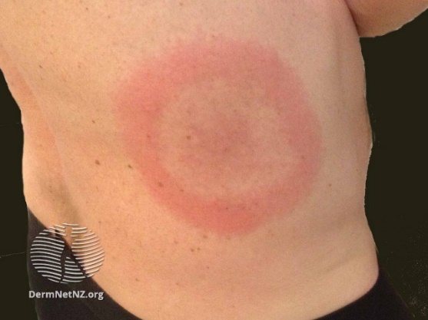
“I’ve got this rash and Google says that means I have Lyme disease”
Erythema chronica migrans typically starts 7-14 days after the tick bite, range 3-33 days
Usually, a bullseye appearance but can just be red
Usually not sore or itchy
Many patients appear in the first 3 days with a painful or itchy rash spreading from a bite/sting mark
This is more likely a common-or-garden localised response to either venom or bacterial infection from a.n.other insect bite/sting
Can be managed as per Pharmacy 1st

Slide 22
“3 weeks of antibiotics? I don’t know about that…can’t you do tests or something?”
Strap in, here’s the tough bit…
Lyme disease can be treated, more effectively if antibiotics are started early i.e. within 2 weeks of catching… BUT…
…blood tests, available in GP, are unlikely to be positive at 2 weeks and are usually more likely to show an antibody response between 6 – 12 weeks…BUT…
…by then it’s pretty much too late to effectively treat, risking long-term or secondary complications to multiple organ systems.

Slide 23
So what should I do?
Take a good history with attention to timeline
If confident that it was a tick, but no rash present, explain only 10-15% carry the disease and explain to patient about presentation of erythema chronica migrans
If rash consistent with ECM present and good tick history, suggest starting 3-week course of antibiotics whilst awaiting results of bloods done at 3-4 weeks, repeated 6 weeks later if initially negative (just finish course if positive on first test)
Patient may conclude that simply taking the antibiotics is sensible; you don’t stop them halfway through if a week-3 test is negative and you’ll be finished by the time your bloods are positive
Rx = Doxycycline 100mg BD or 200mg OD for 21 days, or, Amoxicillin 1g TDS for 21 days.

Slide 24
Questions?

