Slide 1
POWER RESILIENCE

Slide 2
Type of Power Failures
Unplanned
  NETS (National Electricity Transmission System) failure
  Localised Power Failure
Planned
  ROTA Load Disconnection

Slide 3
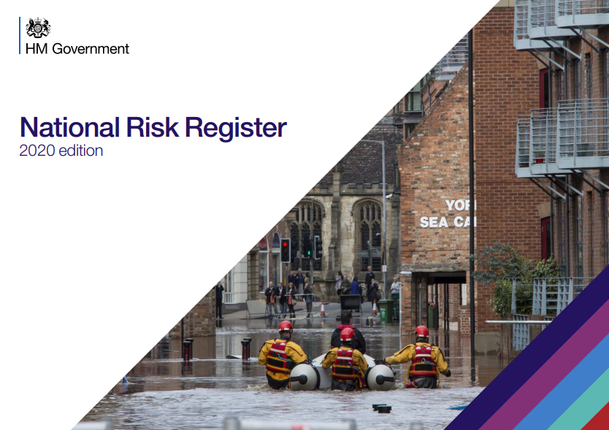
NETS Failure
It has been assessed that it could take up to seven days for the reasonable worst case scenario
The timeframe to a full power cut is likely to be less than two minutes, meaning there will be no preparation time.
The time taken to restore power is highly dependent on what has caused the failure of the National Electricity Transmission System and the extent of the damage to the network

Slide 4



Electricity Restoration
Electricity Restoration is the procedure to recover from a total or partial shutdown of the National Electricity Transmission system which has caused an extensive loss of supplies. Formally known as ‘Black Start’
Potential Causes
Multiple Faults – Severe weather
System Issues – Generation failure
Terrorism – Cyber attack.
Recovery
Up to 7 days with potential for localised intermittent supplies for up to 14 days,

Slide 5
What to expect?
No warning
Lack of Communications
  landlines resilient for 5 days but will be very congested
  mobiles down within minutes / hour
Transport
  trains, planes and ferry disruption, Roads also affected as signs and traffic lights down. Fuel also inaccessible without power.
Finance & Retail
  cash only transactions, no ATMs, no tills and shops struggling.
Health
  hospitals have backups but persons at risk in community, concerns over care homes.
Animal Health
  milking of cows, heating for poultry farms, etc
Water
  key drinking water treatment works have backups but some supplies which need pumps will fail

Slide 6

NETs Failure
This would be a Catastrophic event and a Major Incident for NHSG and the HSCPs including activation of the Local Resilience Partnership
Is a Nationwide /large scale power outage, usually with little to no notice which could last for up to 7-14 days depending on the circumstances.
There will be no power, no water, no comms, no IT, no fuel, no Think Die Hard 4!!

Slide 7
Localised Power Failure
The time taken to restore power is highly dependent on what has caused the failure of the National Electricity Transmission System and the extent of the damage to the network
The timeframe to a power cut is likely to be less than two minutes, meaning there will be no preparation time.
However if power cut is due to severe weather, whilst it may be difficult to prevent loss of power, plans can be made to minimise length of disruption
Most often associated with Storm Damage e.g. Storm Arwen, Storm Frank
Support is more likely to be available from other areas.

Slide 8

Unplanned Power Outage
Managed under Business Continuity
This type of event is usually unexpected but maybe foreseen due to bad weather events etc
Business Continuity Plan and Business Impact Analysis should help services respond to this type of event

Slide 9

What do services need to do?
Have a Business Impact Analysis (BIA) that identifies the most critical services and
Mitigate the effects of a power outage where possible by establishing ways to keep providing these where possible (alternative premises, back up batteries etc)
Have Business Continuity Plan (BCP) in place to deal with disruptive events (including Power Outages)

Slide 10
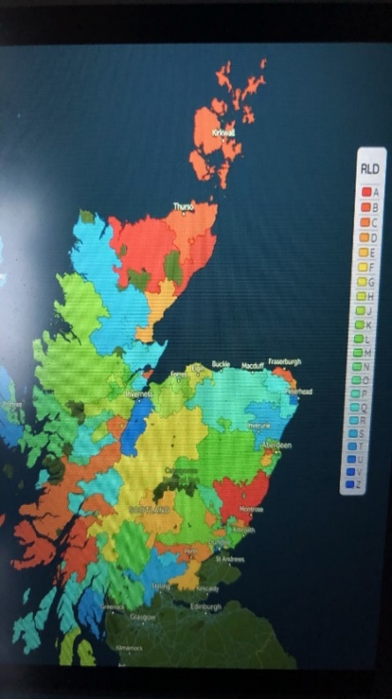
ROTA Load Disconnection
This will likely be managed as a Major Incident as multiple sites and service will be effected at the same time.
This occurs when there is insufficient power available to meet the UK needs.
This a rolling programme of planned power outages of 3 hours across the UK.
The programme has 18 different levels and 18 different zones (letters). As we progress through the levels we increasingly see back to back periods until we get to Level 18 where there is no power.
We will have warning of planned powered outages with an announcement made at 5pm each day confirming which level is being implemented.

Slide 11
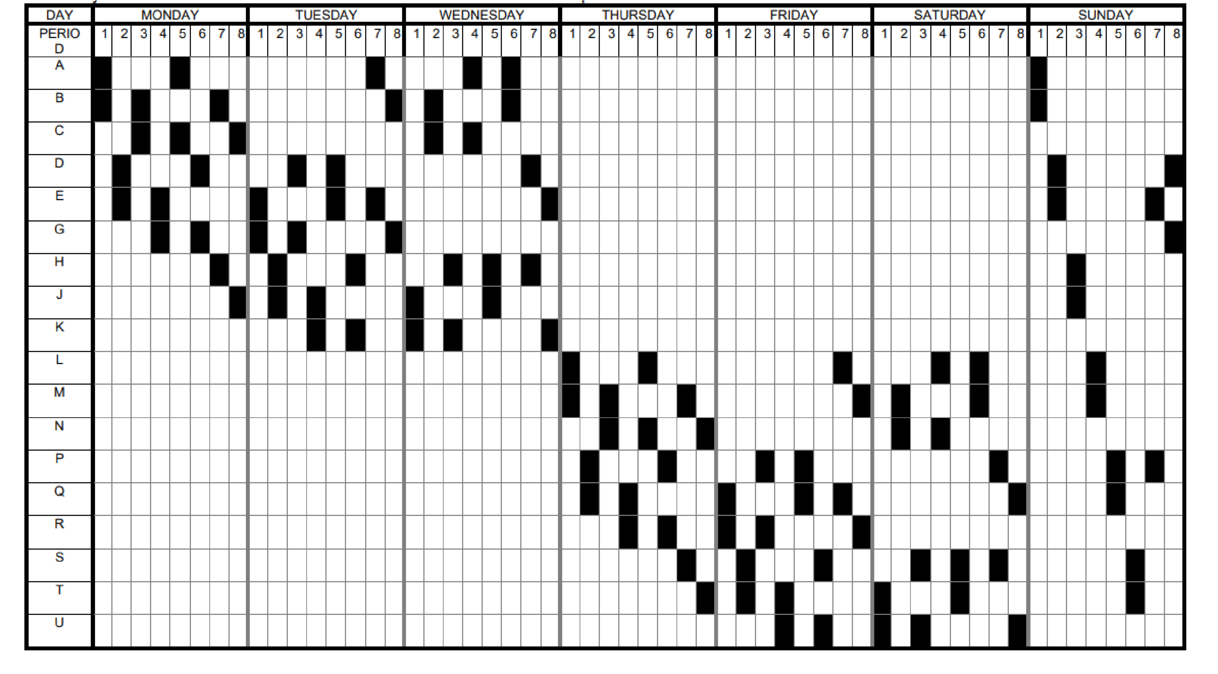
HOW DO THEY WORK?
All users of electricity are divided into groups called ‘blocks’; a customer's block is decided by their postcode and position on the local network. These blocks are then switched off in turn, on a ‘rota’, for a period of three hours. If the level of electricity shortfall increases, more blocks are switched off, resulting in interruption to a larger number of customers. Once introduced Rota Load Disconnections will continue for the full duration of the shortfall in electricity generation.

Slide 12
What do you need to do?
Find out which Rota Block you sit on
Decide what services would be affected and if you would be able to keep them going without power or if you need to cancel rearrange them for when the power is back on (refer to your BIAs and BCPs)
Can you adjust working hours to work around the disconnection
Is there an alternative service that can be accessed/pts redirected
Do you have any power critical equipment/stock that could be affected (refrigerated medication etc)

Slide 13
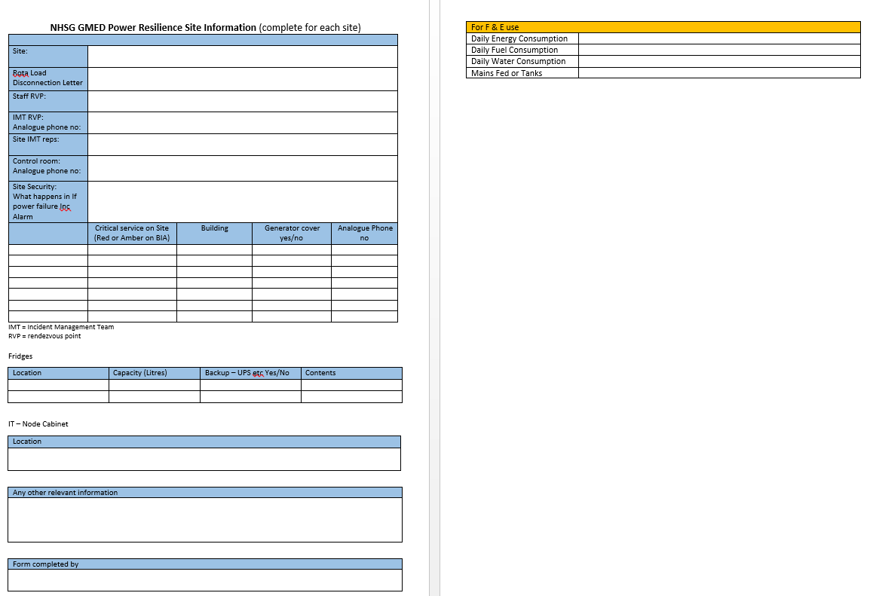
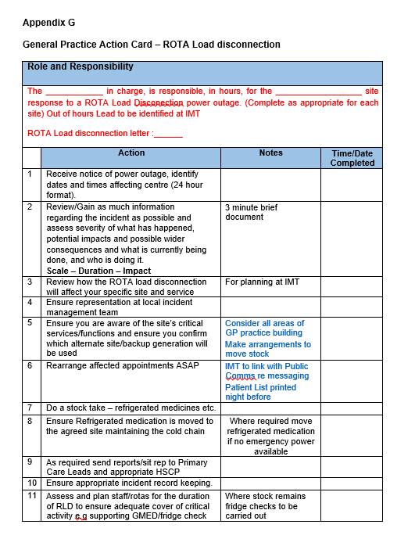
What next?
Complete Power Resilience Planning Template and send back to helen.clark2@nhs.scot
Complete & Print Action Cards for both
  Planned
  Unplanned
Discuss Power Resilience with staff to ensure familiarity with plan
  Consider home needs as well

Slide 14
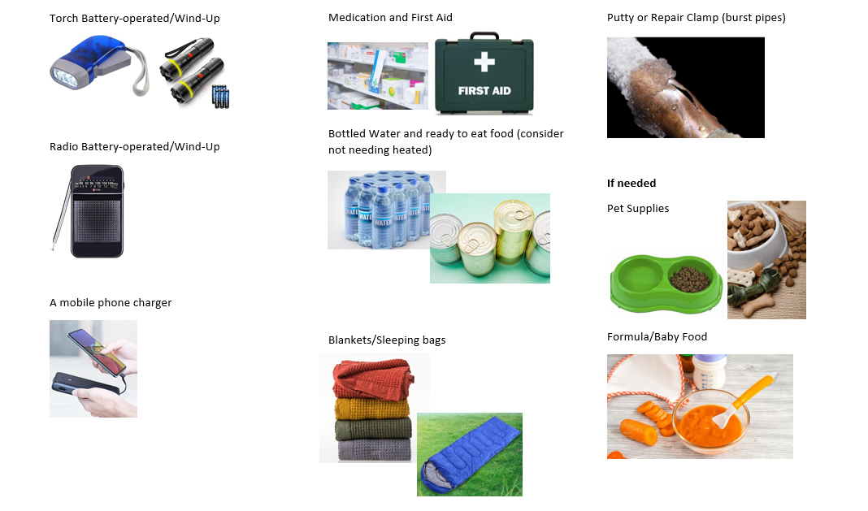
Suggestions for Home Emergency Kit

Slide 15
Any Questions?
helen.clark2@nhs.scot

