Slide 1
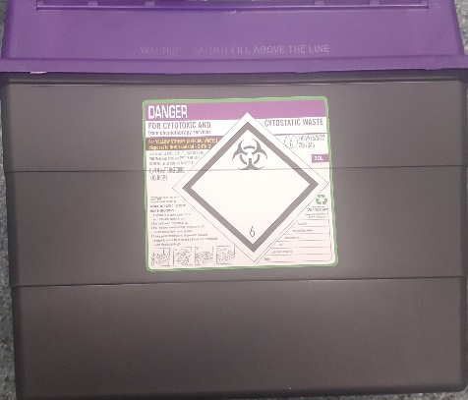
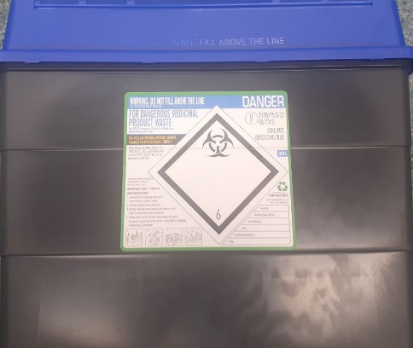
Pharmacy Clinical Waste Sharps Segregation
30L purple lidded bins should be used for patient returned sharps bins containing cytotoxic medication.
Sharps, used syringes, and similar invasive devices used to administer cytotoxic medicines.
Patient returns 0.6l* , 2L
or 4L sharps bin to your pharmacy. If this contains cytotoxic waste place the bin into a 30L purple lidded container. If it contains non cytotoxic waste, place into a 30L blue lidded sharps container
30L blue lidded bins should be used for patient returned sharps boxes.
MUST BE SECURELY SEALED & STORED SAFELY
MUST BE SECURELY SEALED & STORED SAFELY
*0.6l boxes are being removed as an option.
30L Sharps bins (both blue and purple lidded) must have the following details completed:
Contractor Code and “sharps waste”. Date and Signature when Bin Assembled, Date and Signature Bin Sealed
Patient sharps bins (0.6L, 2l and 4l) must have the following information completed:
Date and signature when bin assembled, date and signature bin sealed, CHI number if known (contractor code can be used if CHI is unknown)
ALL INFORMATION MUST BE COMPLETED IN INDELIBLE MARKER. BINS MISSING ANY DETAIL WILL NOT BE COLLECTED

Slide 2
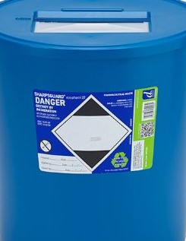
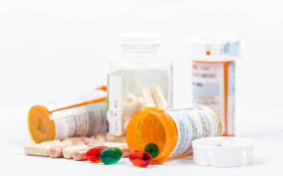
Pharmacy Patient Medicine Returns Segregation
30L purple lidded bins should be used for patient returned Cytotoxic Medication.
This waste stream must be used for returned MDI inhalers but please write “Aerosols” on the container.
Patient returns unwanted or out of date waste, if possible ask patient to remove all cardboard outers so only Medication Waste is being incinerated.
22L blue lidded bins should be used for patient returned medicines.
MUST BE SECURELY SEALED & STORED SAFELY
MUST BE SECURELY SEALED & STORED SAFELY
22L Blue Medicines Waste Bins must have the following details completed on the side of the bin:
Contractor Code and “waste medication” ”. Date and Signature Bin Sealed.
30L Purple bins must have the following details completed:
Contractor Code, and “waste medication” and/or “Aerosols”. Date and Signature when Bin Assembled, Date and Signature Bin Sealed.
All MDI Inhaler Recycling must be sent via purple lidded stream to ensure HTI makes the waste gases inert.
ALL INFORMATION MUST BE COMPLETED IN INDELIBLE MARKER. BINS MISSING ANY DETAIL WILL NOT BE COLLECTED

