Slide 1
Pharmacy Care Records (PCR)
For Smoking Cessation Services
PCR slides are courtesy of NHS GGC

Slide 2
All client quit attempts for pharmacy ‘walk-ins’ should be entered into PCR
Enter data onto PCR as soon as possible to avoid missing payments (up to £80 per client)
NEVER enter quit attempts for clients who have had NRT requested from the specialist services
Notes:
Specialist services requests – claim product vie UCF

Slide 3
To request a new login for pharmacists and pharmacy technicians complete the PCR user account request form and send to pharm.cppcr@nhs.scot. The form can be located on the NHS Community Pharmacy Website (scot.nhs.uk) under ‘NHS Lothian’ under the ‘Useful resources and links’ section
FTY/foundation/pre-registration pharmacists should have completed forms from NES to enable login access. If mislaid, email the ePharmacy Helpdesk at: nss.psdhelp@nhs.scot
For issues with existing PCR logins contact ePharmacy Helpdesk on 0131 275 6600 (Mon to Fri, 9am-4pm) or email them at: nss.psdhelp@nhs.scot
For Quit Your Way Pharmacy Service General Enquiries, contact us on
0131 537 7154 or email: Loth.qywPAT@nhslothian.scot.nhs.uk

Slide 4
Logging into the PCR
Your Pharmacist or Pharmacy Technician (including locums and reliefs) should be 'associating' with PCR every morning to ensure it's ready for use during the day. Associating also helps display important system messages from IT.
As of June 2022, pharmacies will need to associate with PCR not via the old webpage login, but via the new downloadable app.
If your pharmacy has already downloaded the app, it should be visible on your dispensary computers as an icon labelled ‘PCR UA’ or ‘PCRUA Win Client’ and shows a square with a key and an arrow.
If you need to download the app, please go to:
https://www.nss.nhs.scot/pharmacy-services/pharmacy-care-record-pcr/guidance-on-the-pharmacy-care-record-pcr/

Slide 5
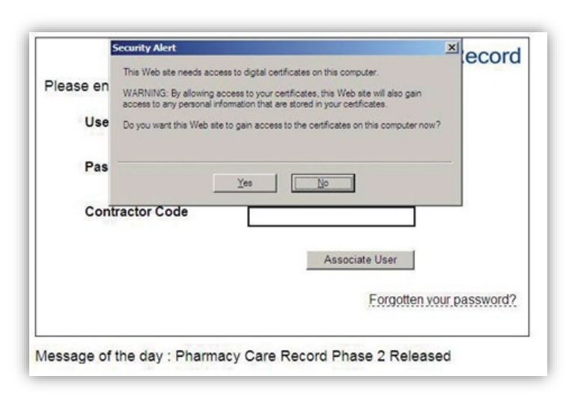
Step 1 – Accept Security Alert 1
Select “Yes” to allow the website to gain access to the digital certificate
Notes:
A user can only access patient records relating to the pharmacy where they are currently working. A user must “associate” with the pharmacy where they are working when they begin work in their usual or a different pharmacy – usually each morning. In most pharmacies, the association process can only be performed on the main ‘server’ computer in the pharmacy, however, some large multiple pharmacies may allow the association process from any computer in the pharmacy. The main server computer is usually the one where the ePharmacy Certificate Management Application is installed and the ePharmacy Client Certificate resides. The association process makes use of the ePharmacy Certificate is one of the checks to ensure that the user is in the pharmacy that they are currently requesting to be associated with.

Slide 6
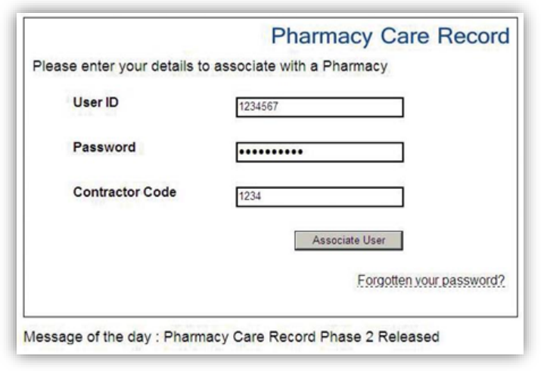
Step 2 – Associate User
Notes:
Enter your PCR User ID, Password and contractor code and select the “Associate User” button

Slide 7
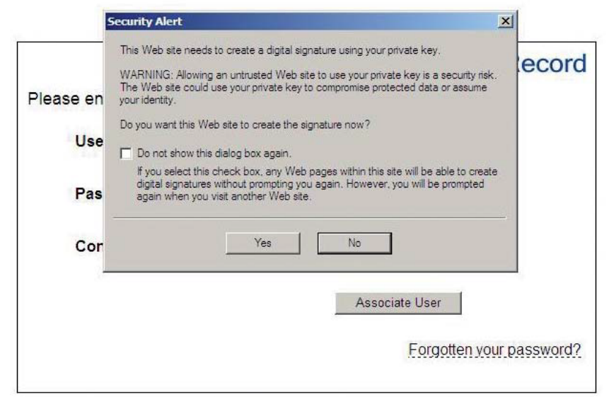
Step 3 – Accept second security alert
Select “Yes” to allow the ePharmacy Certificate to digitally sign a message and send this to the PCR server as part of the security check for the association process.
Notes:
In the “Security Alert” dialogue box, click “Yes” to accept the final security certificate

Slide 8
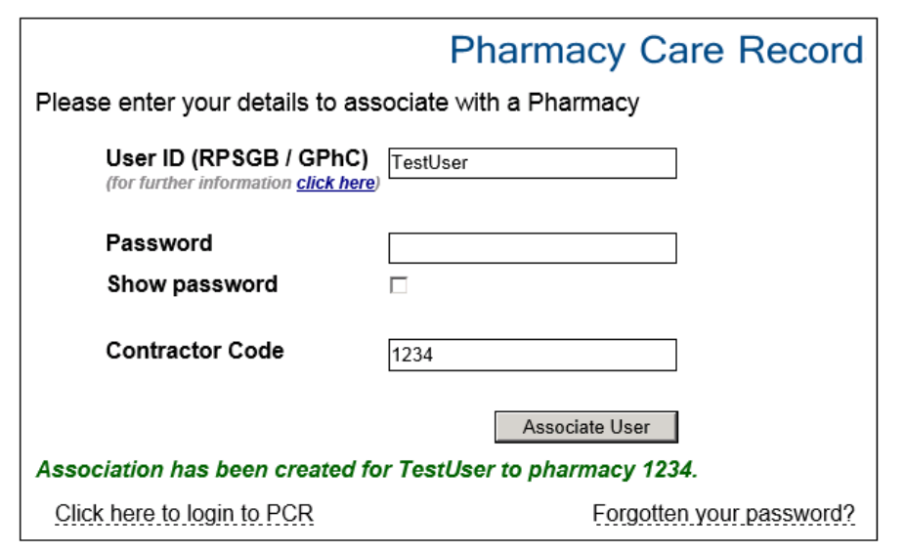
Step 4 - PCR Association Complete
Notes:
If the association is successful, the following a message will be displayed in green text. At this stage, only association with a pharmacy is complete. A further step is required to login to the main PCR application to access patient records. A “Click here to log in to PCR” link is shown after successful association. Use this link to navigate to the PCR login page.

Slide 9
Step 1 - Enter your details & select ‘Login’
Notes:
For forgotten passwords, you can set up memorable questions and answers to reinstate a new password 24/7 without the need to contact the E-Pharmacy Helpdesk
FTY applications - All students are sent a PCR login application form from NES. This should be completed, signed by their tutor then sent to nss.psdhelp@nhs.scot for the team to create an account for them and email to say
the account has been created and
to call 0131 275 6600 when they are in the Pharmacy as the temporary password is only valid for 4 hours.
If the form has been mislaid, email the Helpdesk to be resent a copy.
Once becoming pharmacists, former FTYs should call the Helpdesk for them to suspend their FTY account and create a new one with their qualified GPHC number.
PCR access - If they are locums or anyone who has forgotten their password and needs it reset and only works weekends, we advise them to call us on the Friday and we can extend the password until the Saturday or Sunday depending on what day they are working.

Slide 10
Step 2 - Enter client details then select ‘Search’

Slide 11
Step 3 If client is found, select ‘View’ and go to Step 7. Otherwise continue to Step 4 Step 4 - If client is NOT found then select ‘click here’ link to create new PCR record

Slide 12
Step 5 - Complete fields below and select ‘Save’. Ensure the client’s address and a telephone number is recorded, ideally a mobile number. DO NOT USE PHARMACY PHONE NUMBER as this stops the upload process, causing the pharmacy to miss out on national payments they should be due.

Slide 13
Problems starting a client?
When a client begins a quit attempt in a pharmacy, the PCR will not permit another quit attempt to be started at any other pharmacy until at least 12 weeks after the start of this quit attempt, unless restarted at the original pharmacy.
If you see the message
‘Active Referral within 12 weeks at another pharmacy’,
your client has presented to you within 12 weeks of starting a quit elsewhere. You can advise your client to either:
Return to the pharmacy they began their previous quit with, or
Return when the 12 weeks has passed to be considered for a new quit attempt with yourselves. Call the Quit Your Way Support Team on 0131 573 7154, if you would like us to confirm when the 12 week date will be.

Slide 14
Step 6 - Select ‘View’

Slide 15
Step 7 - Select ‘Edit’

Slide 16
Step 8 – Check client’s demographics are correct before continuing ENSURE client’s telephone number is correctly recorded (not the pharmacy telephone number, to avoid upload failure) and select ‘Save’

Slide 17
Step 9 – Select end tab ‘Support Tools’ then click on ‘Start Support Tool Assessment’

Slide 18
Step 10 - Select ‘Smoking Cessation’ from the ‘Support tool’ drop down list then click ‘Start’

Slide 19
Step 11 – Complete Initial Data Capture entries

Slide 20
Continued - Initial Data Capture Entries

Slide 21
Continued - Initial Data Capture Entries Select ‘No’ at shared care between pharmacy and non-pharmacy services

Slide 22
Continued - Initial Data Capture Sheet Once all fields are completed, select ‘Save’

Slide 23
Step 12 – Select ‘Home’
Do not enter the Quit Date until client returns at week 1 for NRT. Ensure Quit Date entered is within 13 days of initial recorded contact, to avoid failed data upload (despite no warning notification).

Slide 24
Step 13 – When client returns at week 1, log into PCR, and select ‘Reports’

Slide 25
Step 14 – Go to ‘Smoking Cessation Reports’ (by scrolling to the bottom of the screen)

Slide 26
Step 15 - Select ‘Open Smoking Cessation Assessments’ then find client’s name and select ‘View’

Slide 27
Step 16 – Clicking on ‘View’ opens the initial data capture sheet. Scroll down to ‘Quit Date’

Slide 28
Step 17 – Click on ‘Next action’, then on ‘Start quit attempt and confirm quit date’

Slide 29
Step 18 – Scroll down to ‘Confirm quit date and record contact’, record contact and select ‘Confirm quit date’ T
This generates your 1st national payment of £30 and sets your 4 and 12 week MDS (Minimum Data Set) dates

Slide 30
Step 19 – Select 'Initial Data capture' link

Slide 31
Step 20 – Scroll down to the bottom of screen, update 'Pharmaceutical usage' and 'Total number of weeks of known product use', then select 'Save'
This should be updated each week after products are dispensed

Slide 32
Step 21 – Once you click 'Save', this will open Initial Data Capture Sheet. Scroll down to 'Minimum dataset'(MDS).
'Start' should show 'Validated' and 'Submitted'. This confirms you have entered and submitted the quit date and the pharmacy will receive the 1st national payment of £30.

Slide 33
Step 13 – When client returns at week 1, log into PCR & click into 'Reports' Step 14 - Go to 'Smoking Cessation Reports' Step 15 - Select 'Open Smoking Cessation Assessments’ and select client by clicking on View'. Then scroll down to ‘minimum data set' (MDS). Under 'Contact', click on 'Record'
Step 22 – When the client returns each week, repeat steps 13 to 15:

Slide 34
Step 23 – Enter weekly information and select 'Record contact'
Remember to update 'Pharmaceutical usage’ and 'Total number of weeks of known product use' each week after product is dispensed and to click 'Save'.

Slide 35
To find a client on the service fast: Select 'Reports‘, then 'Smoking Cessation Reports’, then click on ‘Open smoking cessation assessments’ to list all your clients with open quit attempts

Slide 36
If there is more than 1 client showing on your report, select 'View’ for each client to access their details

Slide 37
To update and submit a client’s 4 or 12 week MDS data, scroll down to 'Next action: Release 4 week or 12 week MDS’ and click on this link

Slide 38
To submit client 4 week or 12 week MDS data, select 'Submit 4 week / 12 week data‘
This generates national payments to your pharmacy of £15 at 4 Week and £35 at 12 Week MDS per client. Always:
enter a client’s CO reading unless housebound/unable to perform reading, where there is an option to enter why a reading could not be recorded
ensure telephone support is offered for housebound clients

Slide 39
How to check submissions have been submitted
Go to ‘Initial Data Capture’ and scroll down to ‘Minimum dataset’
(Smoking) ‘Status’ should now show 'Validated‘ (if client recorded as a non-smoker) or ‘Failed’ (if client as a smoker)
‘Release Status’ will show 'Submitted' for successful submissions, ‘Not submitted’ if still awaiting submitted or ‘Expired’ if the submission window has been missed

Slide 40
When to action ‘Assessment Completion’
Only complete the ‘Assessment Completion’ section once all 4 week and/or 12 week data has been successfully recorded and submitted. Once completed, no further changes can be made to the client’s record.
What should you check before finishing ‘Assessment Completion’?
That all relevant 4 and 12 Week MDS (Minimum data set) fields are completed and submitted to avoid missing out on the national payments of £15 at week 4 and £35 at week 12.
If a client is a non-smoker at 4 weeks, submit MDS submission as a 'Non-smoker'. Even if they subsequently withdraw prior to 12 weeks, keep the quit attempt open, as they are then eligible for the 12 week MDS follow up. If they withdraw prior to 12 weeks:
Attempt to contact the client (minimum of 3 attempts) to check their smoking status and record accordingly in PCR
If you are unable to reach the client, then update and submit 12 week MDS as 'Lost to follow up' and submit 'Assessment Completion'.
Ensure ‘Pharmaceutical Usage’ entry under 'Initial Data capture' entries is accurately entered
If you have tried and failed to contact the client, ensure the MDS drop down option is entered as 'Lost to Follow up’. This allows the health board to contact these clients directly.

Slide 41
When to action ‘Assessment Completion’ (continued)
Clients should not continue on the service and their 'Assessment Completion' should be carried out if:
the client’s 4 week MDS submission window is missed (i.e. ‘expired’ in ‘Minumum dataset’ window) and they are a smoker or lost to follow up. However, if expired but client still attending and is a non-smoker, further weekly contacts can be entered on PCR (although the 12 week submission follow up window will never open).
the client is recorded as 'smoking' at 4 week MDS, as they are no longer eligible to continue the service
the client has resumed smoking, but is deemed suitable for a subsequent new quit attempt, to allow for a new quit attempt entry on the PCR
the client has not returned and has not been successfully reached after (a minimum of 3) attempted contacts. To avoid missing pharmacy national payments due always release the 4/12 week MDS first, update as ‘Lost to follow up’ & hit ‘Submit’ BEFORE updating the Assessment Completion. (Once Assessment Completion is submitted no retrospective changes can be made).

Slide 42
Top Tips on avoiding common pitfalls!
Check the PCR ‘Smoking Cessation Reports’ section weekly (as close to a Wednesday evening as possible, when all data uploads to ISD) under:
‘Expiring within next 7 days’ to avoid any client data submissions being missed (and thus no further payments made).
‘No interaction in last seven days’ to ensure these clients are contacted and data recorded before data entry deadlines expire to avoid missing payments. 3 attempts should be made to contact them (but no voicemail messages left, to avoid breaches in confidentiality). Complete each client’s PCR records according to outcome. Always remember to leave client record open until 4 and/or 12 week submission points before updating ‘Assessment Completion’ to avoid missing payments.
‘Awaiting 4 or 12 week follow up’ to ensure 4 and 12 week data are submitted within the required 2 week windows, or payment will not be made, i.e. enter 4 week data by week 6 and 12 week data by week 14 of quit date.
‘Open smoking cessation assessments’, to action any outstanding updates.

Slide 43
Common PCR Errors
Pharmacy telephone number used for either client’s home, work or mobile number
Quit date has been set more than 14 days later
A record already exists on the smoking cessation national database
‘PAT’ will email any PCR errors to the pharmacy with an explanation on how to resolve the error.
On these occasions you will be asked to action the assessment completion to close the error record
Notes:
A record already exist if the client has an open PCR record or already being supported by the specialist team

Slide 44
Top Tips (continued)
When entering new client data on PCR, do not enter quit date until
Week 1 for NRT clients (unless advised to start pharmacotherapy immediately)
Do NOT click ‘Assessment complete’ before all claims have been made and client’s quit attempt has ended
If looking to restart a client’s quit attempt, ensure a Wednesday night has passed between
an old quit attempt’s ‘Assessment Completion’ is recorded
and a new quit attempt is entered

Slide 45
Stop Smoking Medications
Remember to prescribe NRT from the East Region Formulary:
https://formulary.nhs.scot/east/central-nervous-system/substance-dependence/nicotine-dependence/

Slide 46
Thank you!
Any questions?
Call NHS Lothian’s Pharmacy Assist Team on
0131 537 7154 (Mon-Fri 9-5pm)

