Slide 1
Just In Case Bag Scheme
Update 2019

Slide 2
Background of JIC scheme?
What is JIC?
  A service to supply a range of palliative care medications to be kept in the patient’s home, as indicated by the prescriber for use by community nursing teams in the event of a sudden deterioration in the patient’s condition.
Aims of the JIC Scheme:
  Improve access to palliative care medicines OOH and support the provision of care at patients’ homes.
  Avoid the distress caused to patients and their families due to delayed access to medicines used for common symptoms in palliative care, especially in the terminal phase.
  Ensures health care professionals can respond rapidly to worsening symptoms and avoid unnecessary suffering
Objective:
  Support anticipatory prescribing and rapid access to medication by providing a Just In Case bag in the home containing the medicines that are most useful if there is a sudden deterioration in the patient’s condition.

Slide 3
Why is the update needed?
  Since 2011 when the JIC was first introduced, it has been recognised there have been a number of problems relating to the use of the original JIC box scheme. Problems include:
  Lack of Gold Standard MDT meetings to discuss palliative patient’s anticipated medication needs
  Lack of review of patients with a JIC box in place
  JIC box prescribed at end of life rather than well in advance of medication being needed (ideally around 2 to 3 months in advance)
  Prescriber’s concerns about when and what to prescribe on the drug chart
  Prescriptions, especially for CDs, being written incorrectly
  Use in care homes where storage and CD requirements are an issue and where anticipatory prescribing may be more appropriate.
  The amount of space required for storage of the JIC box in a CD cupboard in care homes (one box prescribed per individual patient)
  The use of a “box” to store JIC medicines not always appropriate eg. obtrusive for patients
  The JIC box not being returned for re-use
  The box requires cleaning for re-use
  No indication of expiry dates on outside of box
  If no DN involvement then no monitoring of content or expiry dates of medicines
  The medicines in the JIC box should be in line with the Scottish Palliative Care Guidelines

Slide 4
Changes
JIC BAG – no longer a box
Expiry date on outside of JIC bag
Contents include NHS A&A Medication Administration Record, Symptom Control guidelines (from Scottish Palliative Care Guidelines), Community Pharmacy Network leaflet and a patient leaflet (attached to outside of bag)
Community pharmacy service agreement to dispense the JIC medicines into the bag with associated paperwork, to note and add the expiry date of the earliest medicine to expire on the outside of the bag

Slide 5
The Just In Case Bag
Improved infection control
Recognisable
Low cost
Easy Storage
Not tamper proof

Slide 6
JIC Scheme 2018
A GP, District Nurse, or Palliative Care CNS in liaison with the GP will identify adult patients requiring palliative care support in their home.
If it is anticipated that the patient’s medical condition may deteriorate into the terminal phase of illness within a two to three month period , with the patient and carer’s agreement, the prescriber can initiate and prescribe a Just in Case bag.
The Palliative Care Just in Case bags (JIC) will be available across Ayrshire and Arran from participating community pharmacies (local service).
The prescriber can select medication to prescribe from an approved list of drugs based on the Scottish Palliative Care Guidelines and will be able to prescribe one of each type of medicine in line with the anticipated needs of the patient. Where appropriate they may substitute an alternative s/cut preparation if the patient currently takes a different opioid or anti-emetic orally.
The practice will arrange for the chosen community pharmacy to receive the prescription and a completed NHS A&A medication record.
The community pharmacy will supply the bag, information leaflets and medicines.
The bag will be kept at the patient’s home for rapid administration of medicines commonly prescribed for symptom control in event of sudden deterioration.
All medicines will need to be authorised (prescribed doses, indication, directions, signed and dated) on an Ayrshire and Arran Medication Record chart, in order to enable a community nurse to administer the prescribed medication.

Slide 7
Prescriber Role and Responsibilities

Slide 8
Suitable patients
Patients are identified as appropriate for a Just in Case bag by a health professional.
Patient and carers agree to a Just in Case bag.
For patients who may lack capacity to consent to the treatment contained within the Just in Case bag, health professionals should ensure that an assessment of capacity has been undertaken
Patients will have a terminal diagnosis and a prognosis of months or less (usually the Just in Case bag is introduced in the last two to three months of life).
The supply of a JIC bag in the last few days of life would not be appropriate as pharmacies require up to 72 hours to dispense a JIC bag and the quantity and choice of drugs may not be sufficient to manage the patient’s symptoms.
Patients should be on the practice’s palliative care register
If there are concerns about placement of a Just in Case bag with a vulnerable patient the prescriber is encouraged to inform the NHS CD officer, and involve local police in discussions, regarding placement of the bag.

Slide 9
JIC Bag Contents
Symptom | Standard JIC | ALTERNATIVE FOR EXAMPLE
Pain | Morphine 10mg/ml inj 10 (ten) amps | Oxycodone 10mg/ml inj 10 (ten) amps
Nausea / Vomiting | Levomepromazine 25mg/ml inj x10 amps | Haloperidol 5mg/ml X10 amps
Respiratory | Hyoscine Butylbromide 20mg/ml inj x10 amps | Glycopyrronium 200mcg/ml x10 amps
Anxiety | Midazolam 10mg/2ml inj x10 (ten) amps
Other | Water For Injection 10ml (x10)
The prescriber will provide the completed GP10/NP10 prescription for the entire contents of the bag.
Prescriber can select ONE medication for each indication from the approved list above, in conjunction with local guidelines and approved practices.
Where necessary substitutions can be made for alternative medications, see palliative care guidelines for more information, www.palliativecareguidelines.scot.nhs.uk
The prescriber should consider supplying sufficient medication to cover future needs, including weekends and bank holidays when access to medication may be restricted

Slide 10
Symptom Control Guidance
Anticipatory prescription | The prescription should include the four medications that might be required for end-of-life symptom control, plus diluent. Morphine is the 1st line opioid of choice, however some health boards may use diamorphine first line. The dose stated below is for an opioid naive patient. If the patient is taking a regular oral opioid, a subcutaneous breakthrough dose of the same opioid should be prescribed for JIC box. SC dose would usually be half of oral dose. Breakthrough dose should be calculated as 1/6th to 1/10th of the 24 hour opioid dose.
Opioid for pain and/or breathlessness (FOR OPIOID NAIVE PATIENT) | Morphine sulfate injection (10mg/ml ampoules) Dose: 2mg SC, repeated at hourly intervals as needed for pain or breathlessness If three (3) or more doses have been given with little or no benefit seek advice or review Supply ten (10) 1ml ampoules
Anxiolytic sedative for anxiety/distress or breathlessness | Midazolam injection (10mg in 2ml ampoules) Dose: 2mg SC, repeated at hourly intervals as needed for anxiety/distress or breathlessness If three (3) or more doses have been given with little or no benefit seek advice or review Supply ten (10) 2ml ampoules.
Anti-secretory for respiratory secretions | Hyoscine butylbromide injection (Buscopan®) (20mg/ml ampoules) Dose: 20mg SC, repeated at hourly intervals as needed for respiratory secretions. Maximum of 120mg in 24 hours. Supply 10 ampoules.
Anti-emetic for nausea and vomiting | Levomepromazine injection (25mg/ml ampoules) Dose: 2.5 to 5mg SC, 12 hourly as needed for nausea. Supply 10 ampoules N.B: higher doses of levomepromazine i.e. 10-25mg SC 12 hourly, are generally only used as anti-psychotics to treat agitation/delirium. Use lower doses if not used previously and in frail elderly. Two separate prescription instructions may be required if being prescribed for both indications.

Slide 11
Prescription Issue
Prescriptions Requirements:
  A normal prescription is generated for all the medicines contained in the Just in Case bag and signed by the GP or Non-medical prescriber (NMP)caring for the patient.
  The correct quantities must be specified and prescriptions for any scheduled 2 opioid and midazolam are subject to controlled drugs (Misuse of Drug Act and Regulations) prescription requirements.
  Doses for opioids should be the s/cut equivalent of the patient’s current oral breakthrough dose or 2mg of morphine if opioid naïve
  The Home Office has expressed the view that a dose of “as directed” or “as required” is not acceptable for a controlled drug prescription.
The prescriber is responsible for issuing the prescription and facilitating its transfer to the chosen participating community pharmacy.
Supply of a JIC is available via dispensing GP practices
Seventy two hours should be allowed between request and collection to allow for assembly of the bag. The purpose of the JIC Bag is to provide anticipatory medication in advance of need. If medication is required immediately it should be prescribed and supplied in the usual way.

Slide 12
Medication Administration Record
Prescriber encouraged to provide partially completed chart alongside initial GP10 to Community Pharmacy.
Community Pharmacy will supply blank chart with JIC where necessary.

Slide 13
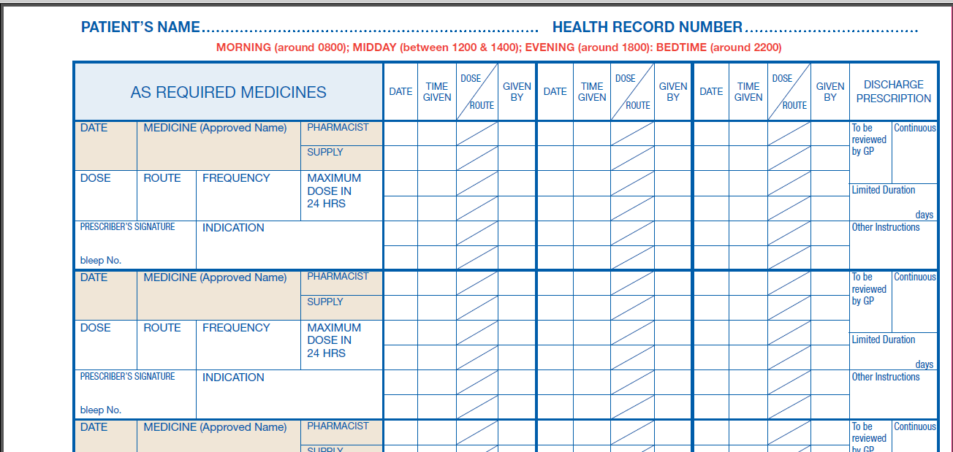
Administration instructions
Doris Jones
05/03/18 Morphine
2mg SC 1 hourly 6
Dr Foster Pain/SOB
05/03/18 Levomepromazine
2.5mg SC 12 hourly
Dr Foster Nausea/vomiting

Slide 14
Community Pharmacy Role & Responsibilities

Slide 15
Supply of the JIC Bag
The pharmacist shall ensure a JIC is available within 3 working days from receipt of the prescription
Manufacturer’s original packs should be used
All drugs should have a minimum of twelve months expiry from the date of issue
Each drug should be labelled as per legal and best practice requirements. The labelled medicines, symptom control guidelines, Community Pharmacy Network Leaflet and an Ayrshire and Arran Medication Administration Record should be placed in the Just in Case bag and a Patient Leaflet attached to the outside of the bag. (If the prescriber has not provided a completed Medication Record with the prescription, the pharmacist should supply a blank chart in the bag)
The pharmacy must ensure the following labels are attached to the outside of the bag:-
  The patient’s name and address
  The expiry date of the bag
  The contact name and details of the pharmacy.

Slide 16
Record Keeping
The pharmacist will maintain records of all JIC bags supplied on the PMR.
The pharmacist may also wish to record the expiry date of the JIC bag as “best practice”.
Claims should be made using approved health board paperwork.
The pharmacist/patient/family/community nurse may identify where JICs previously supplied and remain in use that are within four weeks of their designated expiry date. In these circumstances they may wish to liaise with the prescriber to determine if a replacement JIC may be required.
Should the pharmacist be aware that an expiry date has passed and the bag has not been returned, the community pharmacy can liaise with the patient’s GP practice to see whether a replacement JIC may be required.
The above details must be kept securely and confidentially in the pharmacy. Pharmacists need to keep copies for a period of two years, in line with controlled drug documentation requirements.

Slide 17
Supplying the JIC
The pharmacy should arrange with the patient / their relative to supply the JIC bag.
Delivery to the patient’s home by the pharmacy may be possible (but is not a requirement).
Patients and families should be advised to check the expiry date of the medicines, displayed on the outside of the bag and liaise with community nurse, GP or pharmacy for a new supply
Patients and families should be advised how to store the bag securely and let community nursing team know where it is stored.

Slide 18
Medication Administration
Only a healthcare professional caring for the patient may administer a medicine from the bag. The contents of the bag should be recorded in the nursing documentation.
Medicines from the Just in Case bag can be administered by a doctor, or by the community nursing team if the medicines are authorised (prescribed doses, directions, signed and dated) by a prescriber on the patient’s Ayrshire and Arran Medication Administration record.
Where a medicine has not been written up in advance, a blank Ayrshire and Arran Medication Administration Record supplied with the JIC bag can be used by a prescriber to do so as soon as possible.
If the bag is used by the out-of-hours team, the out-of-hours provider or community nurse is responsible for informing the practice the next day that the bag has been opened and arrangements made for supply of further medication if appropriate.
Community nurses requiring support or advice in managing symptoms should contact the patient’s GP, the local Out of Hours service or Ayrshire Hospice.
When the bag is used the stock record should be completed and any remaining drugs retained for future use if needed.

Slide 19
Return/Destruction of JICs
The patient information leaflet explains the need to return the bag to the pharmacy when it is no longer required.
It is the responsibility of all practitioners to ensure the safe disposal of unused medicines in the bag, and should all work together to encourage the patient’s carers / relatives to bring the bag to the pharmacy for disposal.
Pharmacies cannot collect waste from patients’ homes.

Slide 20
Role of LHB’s
The Local Health Board, or its authorised officer, shall provide all participating Community Pharmacies with the
  Orange plastic bags
  The Symptom Control Guidelines
  Patient Information Leaflets
  Blank Ayrshire and Arran Medication Administration Records
  Palliative Network leaflets
Claims for payment shall be subject to Local Health Board arrangements for Post Payment Verification.

