Slide 1

Common Clinical Conditions Advisory Group
‘What can NEWS2 do for you?’
A guide to utilising NEWS2 Scoring to aid clinical decision making
Maxine McCabe CPIP

Slide 2
Learning Objectives
Understand the elements of NEWS2 scoring tool and how to calculate a score
Be aware of scoring thresholds and what do in each circumstance
Describe circumstances where NEWS2 scoring can be used to support clinical decision making and onward referral of patients

Slide 3
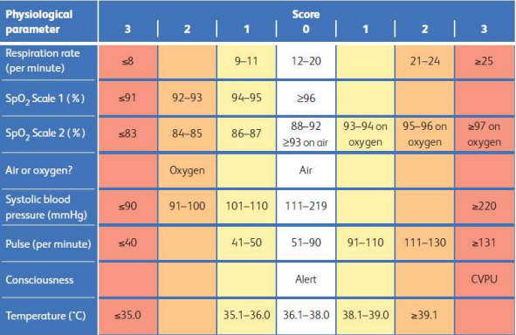
What is a NEWS2 score?
National Early Warning Score
Universal language used across healthcare settings
Aggregate scoring system where each vital sign is given a score based on the result
Total score is generated by adding individual scores together
Improves the detection and response to clinical deterioration in adult patients
*Always use scale 1 for Sp02 unless otherwise directed by a medic (would usually be in an acute setting)
Notes:
Initially used in acute setting where they can monitor results over a period of time and pick up on deteriorating patients. Whilst in community it gives a one off result, this can be used to convey the urgency of any referrals to another HCP

Slide 4
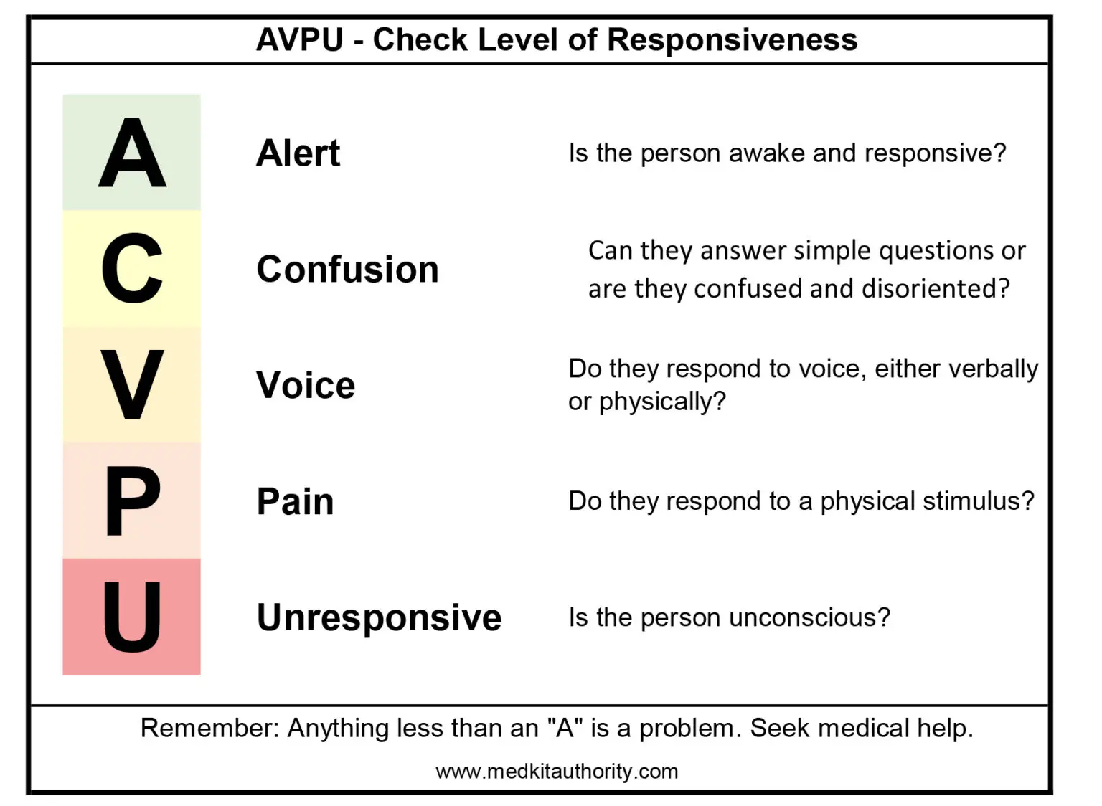
Recording level of consciousness
Confusion relates to new onset, acute or worsening – important to know baseline

Slide 5
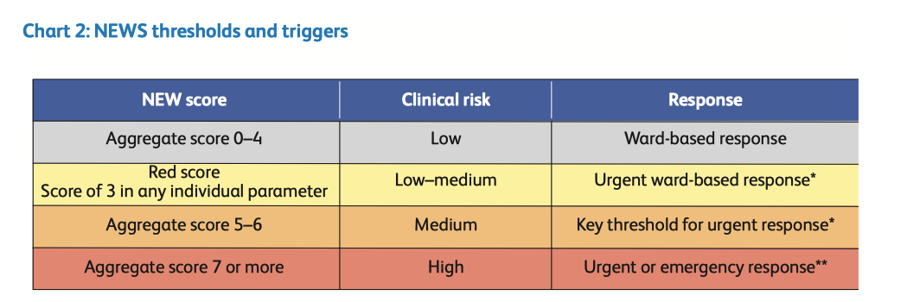
Notes:
Important to remember this is a tool to aid clinical decision making – always treat the patient and not the numbers!

Slide 6





NEWS2 Score calculation using vital signs measurements
Respiration rate: 21 per minute (2)
SpO₂: 97% on room air (0)
Blood Pressure: 110/60 mmHg (1)
Pulse: 105 beats per minute (1)
Consciousness: Alert (0)
Temperature: 38.3ºC (1)
NEWS Score = 5
Notes:
Patient with NEWS of 5 – intervention needed – decision to treat would be based on patient vital signs, history & co morbidities as well as individual confidence and competence
Patient with NEWS score of 5 however RR was 25 – individual score of 3 – referred to GP – admitted to A&E pneumonia (concerned pt may have had a PE)
Patient with NEWS score of 7 – 84 year old woman, reluctant to go to A&E, Likely undiagnosed COPD, LRTI

Slide 7
Patient scenario 1
Patient scenario 2
84yrs F
Presenting complaint – cough & increasing SOB
Vital signs
  RR 25 (3)
  02 Sats 93 (1)
  BP 102/75 (1)
  Pulse 95 (1)
  Temp 38.3 (1)
  NEWS2 = 7
Patient sent to A&E
36yrs F
Presenting complaint – cough, haemoptysis, chest pain/tightness, worsening SOB
Vital signs
  RR 21 (2)
  02 Sats 96 (0)
  BP 128/103 (0)
  Pulse 120-130 (2)
  Temp 38.9 (1)
  NEWS = 5
Discussed with GP who further assessed patient and referred directly on to A&E. Patient admitted with Pneumonia

Slide 8
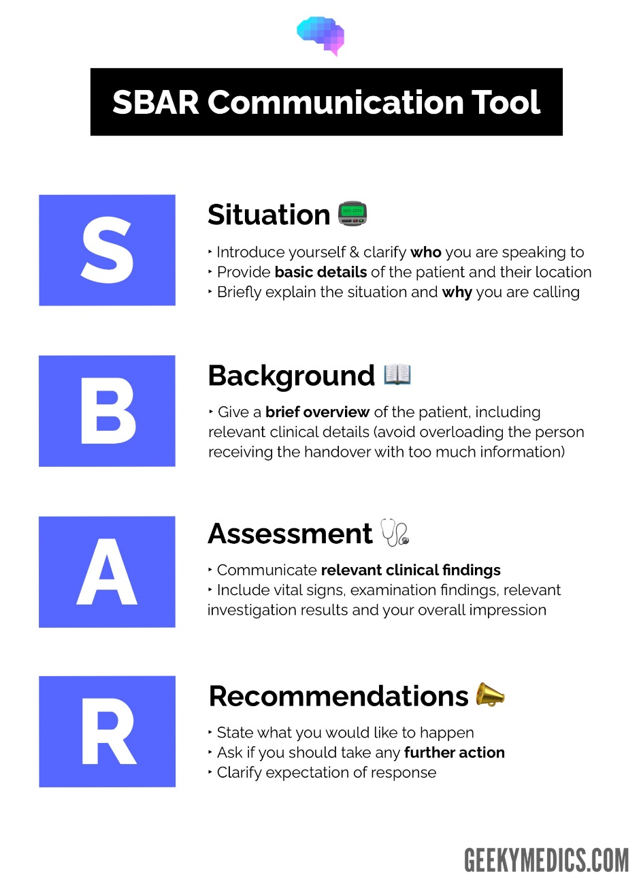
NEWS2 Score
Onward Referral using SBAR
SBAR Communication Tool | Handover | Geeky Medics

Slide 9
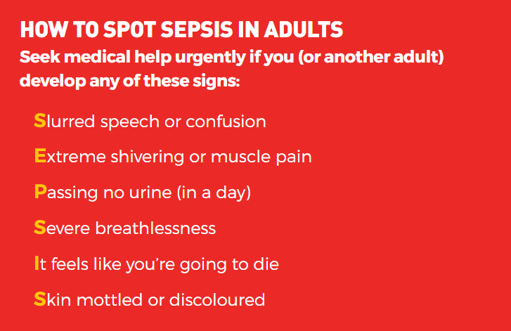
What is SEPSIS?
Sepsis is a life-threatening condition that arises when the body’s response to an infection injures its own tissues and organs.
It occurs when the body’s immune system – which normally helps to protect us and fight infection – goes into overdrive. It can lead to shock, multiple organ failure and sometimes death, especially if not recognised early and treated promptly.

Slide 10
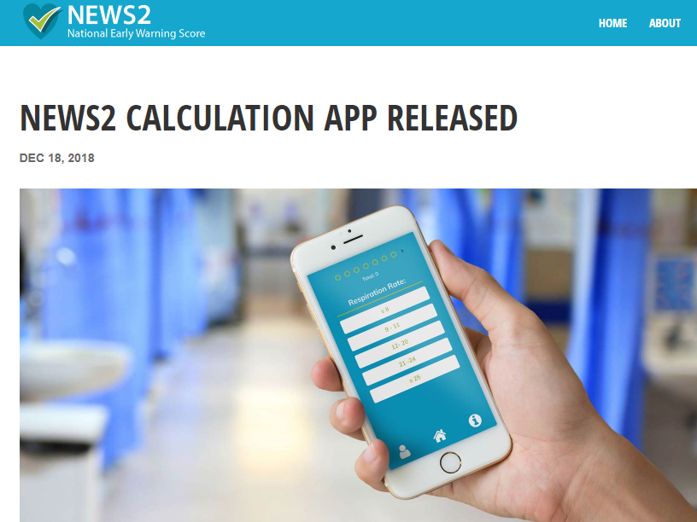
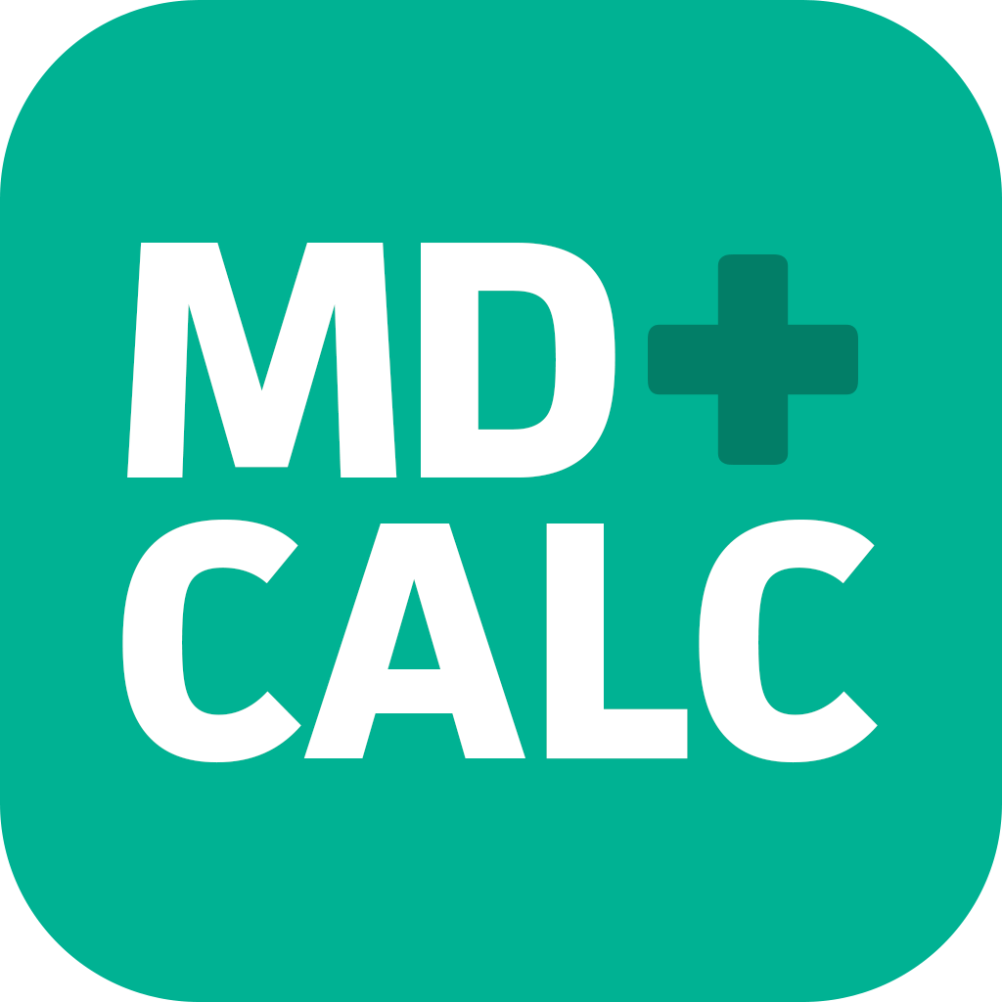
Available on iOS
Or charts available at
National Early Warning Score (NEWS) 2 : charts | Turas | Learn (nhs.scot)
Available on Android
Or charts available at
National Early Warning Score (NEWS) 2 : charts | Turas | Learn (nhs.scot)

Slide 11


