Slide 1
Pharmacy First Plus in NHSGGC
Pamela Macintyre/Lorna Brown

Slide 2
NHS GGC
Population of approximately 1.2 million people and care is delivered via 6 local Health and Care Partnerships
9 main hospital sites, 5 maternity units, 5 emergency departments and 3 minor injury units
283 Community Pharmacies
228 GP Practices
265 Community Dental Practices
189 Community Optometry Practices

Slide 3
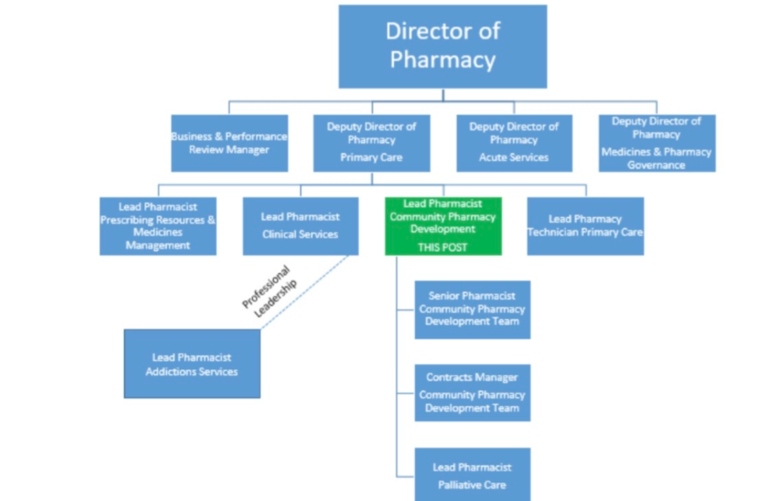
Community Pharmacy Development Team
Notes:
The CPDT Lead Pharmacist leads on key strategic committees within Pharmacy within the above organisation hierarchy and liaises with regional and national committees regarding community pharmacy services and engages with peers at a national level on work that will have impact throughout NHS Scotland. Locally this also includes governance of prescribing from CPIPs with support from the Senior Pharmacist CPDT in conjunction with the Common Clinical Conditions Advisory Committee (CCCAC).
The CPD Team support the GGC CPs day to day with payments, administration of PGDs and other relevant paperwork/procedures.

Slide 4
NHS Pharmacy First Plus (Common Clinical Conditions)
Commenced September 2020
Utilise Independent Prescribing within Community Pharmacy for Common Clinical Conditions
Vehicle to develop career pathway for community pharmacists

Slide 5
Current Position – Spring 25
172 community pharmacist IPs (CPIPs) now actively prescribing
141 pharmacies have signed up to provide the service
283 Community Pharmacies in NHSGGC
439 Pharmacists (383.8 WTE) working in CP across NHSGGC
Notes:
Numbers are increasing monthly and will continue to do so. 2025/26 will be the first FTY year that comes out ‘prescriber ready’

Slide 6
Getting Started…..
Notes:
Ordered your pads, sorted insurance and added to the mailing list, received your introductory newsletter and copy of the Non Medical Prescribers Guidance/Policy.

Slide 7
Responsibility for CPIP Prescribing
Although Pharmacy First Plus is a national service, responsibility for the prescribing lies at a Health Board level.
Like other Non Medical Prescribers, you are required to adhere to governance policies set out by the Health Board and your professional body.

Slide 8
Non Medical Prescribing Guidance
Notes:
The documents you have received as part of your introductory information were initially written from a nursing point of view or pharmacists in the managed sector. They are in the process of being adapted to cover CPIPS working in Community Pharmacy. However the embedded principles within them should be adhered to as a CPIP, this includes engaging with the CPDT and receiving visits from the team to discuss prescribing.

Slide 9
Keep us up to date!!
You must complete the annual audit as per CPDT request. It is mandatory as per the Common Clinical Conditions Advisory Group (usually sent out in Spring each year)
Your prescription pad is linked to your contractor code. If you move, even within your company to a different site/code…. You need to let the CPDT know!
Your pad requires to be reassigned to the new contractor code.

Slide 10
If you don’t…….
Failure to complete the annual audit in a timely manner e.g.no return after 3 requests or failure to engage with the CPDT to discuss your prescribing at a visit (online or F2F), may result in remedial action being taken:
Suspension of prescriber code
Flagging for cessation of PF+ payments

Slide 11
Keeping your pad safe…..
Now that you have your prescription pad, you are responsible for keeping it safe and secure. As you will be aware, GP prescription pads and individual scripts have been stolen and attempts for misuse have occurred.
Look at the link below for information on how to store your pad. Find a system that keeps your pad safe. Security of Prescription Form Guidance (scot.nhs.uk)
Remember to order replacements on time…..
Notes:
It can take 6-8 weeks to get replacement or further supplies of prescription pads. Longer at busy times or over bank holiday periods e.g. Christmas

Slide 12
CPIP Ready Checklist √ Complete or refresh NES Common Clinical Conditions Modules https://learn.nes.nhs.scot/34219/pharmacy/cpd-resources/common-clinical-conditions Pads requested Contact: Michelle.Cooper@ggc.scot.nhs.uk Equipment purchased Check list (below) and potential suppliers on CP Webpage. Remember to organize servicing of instruments. Signed up to GGC CPIP Support Network and Teams Chat Contact: Michelle.Cooper@ggc.scot.nhs.uk |  | Ensure indemnity insurance for IP in place If organized by your company check it covers IP and request a copy for your records Downloaded GGC Formuary App (also has Antibiotic guidelines). Available for Apple and Android. User name: ggcstaff Password: medicines If eligible, book and attend a NES Teach & Treat Hub https://learn.nes.nhs.scot/46733/pharmacy/teach-and-treat-for-common-clinical-conditions/attending-a-nes-pharmacy-teach-and-treat-hub-for-common-clinical-conditions

Slide 13
NHSGGC Formulary & Preferred List
Available at GGC Medicines: Home is the list of items approved for prescribing within GGC. The formulary covers both primary and secondary care so you may find some items that are noted as S – Specialist initiation only (not for primary care or CP supply or initiation)
Within the formulary there is the Preferred List (PL), these are first line choices which can be applicable to most patients and scenarios.
There is evidence that knowing a small list of drugs well can be beneficial to prescribing as you are more familiar with the dosage regimen, potential interactions and counselling required.
Notes:
A community pharmacy example would be Ibuprofen gel 5% as the topical Nsaid being preferred list choice. Ketoprofen and Movelat are on the Total Formulary. Diclofenac Gel is Non Formulary.
The emollient section of the GGC formulary has recently been updated alongside the Pharmacy Approved List options – make sure you are prescribing the correct products to help stay within prescribing budgets.

Slide 14
Importance of Formulary and Preferred List compliance
Choices are evidence based
Linked to and included in guidelines
Usually cost effective (manage budgets)
Often tried and tested
Benefits of familiarity in prescribing regimes and interactions
GPs and other prescribers are requested to adhere to them.

Slide 15
Health Board Support
Common Clinical Conditions Advisory Group
Membership includes – CPIPs, Contractors, Medical Representative (Clinical Director), NES rep and Primary Care Pharmacist
Memorandum of Understanding( MOU) with CPIPs – details monitoring/governance and support for prescribers

Slide 16
How do we monitor prescribing?
Using PRISMs data to generate reports to track prescribing, trends, costs and formulary/preferred list compliance
Management reports to CCC Advisory Group
Individual reports for CPIPs to review their own prescribing
Images of scripts can be requested for clarification or investigation as needed

Slide 17
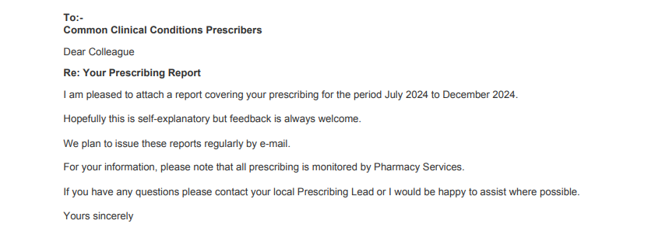

Slide 18
Then and now…….
Notes:
Massive increase in the number of dispensed items

Slide 19
May 21-Oct 21
1285 Rx were prescribed by 37 prescribers
Total cost Rx £4595
Average cost per item £3.58
GGC formulary compliance average 82.5% and Preferred list compliance 70%
Sept 23– Feb24
4725 Rx prescribed by 105 prescribers
Total cost £18,750.04
Average cost per item £3.94
Preferred List compliance 73.7% Total Formulary of 84.7% (97 CPIPs)
Notes:
In most recent report, 8 Prescribers of the had PL compliance of less than 55%
They Rx 318 prescriptions and had an average of 42% PL compliance and 59% TF compliance. In comparison with the 97 prescribers who Rx 4407 prescriptions (average cost £3.94) PL compliance 73.7% TF of 84.7%

Slide 20
Prescriber Activity Levels (based on Rx numbers as proxy measure)
Notes:
There is a massive variation in prescribing activity, which can be due to a number of barriers and enablers: location. Demographics of the local population, prescriber competence/confidence.
We are in the process of finalising a piece of research relating to this in GGC.

Slide 21
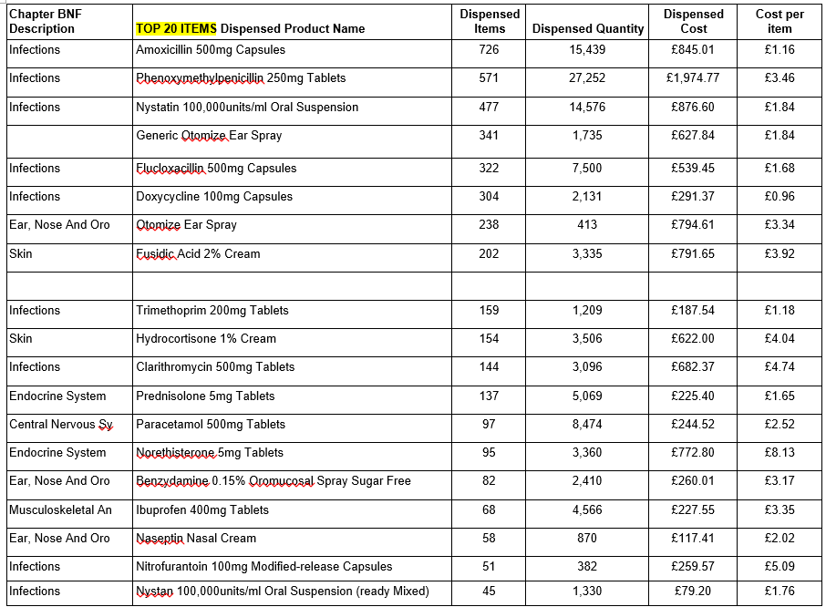
Top 10 Preferred List Items
Notes:
Of the top 20 2277 are ABX (only 529 could potentially be supplied via PGD.
New Nystatin PGD Dec 24. 522 nystatin Rx before this and 579 Otomize Rx – potential to share both nationally.

Slide 22
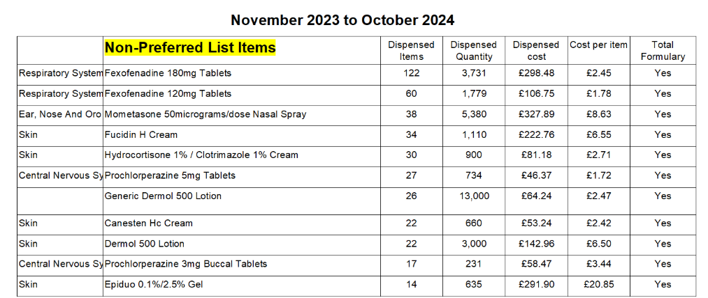
Top 10 Non Preferred List Items
Notes:
8 Prescribers of the had PL compliance of less than 55%
They Rx 318 prescriptions and had an average of 42% PL compliance and 59% TF compliance. In comparison with the 97 prescribers who Rx 4407 prescriptions (average cost £3.94) PL compliance 73.7% TF of 59.7%

Slide 23
Antibiotic Prescribing
Of the top 20 items, 2277 are ABX from a total of 4725 Rx (48%)
Some can be supplied via PGDs or to patients who are outwith PGD criteria
Important to consider patient ‘demands’
Complete Antimicrobial Stewardship modules on Turas
Dealing with Difficult Discussions module on Turas

Slide 24
CPIP Support
Regular peer review and educational sessions with topics driven by the CPIPs (Watch newsletter for topics)
Upcoming – Podiatry, Burns, Lifestyle Medicine, Common Clinical Conditions in Cancer Patients
Teams ‘Chat’ (alternative to WhatsApp)
Newsletter – looking for topics

Slide 25
Turas Supports
Sign up to NES mailing list (see newsletter) and follow on Facebook for upcoming sessions
Check out the ‘Learning Together’ modules on Ears and Sore Throats – you can run these in your pharmacy for all the Team
If you have outstanding training to complete (particularly if self-funded) – check Turas or contact NES for upcoming sessions or to be added to waiting lists

Slide 26
The Future
Continue to develop peer review
Support for IPs in training
Support for DPPs (including DPP Development Programme Pilot)
Vision

Slide 27
Notes:
Thank you for joining – are there any questions

