Slide 1


NHS Scotland –
Marketplace
July 2024
Online Ordering User Guide

Slide 2
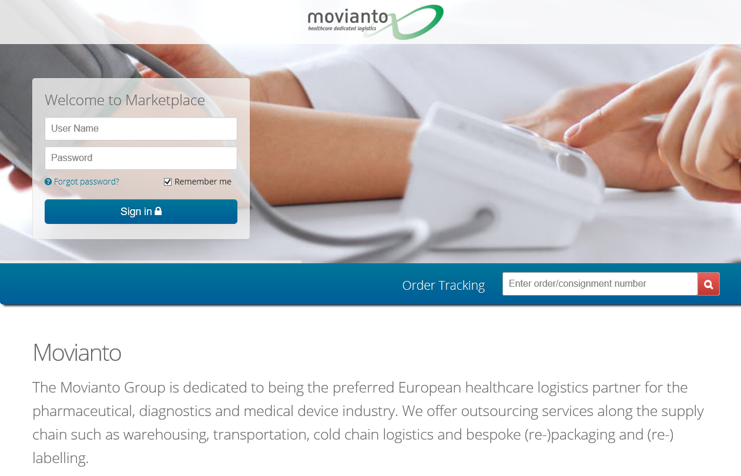
LOGGING ON
Click on the following link: https://marketplace.movianto.com/
Enter your Username and Password. These will be the same as last year. If you are a new user your log in details will have been emailed to you.
If you are unsure, then select the ‘Forgot password?’ option below the Password field and enter your email address.
If you have any further problems logging on, please contact Movianto Customer Services on 01234 587112.

Slide 3
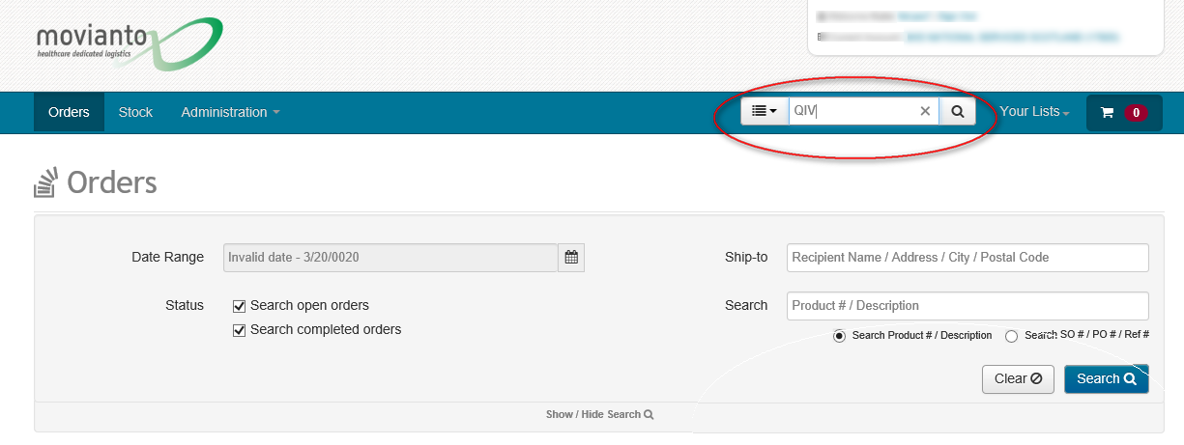
ORDERS SCREEN
This screen shows your order history, including last year’s orders.
To find the vaccine required please type the following “search term” in the search products bar:
  “aQIV” – this will display vaccines for patients aged 65 and over
  “QIVc” – this will display vaccines for patients aged 2 to 64
  Note: Like last season, vaccines have been allocated to each practice so you will therefore only have access to this volume of product. Allocation queries should be raised with Movianto.
Please note – If you are unable to find the products to order, enter a ‘%’ sign in the “Search Products” bar and this will bring up all of the available products to order.

Slide 4
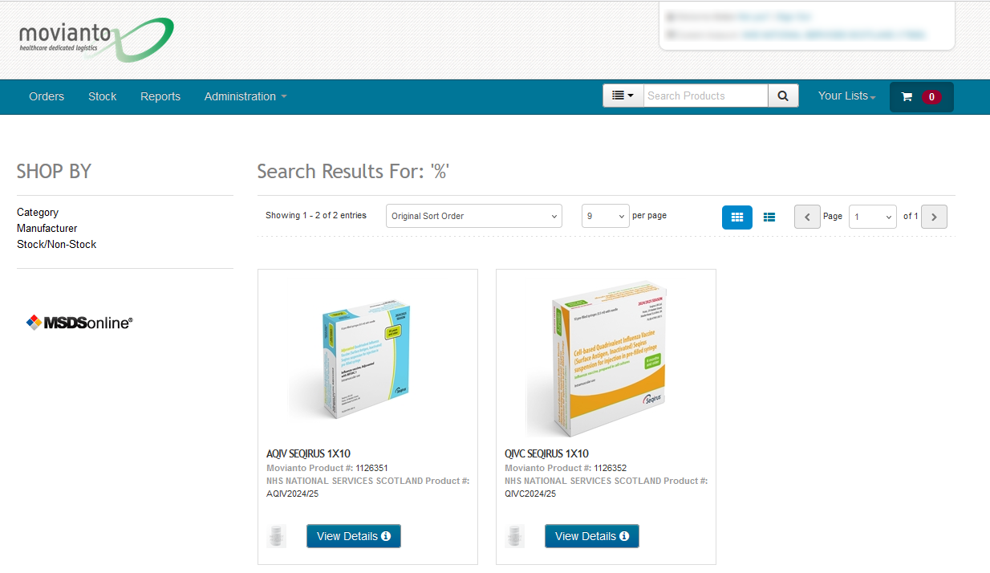
PRODUCTS SCREEN
Click on “View Details” for any product you want to order.

Slide 5
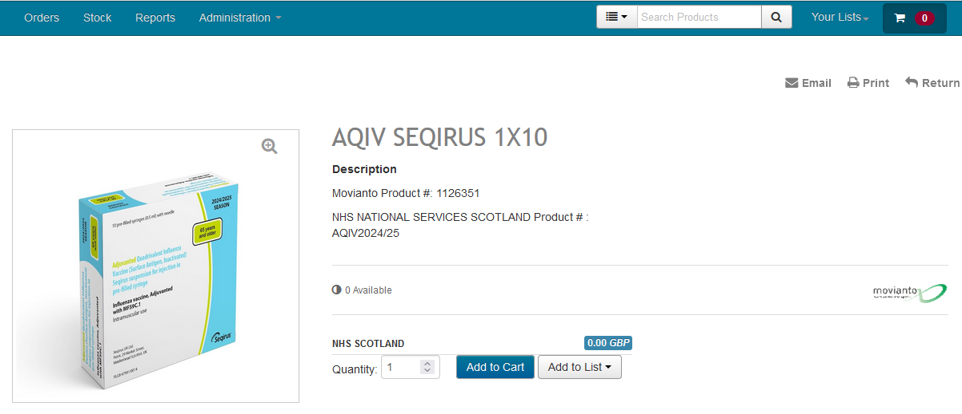
ADD TO CART
The quantity available is shown. This will display ‘0’ until stock is delivered to Movianto.
Enter the number of boxes of 10 you want to order in the Quantity box and click on “Add to Cart” (e.g to order 500 vaccines you must enter the quantity 50)
You should always check the pack size in the product description. In this example the vaccines are available in boxes of 10 however some vaccines are available in single dose packs.
If you want to order another vaccine, click the small arrow at the top to return to the previous screen and repeat.
You should only order vaccines you have space to store.
Note: The price will say £0 as costs will be charged back to your Health Board separately.

Slide 6
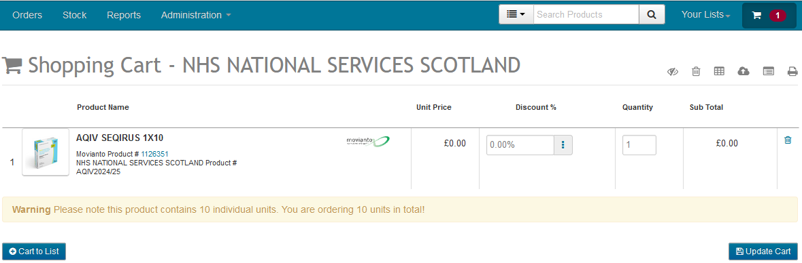
CHECK OUT
Once you have finished ordering the products you require, click on the shopping trolley icon at the top which will show a number next to it reflecting how many products you have ordered.
This will show all products you have ordered along with the quantity. In the example above the order is for 1 packs of 10 vaccines (total 10 vaccines). Amend or remove if required, and press “Update Cart” if you do.
Please be aware the unit of measure “EACH-1” refers to packs, not number of doses.

Slide 7
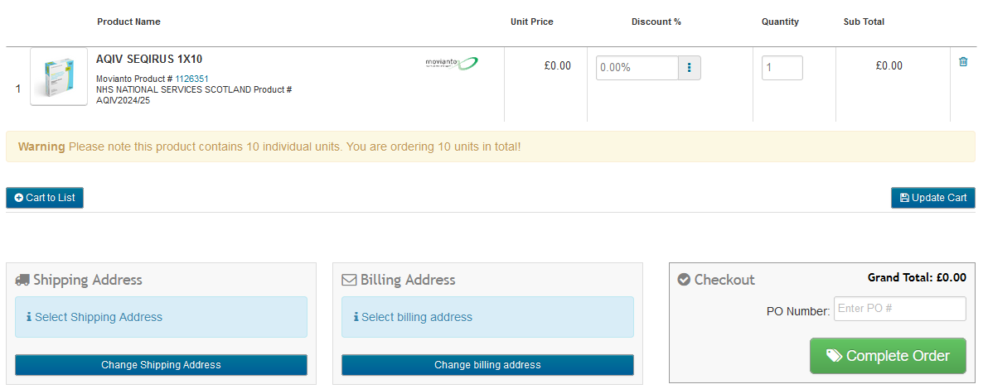
CHECK OUT CONTINUED
Once you are happy that the quantities and products are correct you must then complete the PO Number box.
Enter your name and the current date e.g. “SMITH 23.08.2022”.
Then click on “Complete Order”

Slide 8
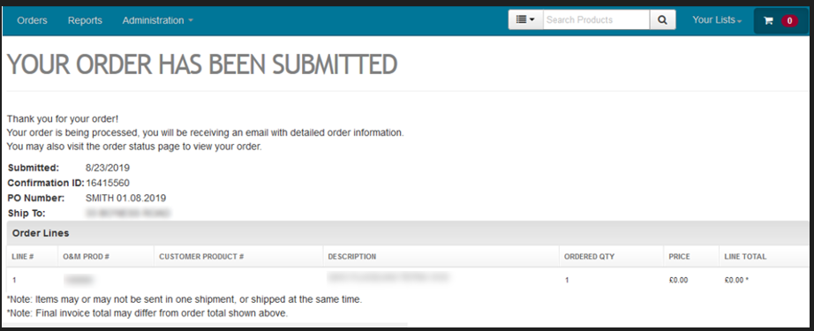
ORDER CONFIRMATION
You will receive an email confirmation which should take no more than 60 minutes to arrive. This will have the details required should you need to contact the Customer Service Team for any reason.
Your delivery day will be the day allocated in the Movianto delivery schedule. You must order by the stated cut off time to receive delivery on this day.

Slide 9
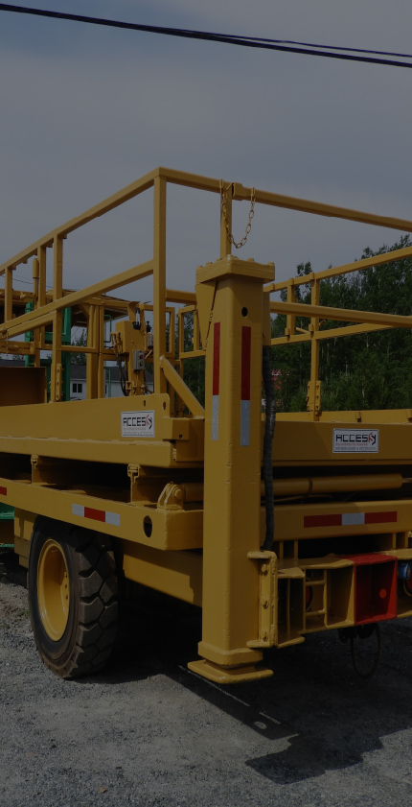
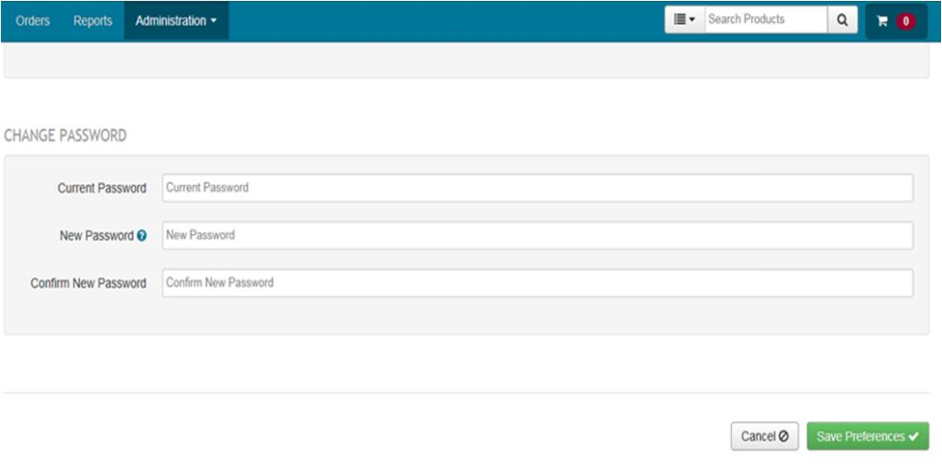

CHANGING YOUR PASSWORD
If you would like to change the password that was auto generated for you then please select the “Administration” drop down at the top and click “Preferences”.
Your details will be shown and at the bottom you can enter a new password and confirm it.

