Slide 1


www.bighealth.co.uk/patient-stories
“Here is the beauty of Sleepio, it tries a number of things, it’s not just the one thing it gives you”
“When it came to Sleepio itself it was definitely about training my brain to ‘do sleep’ differently and it retaught my brain to have this proper bedtime routine.”
“And it worked, I found that very quickly that my sleep started to recover”
“I’ve learnt techniques that will stop a bad night becoming three bad nights, becoming a week of bad nights, becoming a month of bad nights”
Brian (East Lothian)
Mental Health Charity Worker
Notes:
Brian or Lynn -
BoB Data:
Avg of 19 entries per enrollee
15% responder rate across BoB

Slide 2
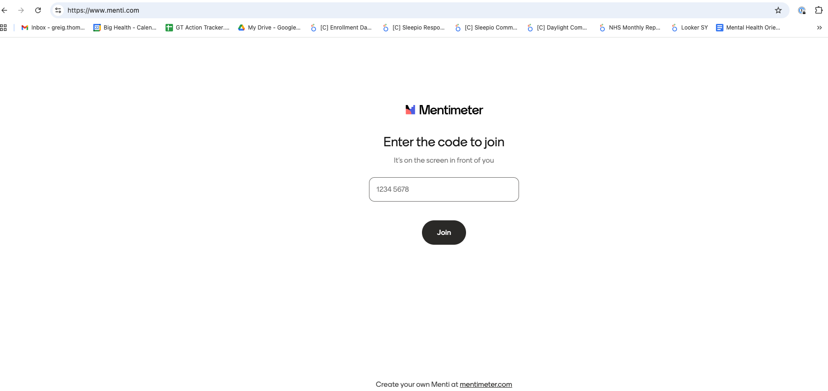
Please go to
www.menti.com
Or you can scan
A QR code during the session

Slide 3


Sleepio
Digital CBT for insomnia (CBT-I)

Slide 4

How does Insomnia commonly present in community pharmacy?

Slide 5

Insomnia: Prevalence and comorbidities
General Prevalence:
  Around a third of adults in Western countries experience sleep problems at least once a week
  6-10% fulfil the criteria for insomnia disorder¹
  Prevalence of insomnia is 1.5–2 times higher in females than males
Comorbidities:
  Psychiatric complications: Doubles risk of developing depression, significant predictor for onset of anxiety, alcohol abuse, and psychosis.
  Medical complications: Increased risk of obesity, hypertension, cardiovascular disease, and type 2 diabetes, in particular with objectively measured short sleep duration
https://cks.nice.org.uk/topics/insomnia/

Slide 6
What do you currently offer to patients who present with Insomnia?

Slide 7

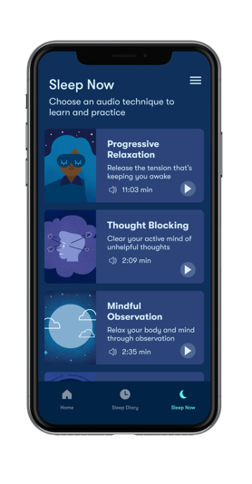
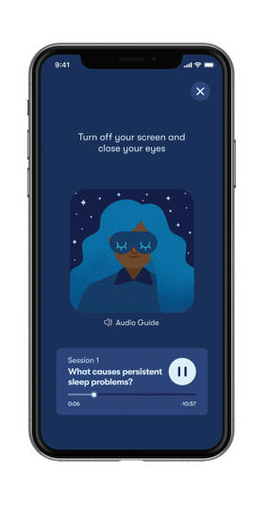
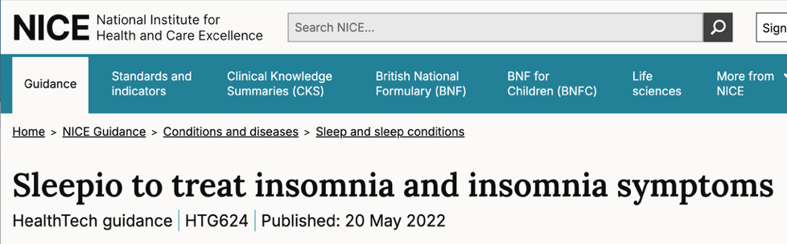
Insomnia Management: NICE Guidance
  Offer cognitive behavioural therapy for insomnia (CBT-I) as the first-line treatment for chronic insomnia in adults of any age.
    CBT-I typically includes behavioural interventions (such as stimulus control and sleep restriction), cognitive therapy, and relaxation training. It can be provided face-to-face or digitally.
    Sleepio is a digital CBT-I-based treatment recommended by NICE.
Notes:
DG Talk track – When patients present, options were historically only pharmacological, when they should be given behavioural treatments first line. This is only possible in Scotland now.
The length of treatment should be as short as possible.
Treatment should be assessed within 3 months of starting and should be stopped in people whose long-term insomnia has not responded adequately.
If treatment is continued, assess whether it is still working at regular intervals.

Slide 8

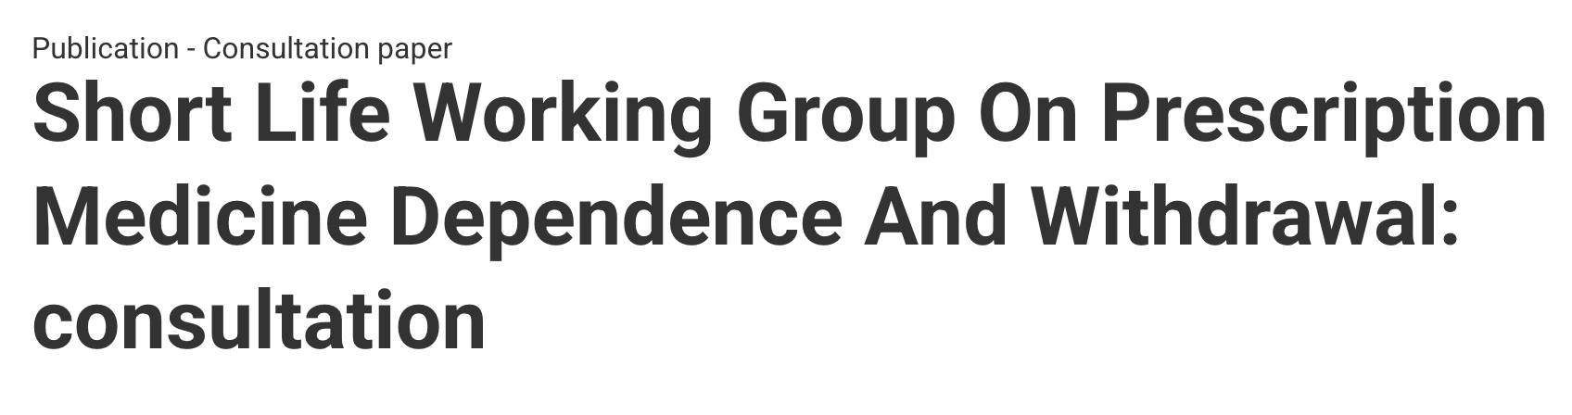
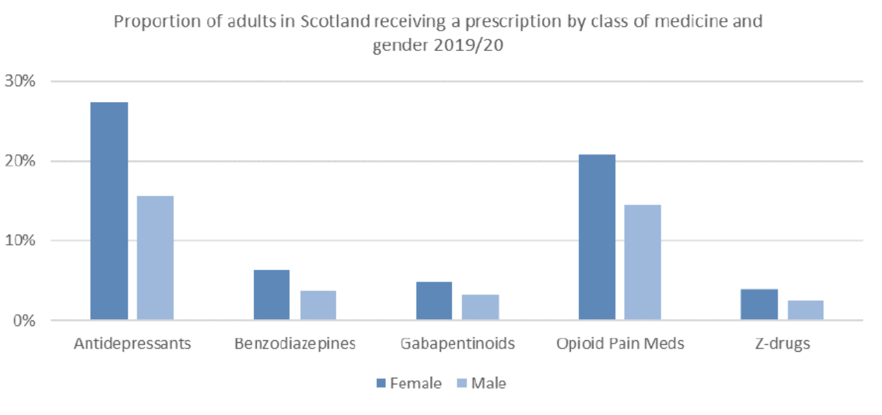
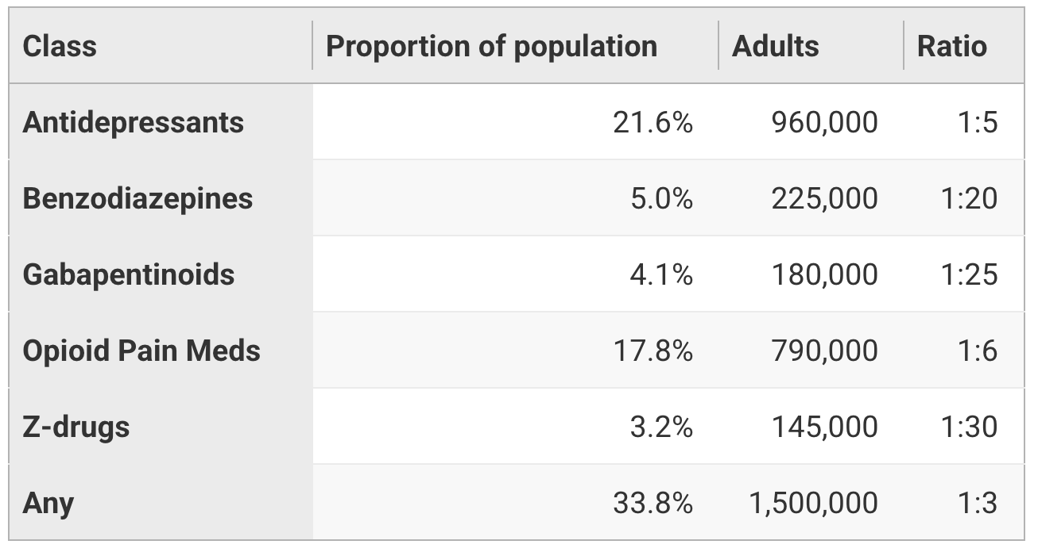
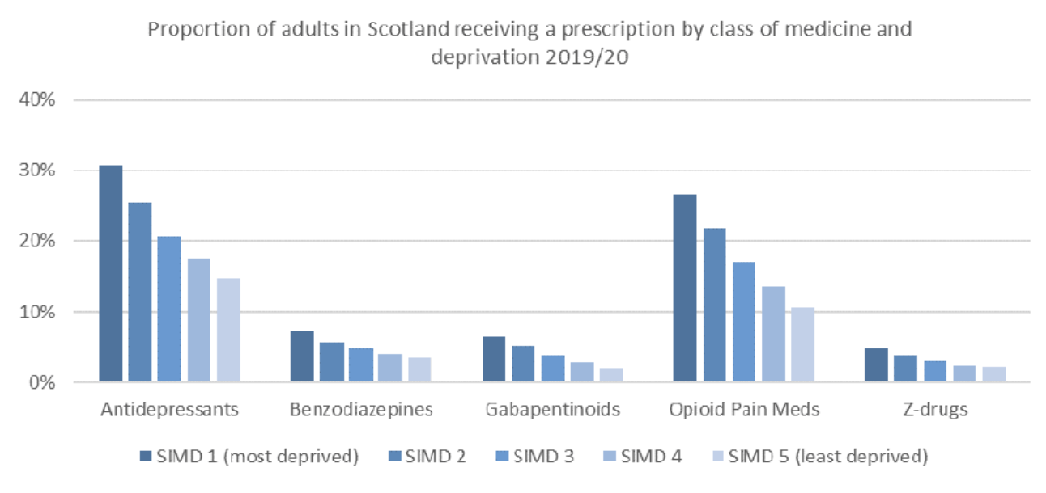
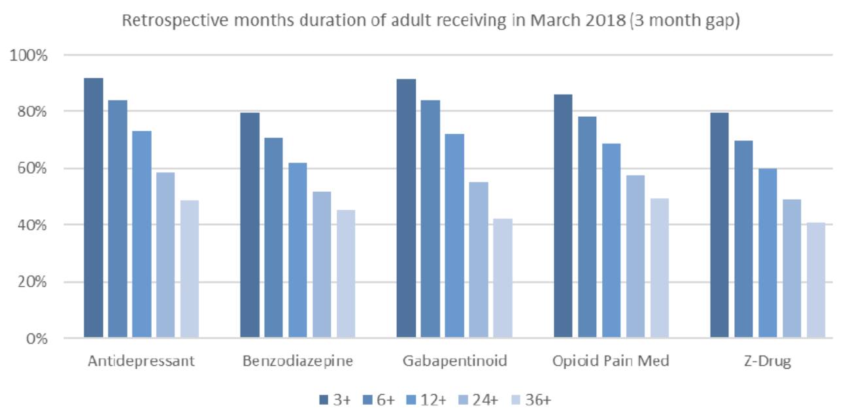
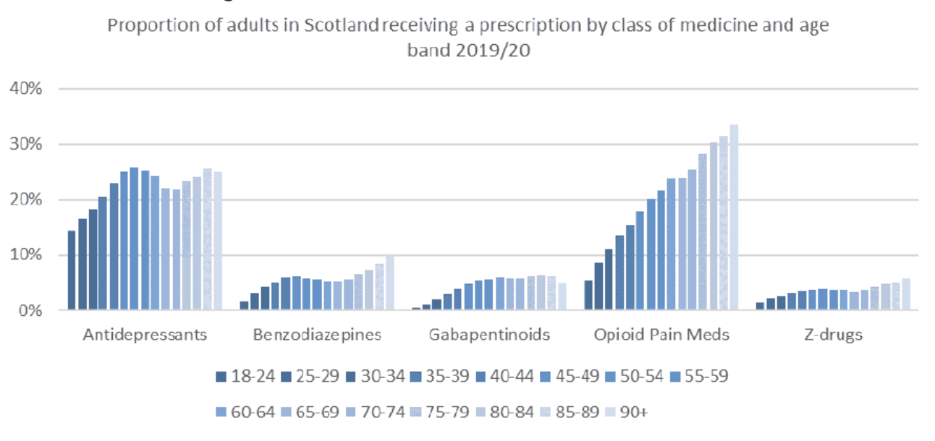
Prescribing inequalities
  1.5x higher in females
  Rates increase with increased deprivation
  Rates increase with age

Slide 9


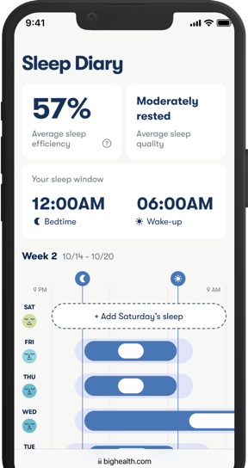
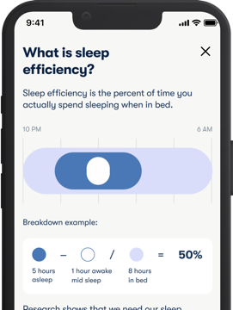
The NICE recommended treatment for insomnia
Sleepio is a treatment that helps patients overcome insomnia and sleep challenges.
Up to 76%
Experience clinical improvement in insomnia²
Immediate access to CBT-I: no waiting times
Fully automated and supported: builds self-management and long-term autonomy
6-10 minute sessions of CBT-I: short sessions deliver meaningful clinical improvement
MHRA registered & NHS DTAC accredited: safe, trusted, and scalable
1. Internal Data. (April 2025).
2. Internal RCT data, August 2023, and Tarnai et al. (2025). Aging and Mental Health
©2025 Big Health Inc. | CONFIDENTIAL & PROPRIETARY | Do not distribute
Notes:
+ We developed the first digital therapeutic for insomnia in 2012 which uses cognitive behavioral therapy (CBT) techniques.
+ Highlight how Sleepio is market leading and only solution that is clinically proven and FDA cleared Digital Mental Health Treatment(DMHT) for insomnia treatment
+ Unlock immediate access to our proprietary CBT-I treatments with results as soon as 3-4 weeks

Slide 10



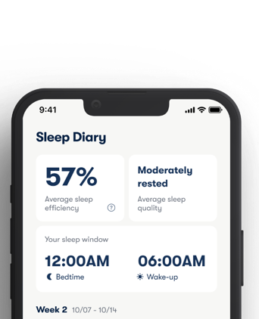

Sleepio evidence summary
NICE
In May 2022 NICE¹ recommended Sleepio as the first-line treatment for insomnia, being more clinically effective than sleeping pills and sleep hygiene, and in-year cost-saving for the NHS by reducing GP appointments and prescription costs
NICE CKS for insomnia recommends Sleepio to offer CBT-I
Clinical Effects
26 clinical studies replicating effectiveness improving insomnia and sleep outcomes
17 published RCTs, comprising over 8k participants
Referenced in 4 UK and international clinical guidelines.¹
DOC-3907 Effective Jun 2025 ©2025 Big Health Inc. | CONFIDENTIAL & PROPRIETARY | Do not distribute
Broader Outcomes
Sleepio is the first digital therapeutic to be recommended by NICE. The American College of Physicians (ACP), European Sleep Research Society (ESRS) and British Association for Psychopharmacology (BAP) guidelines all recommend CBT as the first-line treatment for insomnia disorder. Sleepio studies were cited and used to establish these three guidelines.
Effective in demographically diverse populations⁴
Effective at treating insomnia in populations with common comorbidities, including hypertension,⁵ stroke,⁶ anxiety,⁷ and depression.⁸
Effective during pregnancy^{9,10}
2. Miller et al (2020). White paper 3. Darden et al (2021) Sleep 4. Cheng et al. (2019). Sleep 5. McGrath et al (2017). American Journal of Hypertension 6. Fleming et al. (2024). Journal of Sleep Research 7. Henry et al. (2023). Journal of Affective Disorders 8. Henry et al., (2021). Journal of Sleep Research 9. Felder et al. (2020). JAMA Psychiatry 10. Kalmbach et al (2020). Sleep Med
Notes:
Key mentions would be: Stanford, UCSF, University of Oxford, University of Michigan
73% of real-world patients have a clinically meaningful response, defined as a 25% improvement in SCI-2 scores

Slide 11

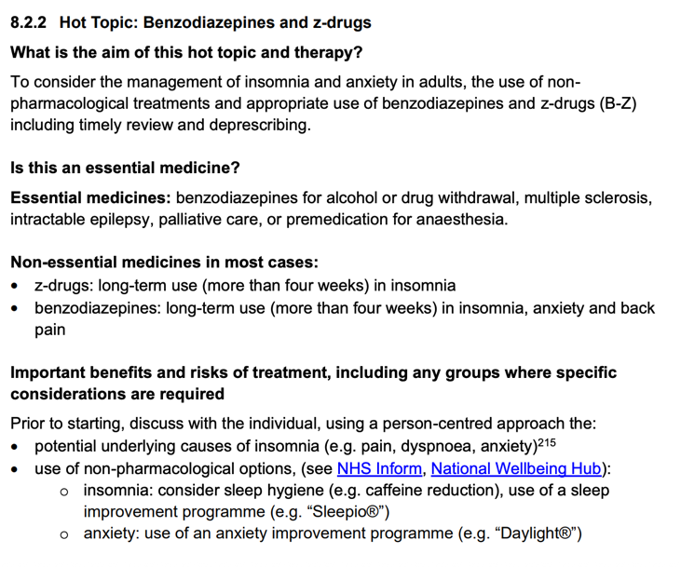
DOC-3907 Effective Jun 2025 ©2025 Big Health Inc. | CONFIDENTIAL & PROPRIETARY | Do not distribute
2. Miller et al (2020). White paper 3. Darden et al (2021) Sleep 4. Cheng et al. (2019). Sleep 5. McGrath et al (2017). American Journal of Hypertension 6. Fleming et al. (2024). Journal of Sleep Research 7. Henry et al. (2023). Journal of Affective Disorders 8. Henry et al., (2021). Journal of Sleep Research 9. Felder et al. (2020). JAMA Psychiatry 10. Kalmbach et al (2020). Sleep Med
Notes:
Key mentions would be: Stanford, UCSF, University of Oxford, University of Michigan
73% of real-world patients have a clinically meaningful response, defined as a 25% improvement in SCI-2 scores

Slide 12
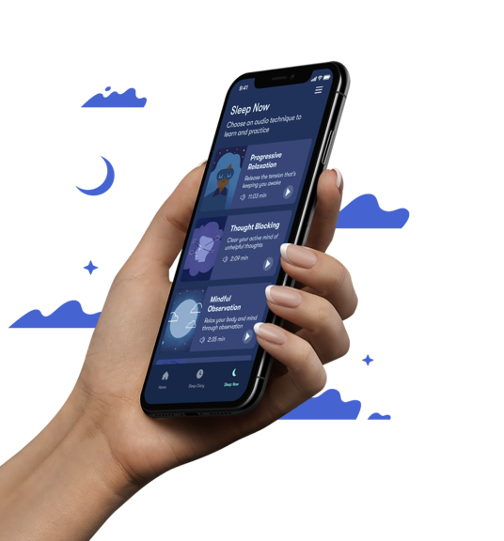
Core techniques rooted in cognitive behavioral principles
Stimulus Control teaches patients healthy sleep habits to promote behavior change and strengthen the association between the bed and sleep
Sleep Restriction recommends personalised bedtime and wake time to improve sleep efficiency and maintain a consistent sleep-wake schedule
Cognitive Restructuring helps patients challenge negative and unhelpful thoughts about sleep
On-Demand Toolkit provides interactive exercises to practice techniques and relax the body and mind
DOC-3907 Effective Jun 2025 ©2025 Big Health Inc. | CONFIDENTIAL & PROPRIETARY | Do not distribute

Slide 13

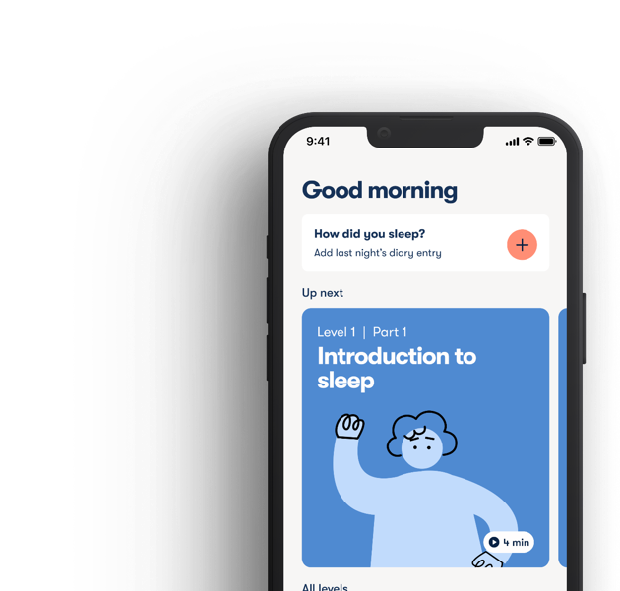
Offering Sleepio to your patients - general guidance
Patients can sign up directly at
sleepio.com/nhs
Patient eligibility requirements
✓ Present with symptoms of insomnia
✓ Conversational level English
✓ Aged 18 or over
✓ Access to a smartphone and internet
Not sure if a patient is suitable? Check full criteria at sleepio.com/suitable

Slide 14
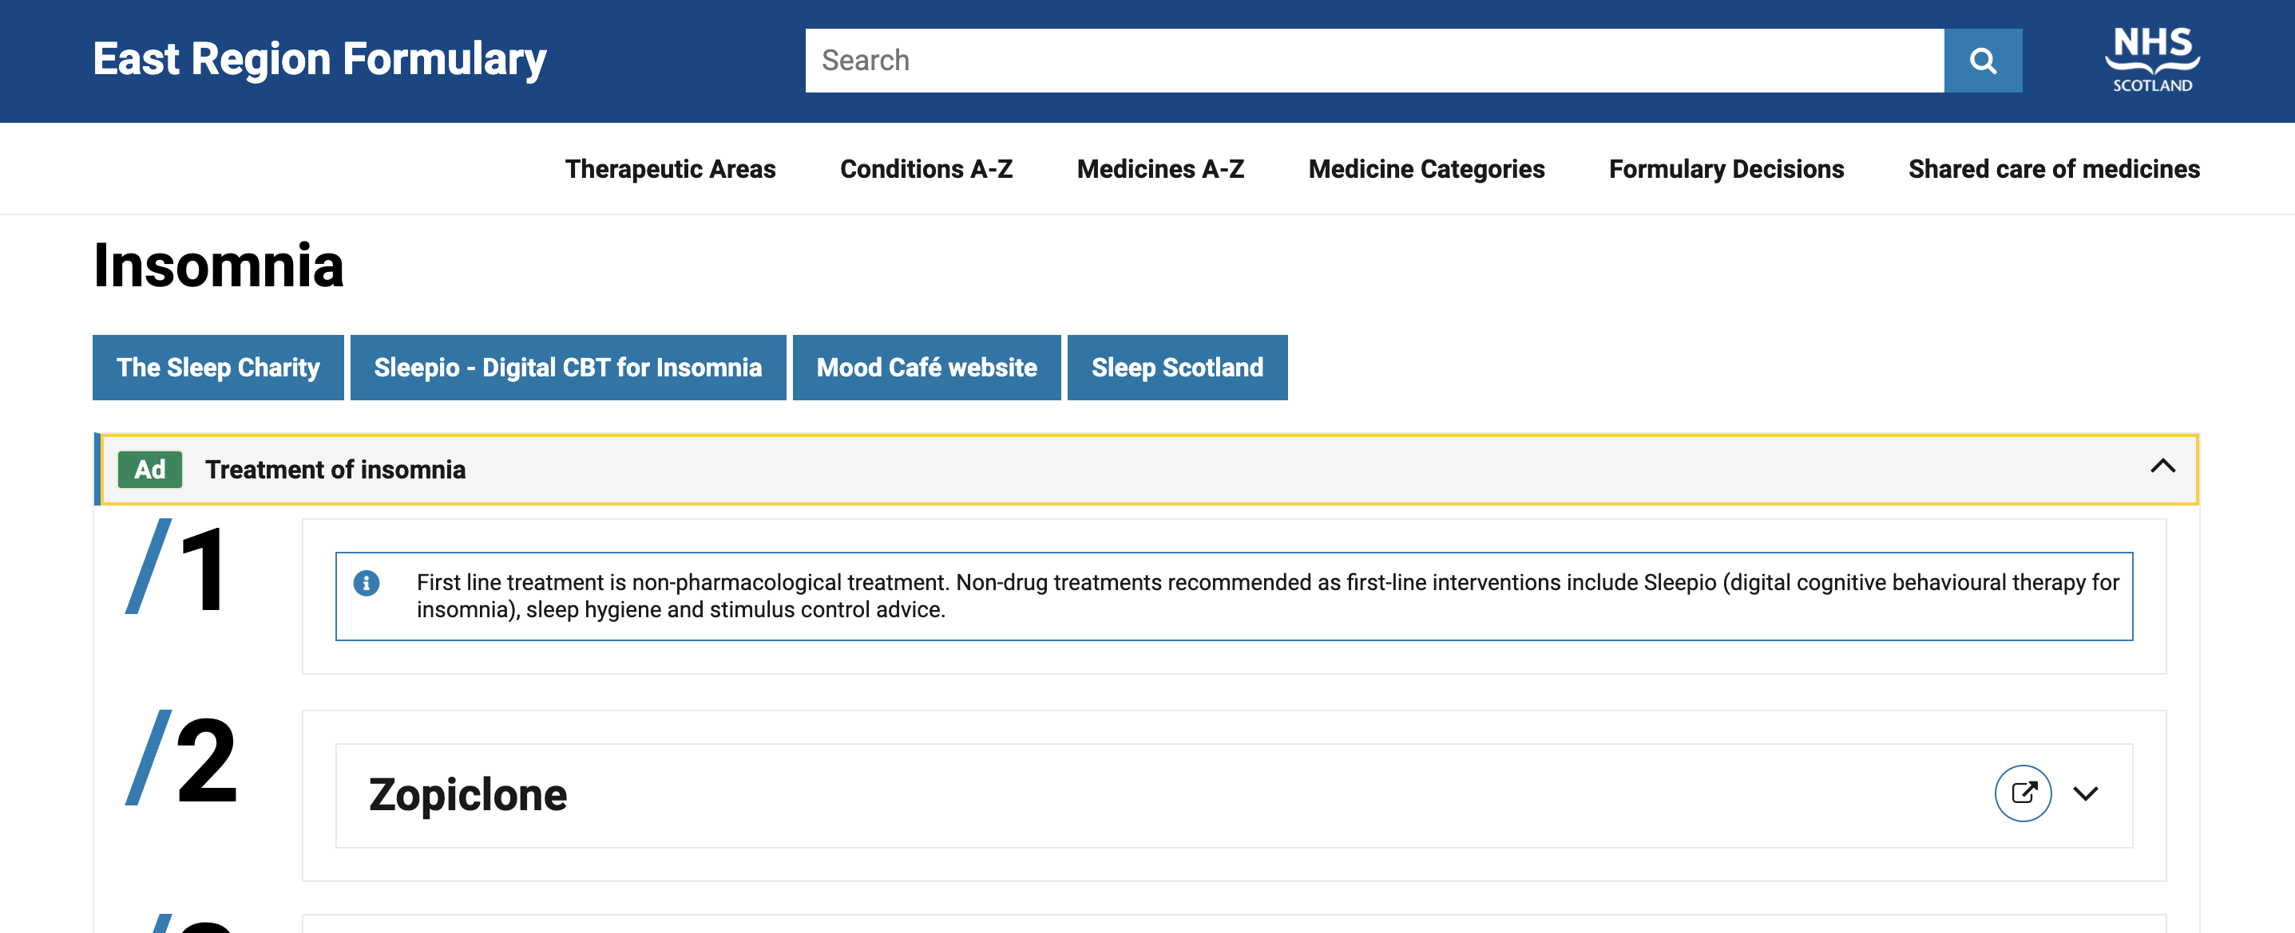
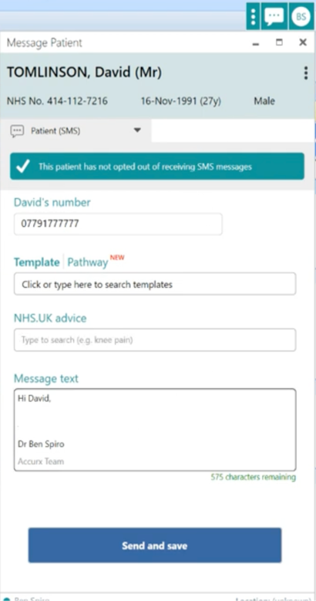
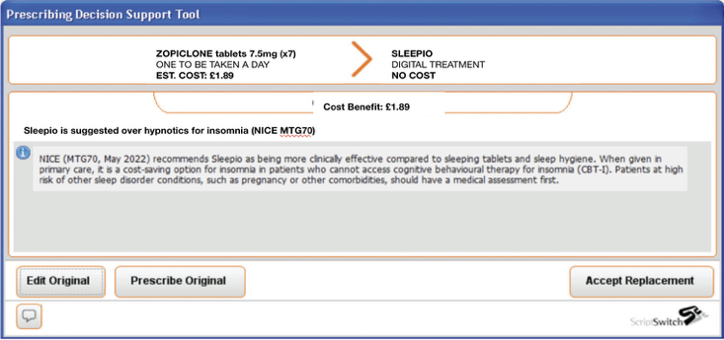
DOC-3907 Effective Jun 2025 ©2025 Big Health Inc. | CONFIDENTIAL & PROPRIETARY | Do not distribute
2. Miller et al (2020). White paper 3. Darden et al (2021) Sleep 4. Cheng et al. (2019). Sleep 5. McGrath et al (2017). American Journal of Hypertension 6. Fleming et al. (2024). Journal of Sleep Research 7. Henry et al. (2023). Journal of Affective Disorders 8. Henry et al., (2021). Journal of Sleep Research 9. Felder et al. (2020). JAMA Psychiatry 10. Kalmbach et al (2020). Sleep Med
Notes:
Key mentions would be: Stanford, UCSF, University of Oxford, University of Michigan
73% of real-world patients have a clinically meaningful response, defined as a 25% improvement in SCI-2 scores

Slide 15
What would most help you offer Sleepio to patients?

Slide 16
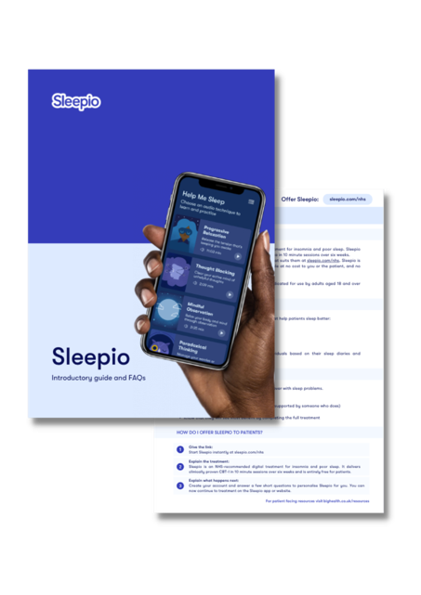
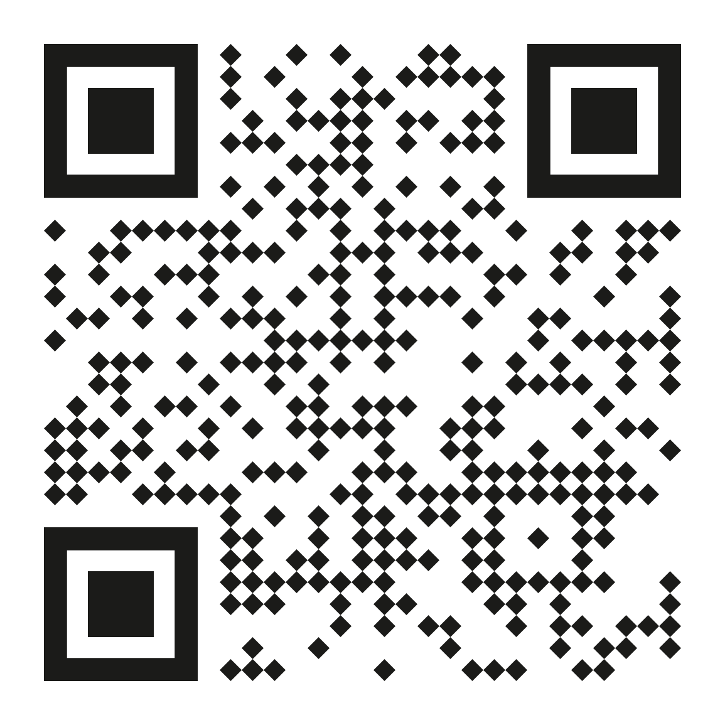
Sleepio resources for you and your team
Further information on Sleepio can be found at bighealth.co.uk/resources
Resources include
Scan for resources
✓ Sleepio FAQs
✓ Information for your website
✓ Clinician and patient poster
✓ Training presentation and video

Slide 17
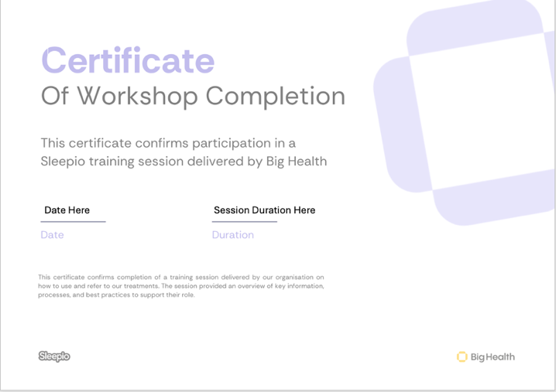
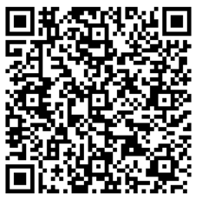
Thank you
Please fill out our feedback survey
Effective Jan 2026 ©2026 Big Health Inc. | CONFIDENTIAL & PROPRIETARY | Do not distribute

Slide 18
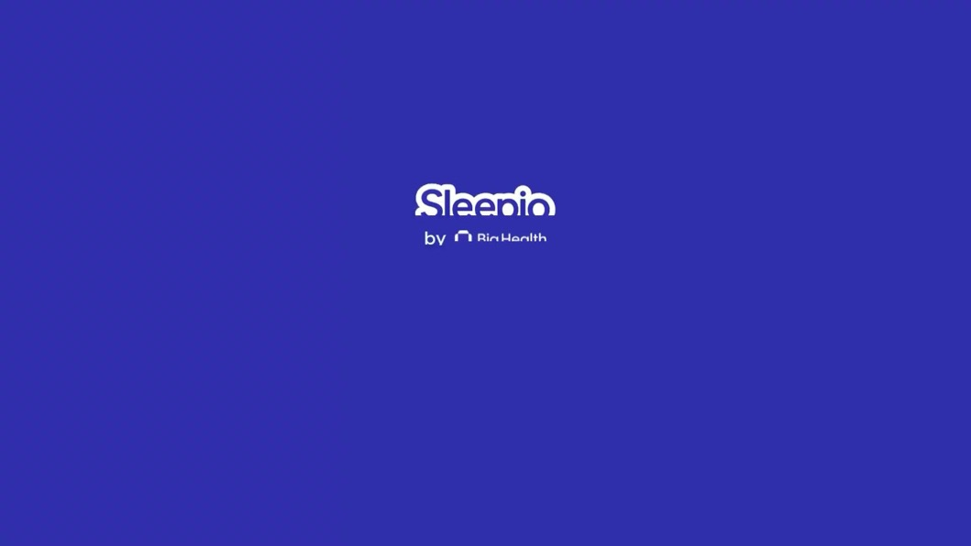
Patient case study - Brian
Notes:
Brian or Lynn -
BoB Data:
Avg of 19 entries per enrollee
15% responder rate across BoB

