Slide 1
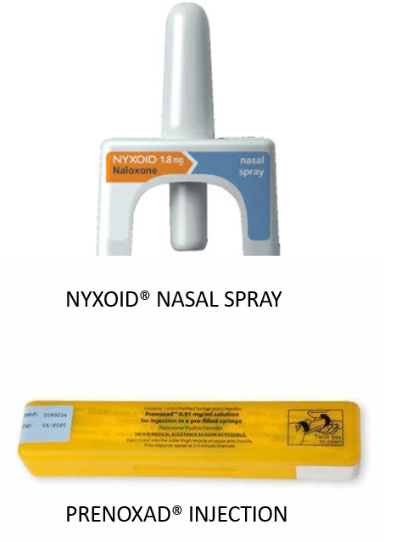
Naloxone Supply in Community Pharmacy
Substance Misuse Pharmacist Team as follows
Lucy Skea – Lead Specialist Pharmacist in Substance and Medicines Use NHS Grampian
Extended Team of Specialist Pharmacists
Alana Gibbs - Banff, Aberdeenshire
Andrew Mckechnie- Fraserburgh,Aberdeenshire
Euan Whittingham – Peterhead, Aberdeenshire
Kirsty Regan – Split Post between Moray Drug and Alcohol Service (MIDAS) and Inpatient Mental Health Wards Dr Grays, Elgin, Moray
Bethany Potter – Specialist Pharmacist, Aberdeen city, Base Timmermarket
Jill Carnegie –Specialist Pharmacist, Aberdeen city, Base Fulton Clinic
Gram.smspharmacists@nhs.scot
NALOXONE 1.26MG NASAL SPRAY

Slide 2
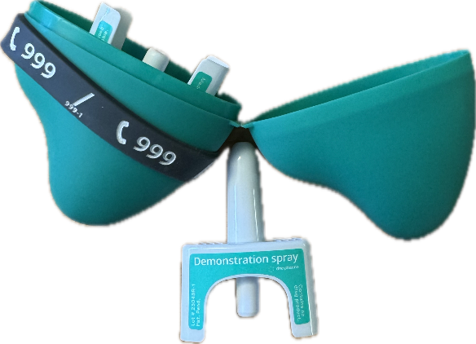
What Will We Cover?
  Information on Nitazenes, increase in fatal and non-fatal overdoses across Scotland
What is Naloxone and why is it important
Why is Community Pharmacy so important
The two community pharmacy naloxone services
How to make and record a Naloxone supply
Community pharmacy experience
Notes:
2023 figures

Slide 3
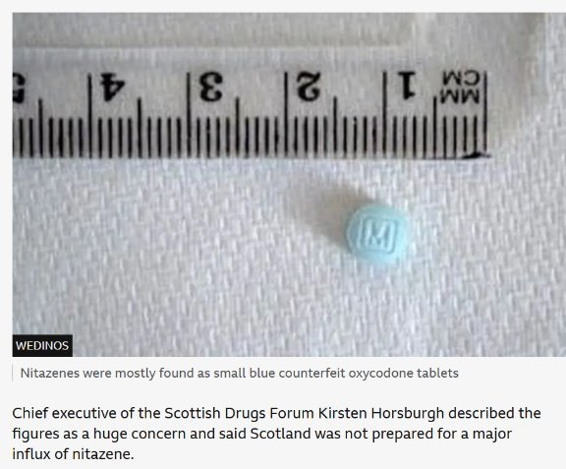
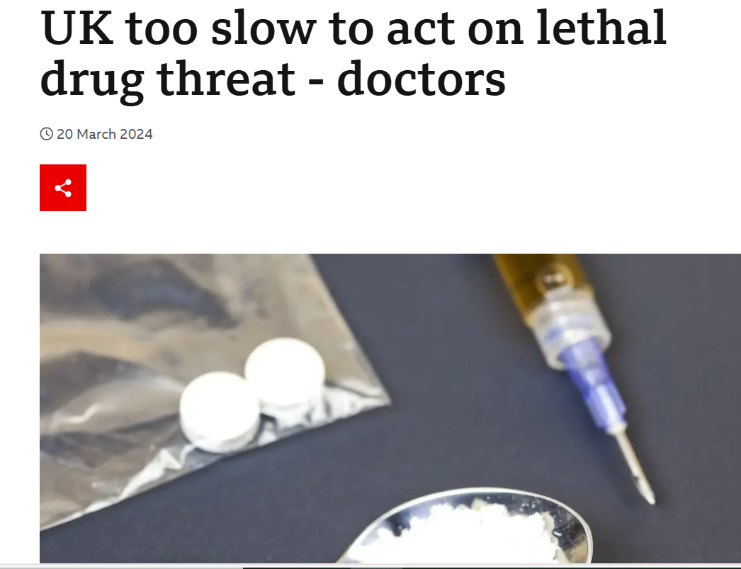
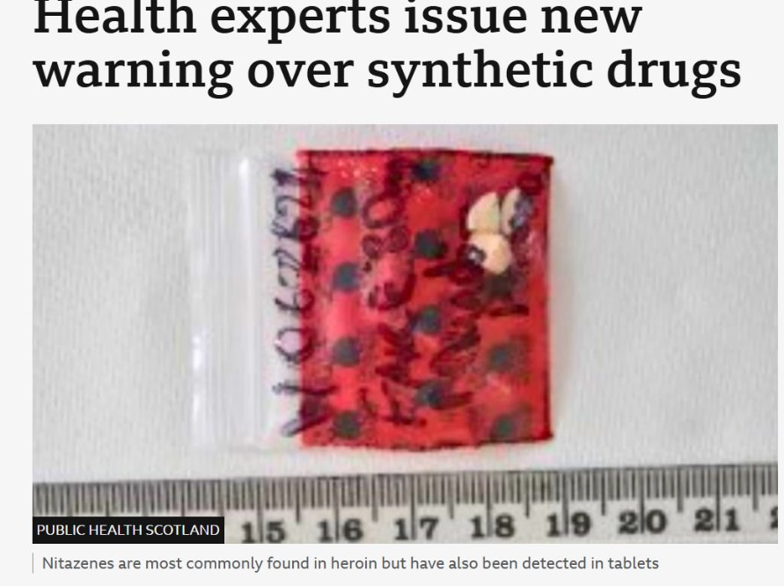
In November 2023, 40 overdoses were reported in Dublin in a 36-hour period, with traces of a “nitazene-type substance” found in heroin supplies​​.
NITAZENES : SYNTHETIC OPIOIDS
Notes:
Some Uk Drs had called for action in March 2024, they felt there was not enough sharing of the reports around nitazenes, that there was a failure in collecting data etc... New opioids have arrived in the UK in the last two years, called "nitazenes". They have recently been found mixed with heroin, with some being sold as illicit oxycodone pills or even Xanax powders

Slide 4
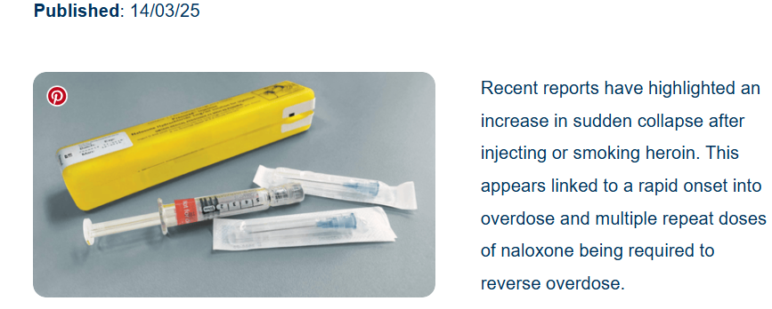
Concerns Grow after sudden increase in Overdoses
Everything you need to know about nitazenes - The Pharmaceutical Journal
Multiple doses of naloxone needed to reverse drug overdoses, pharmacists warned - The Pharmaceutical Journal
Notes:
Just some of the headlines in Pharmacy and posted via Community Pharmacy Scotland warnings

Slide 5
Why are Nitazenes so Dangerous?
Nitazenes, which are illegal in the UK, are synthetic drugs produced in laboratories. They are similar to heroin and morphine, but can be several hundred times more potent, so overdose can be rapid!!
This increased potency added to the fact that majority of people are using/and or prescribed more than one central nervous system depressant, leads to a much greater risk of a sudden rapid overdose occurring .
The vast majority of people taking drugs do not expect to die from an overdose!!
Notes:
Although overdose is more common/higher risk in those who inject.. Even people smoking what is perceived as small amounts are overdosing.

Slide 6
Nitazene Drugs Linked to Rise in Drug Deaths
Latest update released July 25 from Public Health Scotland (PHS) revealed there were 312 suspected drug-related fatalities between March and May 2025, a 15% rise on the previous quarter
PHS suspected drug death data is based on police reports and is different to the finalised figures published annually by National Records of Scotland (NRS), external.
Notes:
Health experts have issued a new warning over synthetic drugs which could explain a sharp rise in suspected drug deaths.

Slide 7

RADAR: Rapid Action Drug Alerts and Response
(RADAR) is Scotland’s drugs early warning system.
Using innovative data collection methods, RADAR validates, assesses and shares information to reduce the risk of drug-related harm by:
identifying new and emerging harms, recommending rapid and targeted interventions
Find out more about the reporting form and how to get involved.
Reports comprise of a set of Harm Indicators, Toxicology indicators, Testing indicators, Trends and Service Indicators
Notes:
RADAR stands for Rapid Action Drug Alerts and Response, its scotlands drugs early warning system. Reports comprise of a set of Harm Indicators, Toxicology indicators, Testing indicators, Trends and Service Indicators. I will take you through some of the detail of these in next few slides

Slide 8
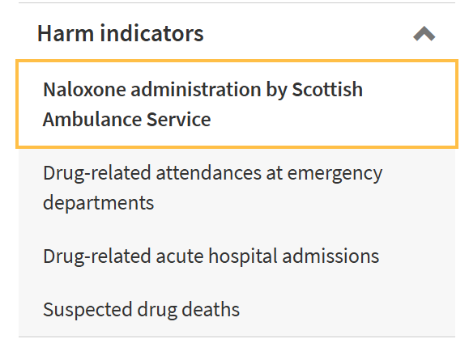
Naloxone Administered by SAS
Between March and May 2025, there were 1,089 Scottish Ambulance Service naloxone administration incidents (weekly average 84).
The total number of incidents during this time was:
45% higher than the previous quarter (752; weekly average 58)
similar (2% higher) compared to the same period in 2023 (1,066; weekly average 82)
9% higher than the same period in 2024 (1,002; weekly average 77).
NHS Grampian saw 118% increase in SAS naloxone incidents
Notes:
One of the Harm indicators is Naloxone Administered by Scottish Ambulance Service, here I have pulled out some data from most recent report, shows the increase in use and then you can see specifically the increase in Naloxone administration in Grampian

Slide 9
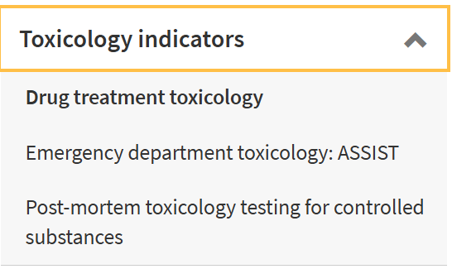
Post-mortem toxicology testing for controlled substances
Post-mortem toxicology testing for controlled substances
Between January and March 2025, the most common drug types detected in post-mortem toxicology were opioids (72%) and benzodiazepines (49%).
The most commonly detected individual drugs were:
heroin/morphine (36%)
cocaine (33%)
diazepam (28%)
methadone (24%).

Slide 10
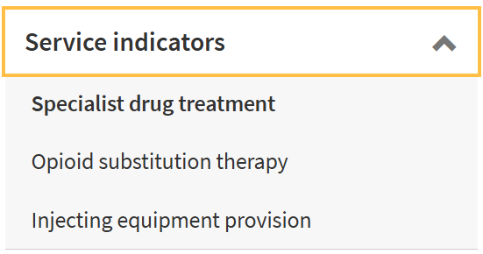
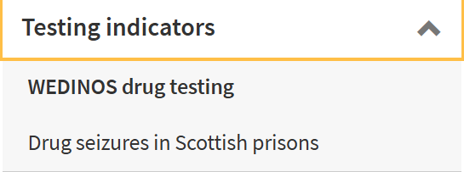
Service indicators and Testing Indicators

Slide 11
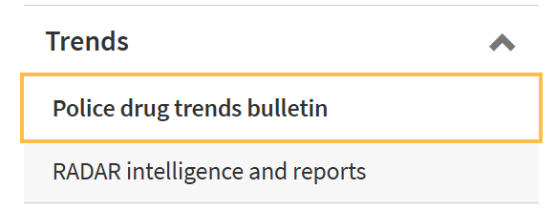
Drug Trends
The purposes of Police Scotland’s Statement of Opinion (STOP) bulletin are to raise awareness of drug trends and to demonstrate some of the substances present in Scotland's drugs market.
Notes:
Although ketamine has been in the illicit drugs market for decades, the STOP Unit have noted an increase in the recovery and identification of ketamine, particularly among younger people.

Slide 12
Public Health Scotland RADAR
https://scotland.shinyapps.io/phs-drugs-radar-dashboard/
Notes:
This is publically accessible , allows you to search NHS Grampian specific data

Slide 13
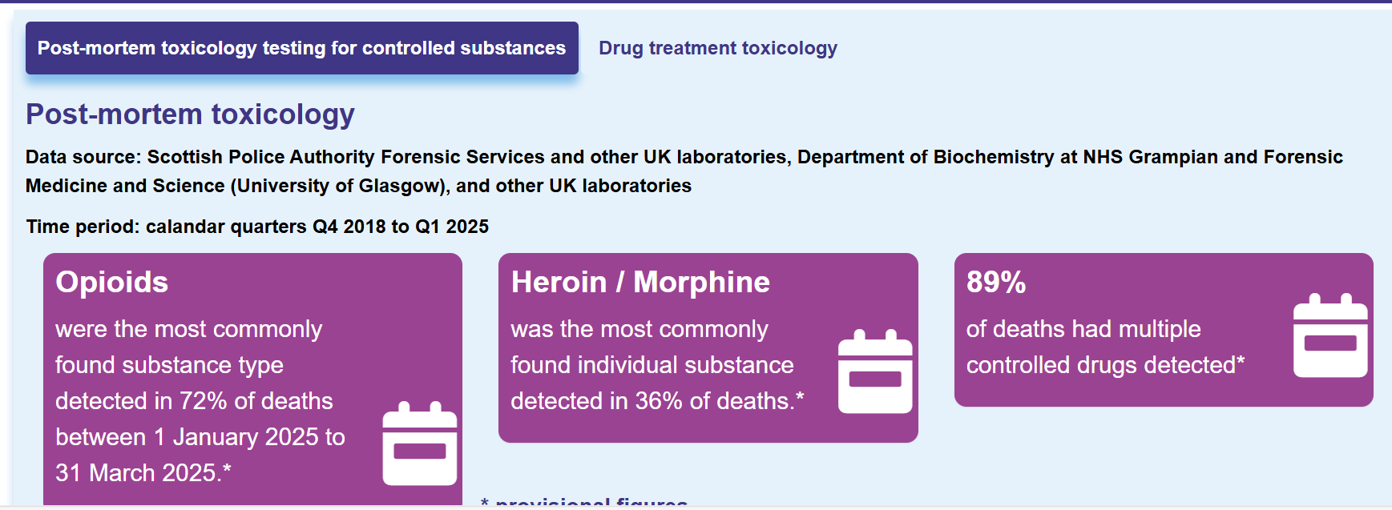
Public Health Scotland RADAR dashboard data

Slide 14
Definition/Terms related to an overdose
The use of any drug in such an amount that acute adverse physical or mental effects are produced
A drug overdose (overdose or OD) is the ingestion or application of a drug or other substance in quantities much greater than are recommended
Opioids are the deadliest drug type; at least one type of opioid is a factor in 71.76% of ODs. Opioids kill more than three (3) times as many people as cocaine. OD deaths rank just below diabetes in terms of highest death count

Slide 15
Where to prescribed Opioids fit in.....?
We all know Opioids are a type of medicine that help relieve pain. They are very effective over short periods to relieve moderate to severe pain. They are also sometimes prescribed for long periods to relieve pain in serious conditions. Examples of opioids include codeine (including co-codamol), tramadol, fentanyl, morphine, oxycodone and tapendadol.
All Opioids carry a serious risk of Dependence, tolerance and for some addiction, especially with long-term use.
Overview | Medicines associated with dependence or withdrawal symptoms: safe prescribing and withdrawal management for adults | Guidance | NICE
Notes:
So we have been talking a lot about nitazenes, but all opioids carry a risk of unintentional overdose, all opioids carry warning notices in leaflets about the risk and that this increases when they are combined with other drugs that can suppress the CNS... remember in simple terms any drugs that carry a warning can cause drowsiness/ don’t operate machinery etc are drugs that will suppress the central nervous system.. This inlcudes antihistamines, some antidepressants. Its not just opioids and benzodiazepines, gabapentinoids are powerful CNS depressants and can have predictable and unpredictable affects alongside opioids.. Age can have an impact, illness etc

Slide 16
For further information on using opioids safely, see the MHRA Opioid Safety leaflet letter
Taking too much opioid medicine is called an overdose, whether it’s intentional or not. This can be very serious and may cause death.
Some of the signs of an overdose include:
confusion or hallucinations
slurred speech
lips or fingernails are blue or purple
poor coordination or balance
unresponsive or unconscious
heavy or unusual snoring
difficulty breathing or no breathing
very small pupils in the eyes
Your family, friends, and carers should know these signs so they can take immediate action.
If you think that you or someone else has taken too much of their opioid medicine, dial 999 immediately
Notes:
All Prescribed or OTC opioids carry warning labels of the risk of overdose and that this is increased if taken in combination with other CNS depressants and or alcohol or illicit drugs. This slide is an extract taken from the Opioid Safety Leaflet, its really helpful to go through the different risks for a patient prescribed any opioid

Slide 17
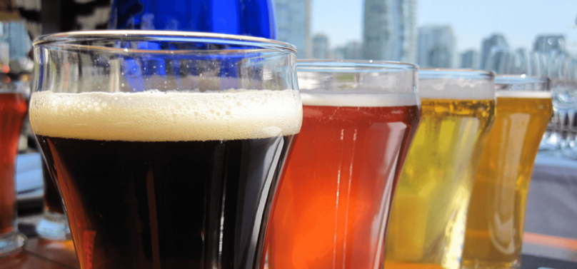
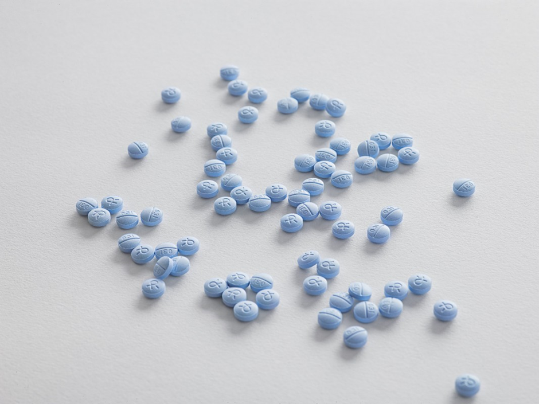
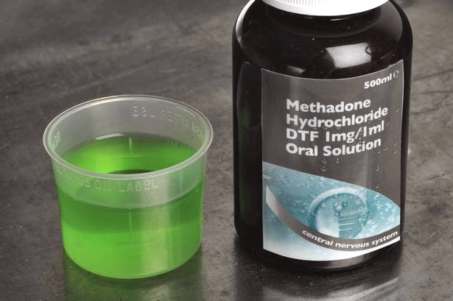
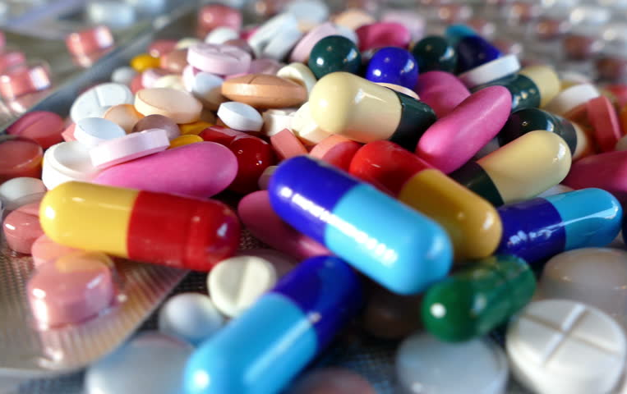
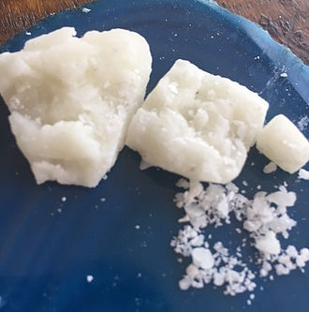
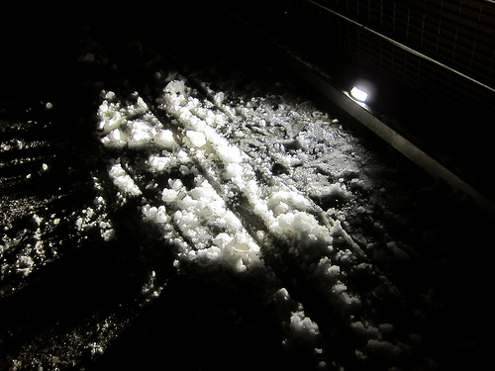
In 2023 83 people died in Grampian -Drug related deaths are ACCIDENTAL and PREVENTABLE
The following substances were most commonly found in Scotland’ drug related deaths in 2023. The percentage shows the number of people who died with them in their system. This landscape can change with time
ALCOHOL
16% Grampian
12% Scotland
BENZODIAZEPINES
41% Grampian
57% Scotland
OPIOIDS
77% Grampian
82% Scotland
GABAPENTINOIDS
28% Grampian
35% Scotland
COCAINE
50% Grampian
35% Scotland
Notes:
We are likely to see an increased number of people have lost their lives when the next official drug related death figures are released

Slide 18
Why Community Pharmacy
Community Pharmacies are situated in nearly all communities
Higher number of community pharmacies in deprived areas
Often have good relationships with people
Some pharmacies provide injecting equipment , it may be the only service and individual is accessing .. therefore only route to naloxone supply...
Notes:
One of our key roles is to do our best to keep the public safe and reduce harm from medicine
Publically Accessible ! Open at weekends and some even open in evenings
No appointments necessary
Experts in medicines and counselling on medicines use

Slide 19
Why Community Pharmacy
All Pharmacies that are contracted to provide opioid replacement therapy , Should be providing every patient with overdose awareness advice and regular offer to provide naloxone
Community Pharmacy staff will usually have the most frequent contact with patients on ORT more than any other healthcare professional, thus lots of opportunities to discuss/offer naloxone
Research has shown many positive outcomes for people who use substances through interventions made by community pharmacy teams

Slide 20
We really need more supplies of Naloxone to be issued from Community Pharmacies
Total number of pharmacies in NHS Grampian is 130 (125 signed up to level 1 SMS SLA)
The number of pharmacies that have recorded making a supply of naloxone to anyone in the past 12 months is only 17 (data extracted from NEO)
9 Pharmacies in City, 7 in Aberdeenshire and only one pharmacy in Moray
Number of Pharmacies that provide Needle Exchange in Grampian is currently 27, of those only 15 have recorded making a supply of naloxone in the last year
Therer are over 2000 patients on ORT in Moray, City and Shire
Its not just patients that are on ORT that are at risk of opioid OD, this does not include those that might witness an OD e.g family and friends...
Notes:
Sometimes the feedback we get is that " no one is asking for it" but we need Naloxone to be proactively discussed and offered to those at risk, there should be no stigma around naloxone, we need pharmacy staff to be aware of the groups of people/patients that may benefit from having the training and a supply. Having posters to advertise this to the general public such as those available from Health information resources could help highlight this in your pharmacy.

Slide 21
Time to find out more about Naloxone
Bethany Potter, Specialist Pharmacist with Aberdeen City
Based Timmermarket

Slide 22
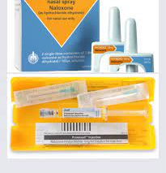
What Is Naloxone?
82% people in Scotland (77% Grampian) who died had an opioid drug present in their system
The majority of deaths occur in someone’s home - In many cases another person is present
If naloxone was available and those present able to use it, lives may have been saved
Specific opioid-antagonist that acts competitively at opioid receptors.
Safe and easy to use -Safe to administer even if you don't know what has been taken. It will NOT reverse the effect of other types of drugs e.g. cocaine or diazepam BUT - If these other drugs are present, it may remove enough ofthe opioid to help.
Helps to restore consciousness and improve breathing. Buying time for an ambulance to arrive
Temporarily reduces the effects of opioid drugs for a short time (around 30 to 90 minutes).

Slide 23
WHO CAN HAVE A SUPPLY OF NALOXONE?
Anyone Who is at Risk of, or Might Witness an Opioid Overdose.
ANYBODY can administer naloxone for the purpose of saving a life
People who use prescription opioids – in particular those taking higher doses
People who use any type of opioid in combination with other sedating substances such as benzodiazepines or alcohol
People who us any type of opioid and have medical conditions such as HIV, lung, liver disease or who suffer from depression
People with opioid dependence, in particular following reduced tolerance
People who inject opioids
Anyone in contact with people who use opioids (in all categories above). Community pharmacies can issue naloxone to people who work for a service on a named basis – but can't issue to a generic service
Think about who you should be offering Naloxone to

Slide 24
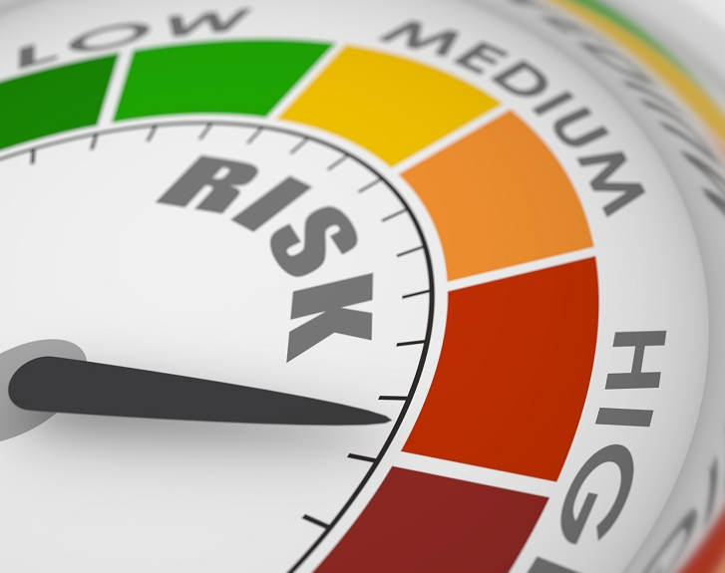
Risk Factors for Overdose
Just left residential rehabilitation or hospital
Recent detoxification
Periods of relapse
Life events e.g. bereavement, relationship breakdown
Change in social circumstances e.g. Loss of home or job, benefits rebate
Festive periods, weekends & holidays
Poly-drug use
Release from prison
Anything that reduces a person’s TOLERANCE to drugs
Change in physical or mental health
Notes:
Tolerance is a person's diminished response to a medication or substance, which occurs when the medication or substance is used repeatedly and the body adapts to the continued presence of the medication or substance.
Relapse can be to any substance

Slide 25
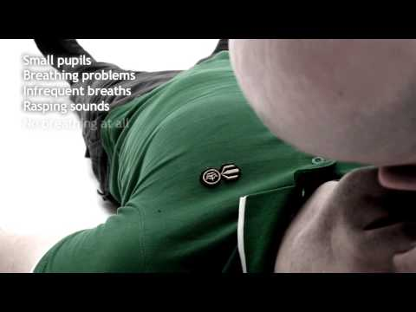
Signs of opioid overdose

Slide 26
Signs of overdose
People may be:
unconscious
unresponsive
awake, but unable to talk
vomiting
making choking sounds, or a snore-like gurgling noise
They may also have:
stopped breathing or have slow, shallow or erratic breathing
bluish purple skin (in lighter skinned people) or greyish or ashen skin (for darker skinned people)
a limp body
a pale or clammy face
blue or purplish black fingernails and lips
slow, erratic or no pulse (heartbeat)
Notes:
Very briefly cover this – if query it MAY be an overdose administer naloxone

Slide 27
KEEP IT SIMPLE
If a person doesn't respond to you shaking their shoulders and calling their name, it’s time to take action

Slide 28
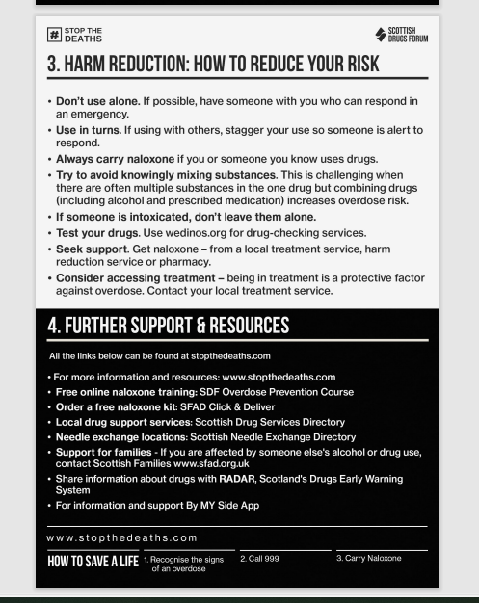
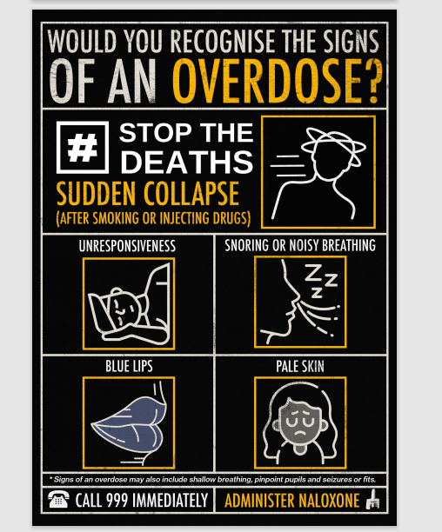
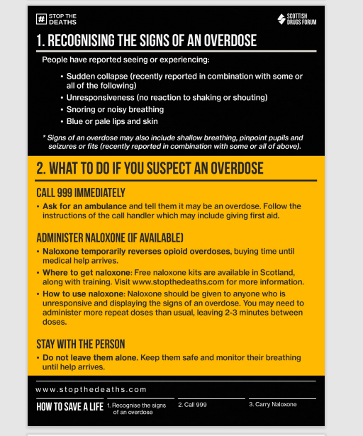
Poster Resources from SDF

Slide 29
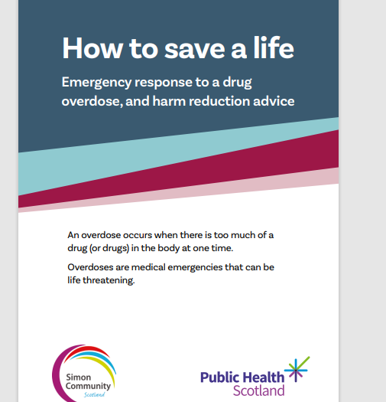
How to save a life. Emergency response to a drug overdose, and harm reduction advice
Notes:
Available from Public Health Scotland, contains advice about signs and symptoms of overdose due to different drugs such as stimulants and depressants, also available in different languages

Slide 30
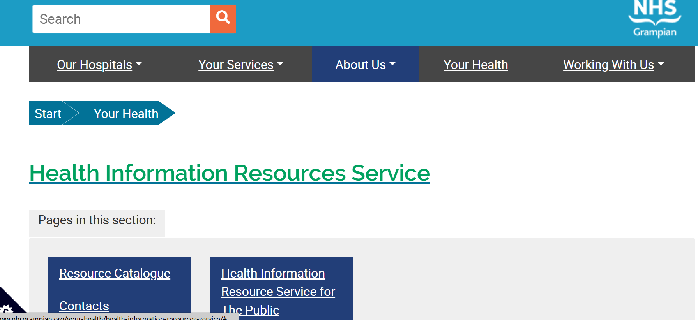
Health Info Resources Service NHS Grampian
Notes:
You can search the catalogue with key work naloxone or overdose to see what can be ordered
Resources can be mailed to a local GP practice and then collected from the Pharmacy (tell the practice if you expecting something)

Slide 31
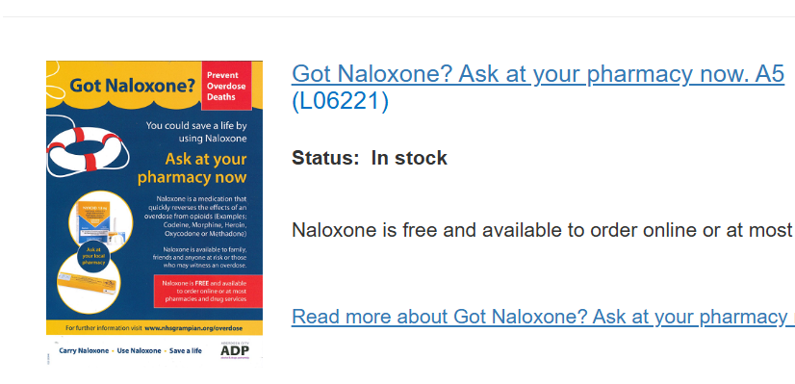
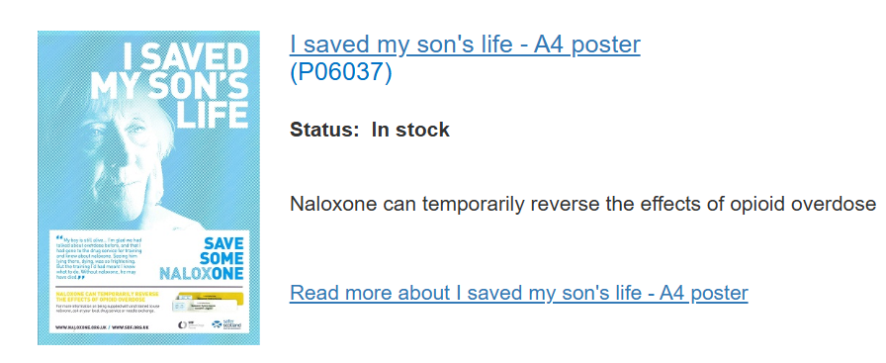
Examples of Resources to order to advertise HPAC

Slide 32
HOW TO ADMINISTER NALOXONE
This advice applies for when naloxone is to be administered in an "emergency situation" as well as the training points that should be covered when people are issued with a "take home supply"""

Slide 33
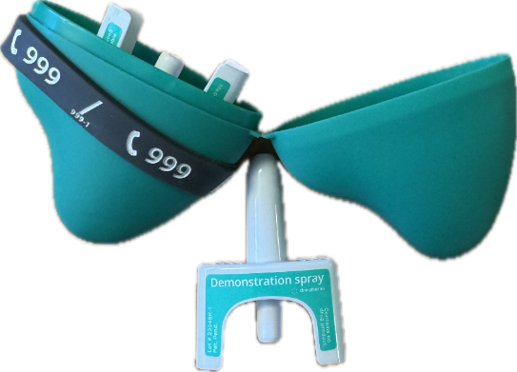
Naloxone products
NALOXONE 1.26MG NASAL SPRAY
There are 3 naloxone products available (as well as an IV product)
  Prenoxad IM injection
  Nyxoid 1.8mg nasal spray
  Naloxone 1.26mg nasal spray (sometimes referred to as the pebble)
Note there is an additional IM naloxone available that does not include needles in the pack. Prenoxad kits contain 2 needles for use

Slide 34
Safety first
Encourage people (or you) to consider their own safety before taking action.
Follow the“S.A.F.E.”approach:
SHOUT for help
APPROACH with care
Ensure area is FREE from danger
EVALUATE if safe to take action
Take someone with you
Do you need anything else – gloves?
Call an ambulance and stay with person till it arrives
Even if unsure call an ambulance – operator can support with how to use naloxone if needed

Slide 35
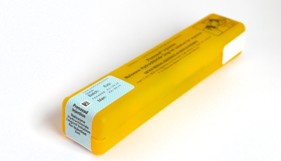
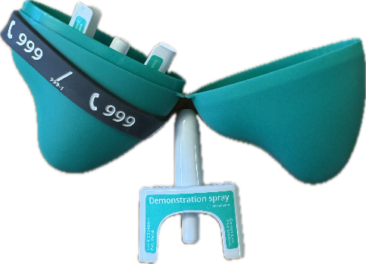
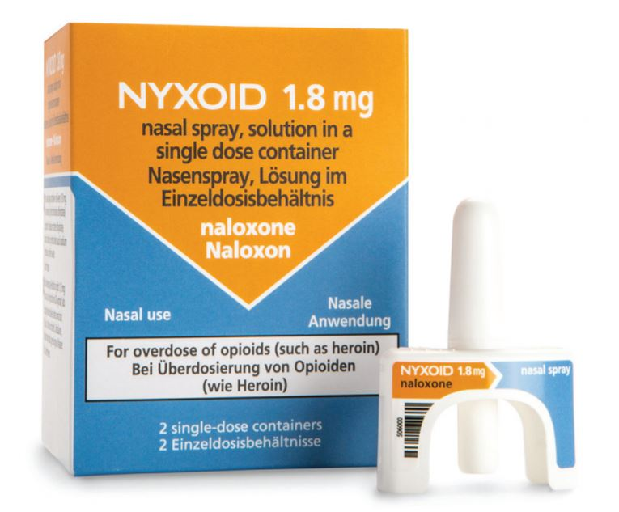
FOR PRENOXAD, NYXOID AND NALOXONE NASAL SPRAY
Administer one dose every 2 – 3 minutes until...
The person responds – put in recovery position and stay with them OR
The emergency services arrive and take over OR You have no naloxone left
Multiple doses may be required, so may need more than one kit.

Slide 36
The Recovery Position and Basic Life Support
Where does Naloxone fit in?
Notes:
Highlight this is not a full basic life support training course

Slide 37
IN OVERDOSE, THE PERSON WILL BE UNCONSCIOUS...
AND BREATHING = RECOVERY POSITION + NALOXONE
OR NOT BREATHING = BASIC LIFE SUPPORT + NALOXONE

Slide 38
How to use the Different Naloxone Products
Notes:
Highlight this is not a full basic life support training course

Slide 39
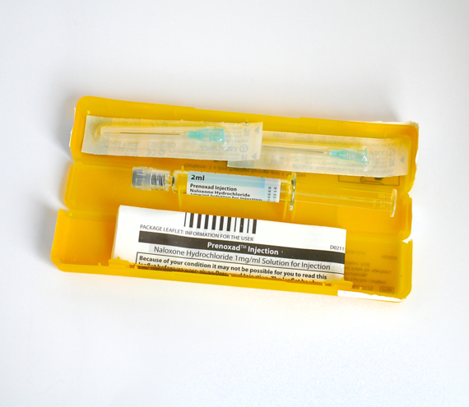
Naloxone intramuscular Injection "Prenoxad"
Box contains one pre-filled syringe with 5 x doses of naloxone (0.4mg) plus 2 needles
Must be PRENOXAD brand of naloxone - others don’t contain needles
INTO MUSCLES - Administer in thigh or upper arm muscle, through clothes is fine!
Put back in yellow plastic box to dispose of / protect from needles after use
Dosing on the side of the barrel is in dose number – not volume
Licensed from 18 years old

Slide 40
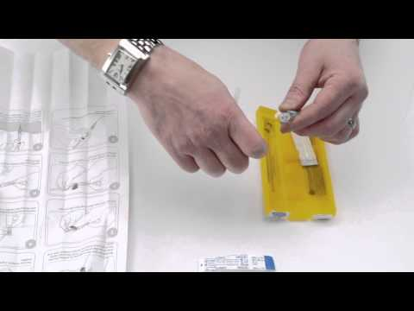
How to use Prenoxad Injection – Demo or video

Slide 41
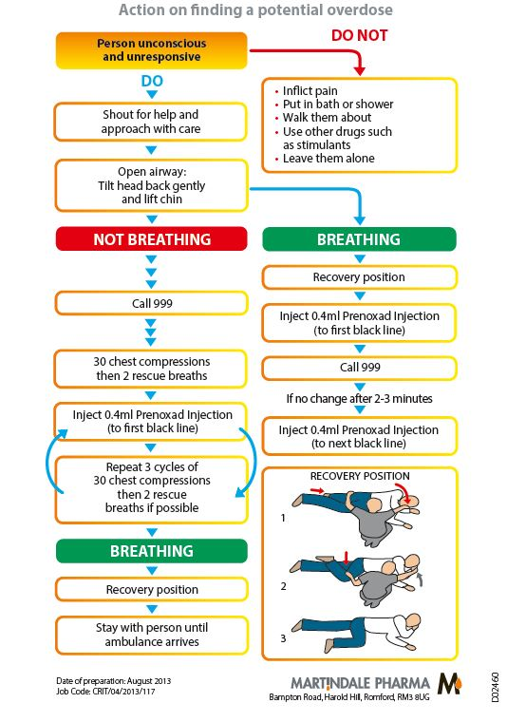
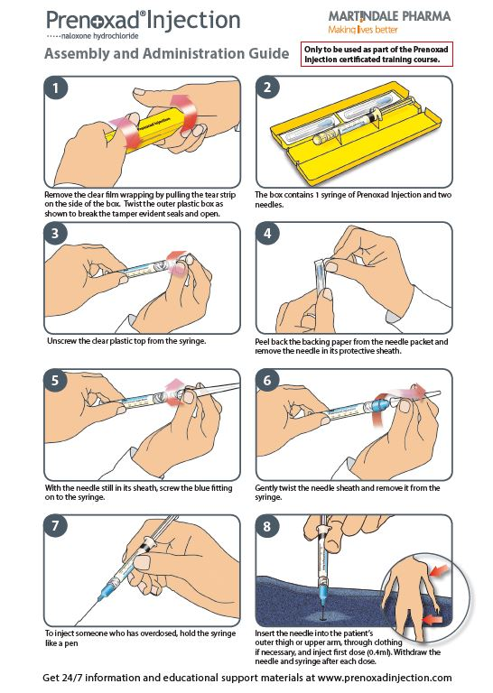
Tear off Instruction Leaflet Available
NHS Grampian resources
www.nhsghpcat.org
Other naloxone resources also available

Slide 42
NALOXONE NASAL SPRAY "NYXOID"
Box contains TWO nasal sprays
Each spray contains ONE DOSE of naloxone (1.8mg)
Do not test - when it’s gone it’s gone!
Administer the contents of one spray into the nostril
Use the other nostril for the next dose
Licensed from 14 years old

Slide 43
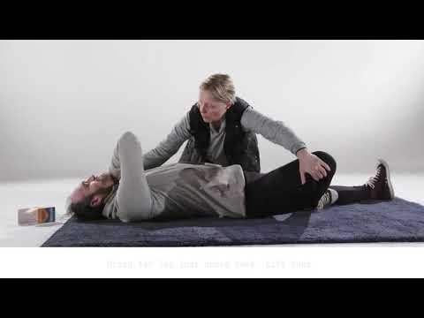
How to use Nyxoid Nasal Spray – demo or video

Slide 44
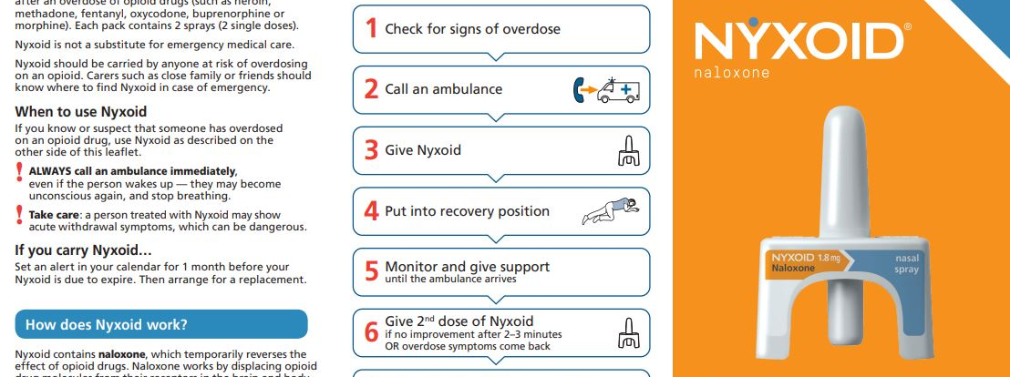
Leaflet available
www.medicines.org.uk/emc/rmm/1278/Document

Slide 45
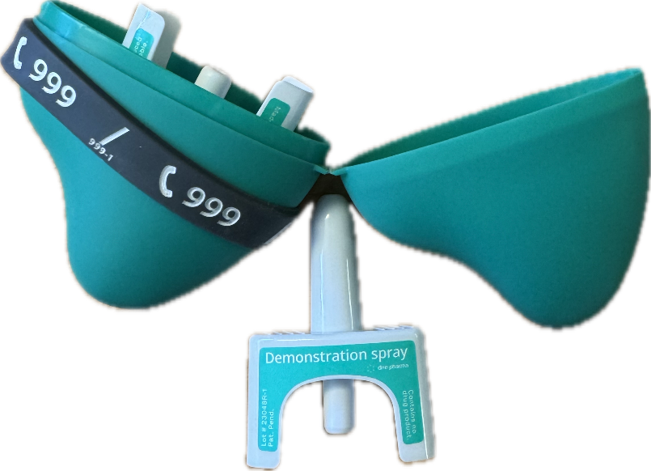
NALOXONE 1.26 MG NASAL SPRAY
Box contains TWO nasal sprays
Each spray contains ONE DOSE of naloxone (1.26mg)
Do not test - when it’s gone it’s gone!
Administer the contents of one spray into the nostril
Use the other nostril for the next dose
Same device as nyxoid but case may make it easier to people to carry.
Naloxone dose is slightly lower.
Licensed from 14 years old
Notes:
All products should have a similar onset of action however intranasal products concentrations can tend to rise for a longer period of time which MAY result in more severe withdrawal symptoms.
If there is large amount of mucus this can affect the absoprtion of IN naloxone
People may also give full cylinder of IM rather than individual doses.

Slide 46
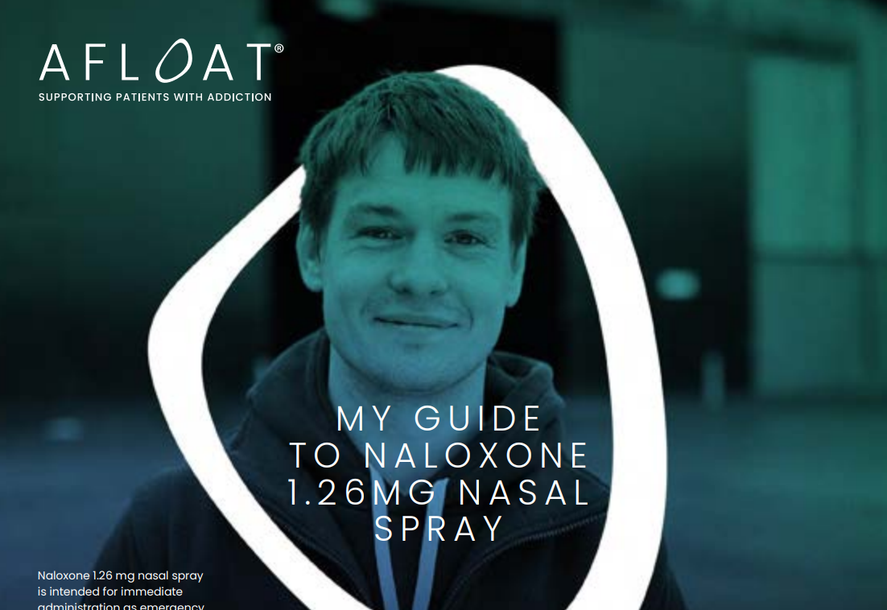
Naloxone 1.26mg nasal spray website
Prescribed Naloxone 1.26mg Nasal spray / likely to witness an opioid overdose | Naloxone United Kingdom

Slide 47
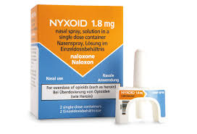

Q: NYXOID, NALOXONE 1.26MG NASAL SPRAY OR PRENOXAD – WHICH IS BEST FOR PATIENTS ?
A: THE ONE THAT WILL BE USED!
A single dose of either should work in roughly the same time
Naloxone 1.26mg nasal spray might be better for people who are less likely to carry naloxone on them
Nyxoid might be better for
  Younger people – licensed from 14 years
  People who won’t take the injectable product e.g. Don’t like injections, Family members, non-clinical service workers
  People who have refused naloxone in the past
Check what the person's preference is

Slide 48
Q: NYXOID, NALOXONE 1.26MG NASAL SPRAY OR PRENOXAD –WHICH IS BEST FOR AN EMERGENCY?
A: THE ONE THAT YOU FEEL CONFIDENT USING!
Remember multiple doses might be needed – think about number of kits given/taken
Prenoxad is injectable – but designed to be easy to use
Notes:
0.4mg prenoxad is the same as 1.8mg nyxoid. Have rougly same onset of action but IN might continue to rise and last longer as levels can continue to rise.

Slide 49
MAKING SUPPLIES OF NALOXONE

Slide 50
There are two services available through community pharmacies that enable you to supply Naloxone.
Local Service Level Agreement for “take home” Naloxone
National Naloxone Emergency Supply Service

Slide 51
Local SLA for take home supply- who may be supplied?
  Allows pharmacies to provide training and issue people with a “take home” supply of naloxone for future use.
    Those at risk of an opioid overdose (think people on ORT, high dose opioids, people accessing injecting provision equipment services, anyone known to use substances due to the unknown content of illicit substances)
    People who are likely to witness an opioid overdose e.g. carers, family members, partners, friends
    Organisations and businesses likely to be in contact with people that are at risk of opioid overdose (non-clinical settings) e.g. hostels, homeless shelters etc. (note a supply should be made to the individual asking for the supply and not the organisation)

Slide 52
Local SLA for take home supply- pharmacy requirements.
  It is a requirement of all pharmacies who are signed up to deliver the SMS level 1 SLA to proactively supply naloxone as a “take home supply” to people. Pharmacies not signed up to SMS level 1 SLA can sign up to the Naloxone take home supply service.
  SLA_Level_1_Substance_Use_Service_25.26.docx
  2024-Revised-SUS-Guidance-Document-1.docx
  Any staff member who has completed the relevant training can supply Naloxone (stated in Guidance for Drug Treatment Services Undertaking Supply of Naloxone to People at Risk of Opioid Overdose, Significant other and Services in Contact with those at Risk )
    It does not need to be a pharmacist.
  It is suggested that the training be completed every 3 years

Slide 53
Local SLA for take home supply- patient supply
  People should be given training on naloxone before being supplied with a kit
  If they have already been given training there is an option to select this – but good practice to cover basic points again
  Go over different products and give training on the product that people are most comfortable using
  Multiple kits can be issued
  Kits supplied via the take home naloxone service should be labelled with address of the pharmacy supplying.

Slide 54
Local SLA for take home supply- patient supply
  Further information on training requirements and issuing a supply can be found:
    Naloxone training and supply SLA
      SLA_Take-Home-Naloxone_25.26.docx
    Guidance for Drug Treatment Services Undertaking Supply of Naloxone to People at Risk of Opioid Overdose, Significant other and Services in Contact with those at Risk
      Guidance For Services In Grampian To Supply Naloxone To People At Risk Of Opioid Overdose, Significant Others And Services In Contact With Those At Risk

Slide 55
Key points
How to identify overdose
How to respond
Call an ambulance
Basic Life Support or Recovery Position if you know how to do it
What does naloxone do?
Nyxoid, Prenoxad or naloxone nasal spray?
How to use it
Issue and record supply

Slide 56
Making supplies to people at risk or likely to witness overdose
BRIEF
Deliver as a brief intervention
SIMPLE
Keep it simple – focus on the key points
HAVE EVERYTHING HANDY
Naloxone kits, leaflet, Key information sheet

Slide 57

Discussing Drug Use
Help! I don’t feel confident discussing these different drugs”
That’s OK! You don’t need to know all the details to safely use, or give out naloxone
Naloxone can be administered even if you don’t know exactly what the person has taken. It won’t have any effect if opioids are not present
All you need to do is explain the risk of overdose to the person and the correct course of action to take.

Slide 58
What if someone refuses naloxone?
"I don’t like needles"
"I can’t have it in the house – what will my partner think?"
"Are you saying I’m not doing well?"
"My medicine is safe. My doctor prescribes it"
"I'm not using substances any more, I just take my methadone.."
THINK ABOUT HOW YOU MIGHT RESPOND
ARE THERE ANY OTHER BARRIERS YOU CAN THINK OF?

Slide 59
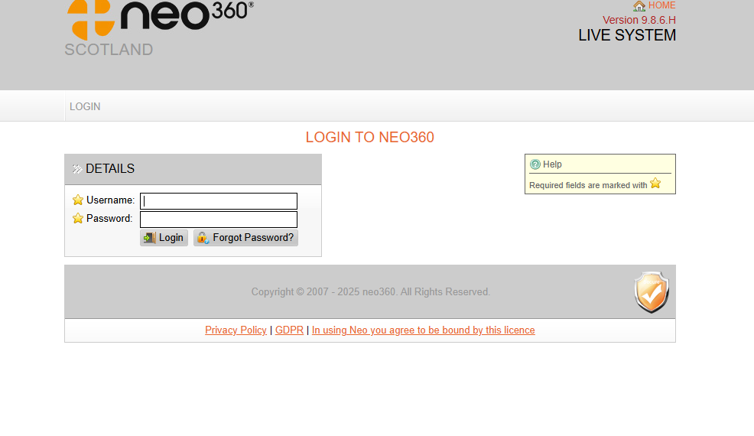
Local Service Level Agreement (SLA) for “Take Home” Naloxone training and Supply
  Recording
    Supplies should be recoded on NEO360
      Login to neo360
    Record supplies while person is there as you need their details and the Naloxone details
    If you need NEO360 access please email: gram.pharmaceuticalcareservices@nhs.scot. They can set up accounts, change passwords, add/remove staff
    Each staff member should have a log in. Each pharmacy will also have a site log in where reports can be done
    More support on the Community Pharmacy Substance use page – including support with using NEO360
    Substance Use Service (SUS) Addiction Support – NHS Grampian

Slide 60
Local SLA for take home supply- What fees can be claimed?
  Service Fees applicable:
    For naloxone supplies made to people who attend the pharmacy for opioid replacement therapy there is no separate supply fee applicable, this is because the monthly per patient fee includes the requirement to supply naloxone to patients as required.
    For supplies made to anyone else, a £15 training and supply fee can be claimed via the monthly claim's worksheet for each person supplied with kit(s)
    Stock reimbursement
    Stock for this service can be claimed for by submitting invoices to PCCT along with the monthly claims form.

Slide 61
National Naloxone Emergency Supply Service
  Previously a local service in Grampian but this has been replaced by the national service
  Pharmacist MUST hold a minimum of two naloxone kits for use in an immediate overdose situation (can be injectable or nasal)
  These are for use by pharmacy staff or for issuing to a member of the public for use in an immediate overdose situation
  The overdose does not have to be in the pharmacy, the naloxone can be issued to a member of the public to take to the site of the overdose for use
  Should have an SOP in place
  ALL pharmacy staff should be aware and have completed the overdose awareness and naloxone training specified in the circular
    Important as a member of the public may ask anyone in the pharmacy – delays could result in a delay to saving a life
Further information including training requirements can be found in the circular: https://static1.squarespace.com/static/6465418b5e15221808eb56ea/t/65ee33ae22855d10f9e34406/1710109615530/Circular%2BPCA%28P%29%282023%2934%2B-%2BAdditional%2BPharmaceutical%2BServices%2B-%2BNaloxone%2Bemergency%2Bsupply%2Bservice%2B-%2B12%2B09%2B23%2Bupdate.pdf

Slide 62
National Naloxone Emergency Supply Service
Recording
  Record via UCF under public health services
  Either use “Emergency Naloxone – Administered” or “Emergency Naloxone – Expired”
  Ideally record under the person who is overdosing CHI but you can record without a CHI
  If the person is not known you can use a “dummy patient” as below
  Use “dummy patient” for recording expired stock
  Can use consultation notes to record further details or follow company recording process
Dummy Patient
  Forename: Naloxone
  Surname: Naloxone
  DOB: 01/01/2000
  Address: 1 Any Street, NF1 1AB
No label is needed for naloxone administration in an emergency. This is covered in Schedule 19 of The Human Medicines Regulations 2012.
Reimbursement
    Initial two kits were funded at the start of the service
    Further kits are claimed as above

Slide 63
Community pharmacist experience

Slide 64
Community Pharmacy Experience
Scenario
A patient came running into the pharmacy saying that someone, who we knew as a regular, was unresponsive in a car in the carpark.
Given the patient’s history, my first thought was that this could be an opioid overdose, so I grabbed a naloxone nasal spray and headed straight out. Another member of staff called 999 right away.
When I got to the car, the patient looked like they were just sleeping, but they weren’t waking up even when we shook their shoulders and shouted their name. Patient was breathing but it was shallow and they were completely unresponsive.
I gave one dose of naloxone via nasal spray, then waited a few minutes. There was still no change, so I gave a second dose after 2-3 minutes. Unfortunately, there was no response after that either but thankfully the ambulance arrived not long after the second dose. In the end, I don’t think it was an opioid overdose, given the lack of effect.

Slide 65
Community Pharmacy Experience
What went well:
Having more than one staff member trained in naloxone use really helped. Everyone knew what to do and just got on with it.
The naloxone kits were stored in an easily accessible location in the dispensary, which saved time.
Having the nasal spray version in stock was a huge help. My hands were shaking with adrenaline, and I don’t think I’d have managed a needle in that moment so having a spray made things easier.
One thing to note: the nasal spray plunger needs a bit more pressure than you'd expect. In the moment, don’t worry about being too gentle, just make sure it gets done.
Things to follow up on:
We had to replace the naloxone kit used.
Staff involved were sent for a break afterwards.
We had to record the use of emergency naloxone through the patients PMR. There's also an NHS naloxone incident form which needs filled in and submitted to pharmaceutical care services. The template can be found in the SLA - worth having a look.
The patients GP and CPN were also informed of the incident.
After the event, everyone done a quick refresher session, just to stay confident with using the naloxone.

Slide 66
Community Pharmacy Experience: Emergency
Scenario: Distressed female ran in pharmacy to say their partner had overdosed and they needed naloxone now
Pharmacist grabbed a nyxoid kit and asked another member of staff to call an ambulance , female advised that her partner up the street in flat.
Pharmacist and assistant on adrenaline, made decision to run to flat , patient completely unresponsive to shout and shake, discarded drug paraphernalia and bodily fluids around flat
Administered two doses of nyxoid nasal spray according to instructions.. With no effect !
About to run back to pharmacy for more naloxone, when partner discovered a prenoxad kit on floor in persons flat
Two doses of prenoxad administered before finally a response from patient
Patient roused very suddenly, distressed, agitated, confused , angry , probably experiencing symptoms of opioid withdrawal due to the temporary affect that naloxone has by knocking opioids off the receptors
They wanted their methadone replaced as felt the naloxone had taken affect away, reassured them this was temporary
Patient refused further care from Ambulance on route and told them they did not want them to attend, became more agressive
Notes:
Fairly traumatic experience for all involved including the partner

Slide 67
Community Pharmacy Experience
What went well: Saved Patients Life
Had two members of staff attend
Support over the phone from Emergency services gave reassurance around giving further doses of Naloxone and what to monitor for
Pharmacist provided patient with further advice on what to do if they were to overdose again once the naloxone had worn off
Provided safety assistance for patients partner
Although previously would have felt naloxone nasal easier, found prenoxad very easy to use and would take both types of kit if there is a next time....
Things to follow up on:
We had to replace the naloxone kit used.
Wish had taken more than one kit of Naloxone, multiple doses were needed
Wish had taken gloves and or a mask as area was not particulary safe, always make sure you can exit safely
Felt motivated after to check that all pharmacies I work in have their naloxone kits to hand and staff know what to do.
Feel more inclined to start offering Naloxone take home pro-actively
Followed up with Local SMS service the next day to inform them their patient had overdosed and they were going to check in on them.
Followed up with SMS Pharmacist who recorded the sudden overdose on PHS RADAR.

Slide 68
Remember – you can help save a life!

Slide 69
Actions
Review training - all members of the pharmacy team should be aware of both services (emergency supply and “take home” supply) and have undertaken the appropriate training - suggestion of renewing training after 3 years
Review process/SOPS – are they being followed, do all staff know the process should they be asked for Naloxone (even if not involved in the supply staff should know the process if they are to be asked by someone)
Ensure all staff aware of the guidance for the two services
Consider how you can promote Naloxone
Ensure the Pharmacy has appropriate naloxone stock to provide the service (s)
Ensure naloxone stock is in-date, re-order if not and claim as per the service specification (s) - Note some Naloxone products are only supplied by certain wholesalers
Familiriase yourself with local treatment services and how to signpost to local services
Note: Naloxone does not need to be kept in a fridge, or CD cabinet – think about storing beside IEP, methameasure, etc so easily accessible

Slide 70
Still keen to find out more about different drugs or their overdose risks?
Scottish Drugs Forum (SDF) have eLearning including a Drug Awareness introduction as well as specific benzodiazepine and cocaine modules.
www.sdftraining.org.uk/e-learning
Public Health Scotland have a save a life leaflet that can be ordered
International Overdose Day website has fact sheets on the symptoms of overdose for different drugs in the campaign resources section
www.overdoseday.com/campaign-resources/
Crew 2000
https://www.crew.scot/

Slide 71
Further Resources
Grampian Take Home Naloxone Page (professionals): www.hi-netgrampian.scot.nhs.uk/naloxone/
Community Pharmacy Substance Use Page - Substance Use Service (SUS) Addiction Support – NHS Grampian
Grampian Public Facing Overdose Page: www.hi-netgrampian.scot.nhs.uk/overdose/naloxone/
SDF elearning module: www.sdftraining.org.uk/e-learning
Overview of changes in naloxone legislation (PHE, 2015) www.gov.uk/government/publications/widening-the-availability-of-naloxone/widening-the-availability-of-naloxone
Public Health England (PHE), Health Matters Tool/Website https://publichealthmatters.blog.gov.uk/2017/03/01/health-matters-preventing-drug-misuse-deaths/
Care Inspectorate - Health Guidance: Take Home Naloxone in Social Care Services: www.careinspectorate.com/images/documents/3203/Take%20Home%20Naloxone%20in%20Social%20Care%20Services.pdf
International Overdose Awareness Day Website: www.overdoseday.com/
Nyxoid leaflet: www.medicines.org.uk/emc/rmm/1278/Document
Prenoxad leaflets, booklets etc: www.medicines.org.uk/emc/product/3054/rmms
Naloxone 1.26mg nasal spray leaflets: https://naloxone.uk/
Leaflets can be ordered from: www.nhsghpcat.org
Scottish families affected by alcohol and drugs naloxone supply service -Click and Deliver Naloxone – SFAD
NHS Grampian naloxone suppliers - naloxone-suppliers-in-grampian-for-website-aug-23.pdf
TURAS emergency supply - Community Pharmacy Emergency Naloxone Holding Service | Turas | Learn

