Slide 1
Varenicline for smoking cessation SmPC Training Slides
0.5mg and 1 mg tablets
Teva UK Limited,
Field House,
Station Approach,
Harlow
Essex
CM20 2FB
Job Code: Vcli-GB-00049.
Date of Preparation: December 2024

Slide 2
Reference Product Information
The content of these slides are not exhaustive and should be read in conjunction with the SmPC
Teva UK Limited also distributes some third party products within our portfolio, varenicline products is one of these products. For further information on these third party products, please contact the Marketing Authorisation (MA) holder – Brown and Burk 0203 3847188 or info@bbukltd.com If you require further assistance, you can contact our Medical Information Service by email medinfo@tevauk.com, or call 0207 5407117.
Adverse events should be reported. Reporting forms and information can be found at www.mhra.gov.uk/yellowcard. Adverse events should also be reported to Teva using the Reporting Side Effects Form or email uk.safety@tevauk.com or telephone 0207 540 7117.
SPC’s
0.5mg Varenicline - https://www.bbukltd.com/wp-content/uploads/SPC//Varenicline-0.5-mg-film-coated-tablets_SPC.pdf
1mg Varenicline - https://www.bbukltd.com/wp-content/uploads/SPC//Varenicline-1-mg-film-coated-tablets-spc.pdf

Slide 3
Presentation contents
01
Smoking cessation
02
Summary of Product Characteristics
03
Clinical Information

Slide 4
01 Smoking cessation

Slide 5

Health impact of smoking
Tobacco use - leading cause of death and disability in England
Smoking - the leading cause of preventable heart disease, stroke, and respiratory illness; also associated with numerous other health effects
Two in three people who smoke will die as a result of their tobacco use
Smoking - causes 16 types of cancer and poorer outcomes among those receiving cancer treatment
Smoking during pregnancy is particularly harmful and associated with numerous adverse pregnancy and birth outcomes
https://www.ncsct.co.uk/library/view/pdf/Commissioning-delivery-and-monitoring-guidance.pdf (Accessed December 2024)

Slide 6


Economic impact of smoking in England
NHS
£ 1.9 billion per year
.
Smoking costs the economy
Social care cost
£ 15 billion per year
£49.2 billion per year
Lost productivity due to people who smoke being significantly more likely to become ill while working and be out of work
£ 32 billion per year
https://www.ncsct.co.uk/library/view/pdf/Commissioning-delivery-and-monitoring-guidance.pdf (accessed December 2024)

Slide 7
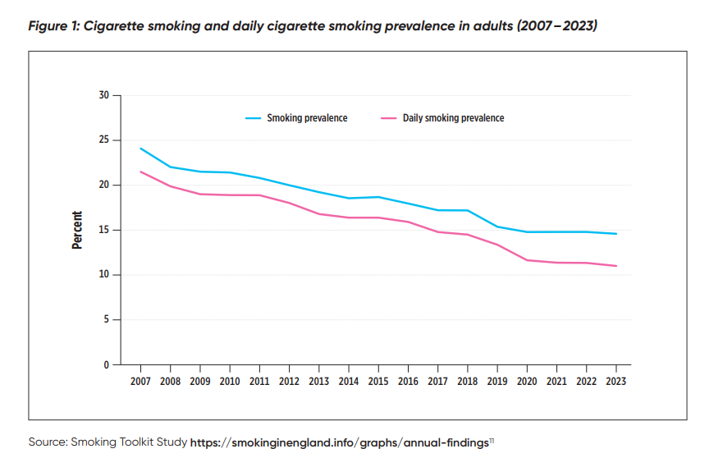
Smoking statistics
Rates of smoking have steadily reduced, from 24% in 2007 to 15% in 2023 (see Figure 1)
Despite this success, there remain more than six million people who smoke in England, with some parts of the country and segments of the population with very high rates of tobacco use
https://www.ncsct.co.uk/library/view/pdf/Commissioning-delivery-and-monitoring-guidance.pdf (accessed December 2024)

Slide 8
02 Summary of Product Characteristics

Slide 9
Treatment indications
Varenicline is indicated for smoking cessation in adults
Varenicline UK SmPC

Slide 10
Posology and method of administration
The recommended dose is 1 mg varenicline twice daily following a 1-week titration as follows:
Days 1-3
Days 4 -7
Day 8 – end of treatment
0.5 mg once daily
0.5 mg twice daily
1 mg twice daily
The patient should set a date to stop smoking. Varenicline dosing should usually start at 1-2 weeks before this date. Patients should be treated with varenicline for 12 weeks.
For patients who have successfully stopped smoking at the end of 12 weeks, an additional course of 12 weeks treatment with varenicline at 1 mg twice daily may be considered for the maintenance of abstinence.
A gradual approach to quitting smoking with varenicline should be considered for patients who are not able or willing to quit abruptly. Patients should reduce smoking during the first 12 weeks of treatment and quit by the end of that treatment period. Patients should then continue taking varenicline for an additional 12 weeks for a total of 24 weeks of treatment.
Patients who are motivated to quit and who did not succeed in stopping smoking during prior varenicline therapy, or who relapsed after treatment, may benefit from another quit attempt with varenicline.
Patients who cannot tolerate adverse reactions of varenicline may have the dose lowered temporarily or permanently to 0.5 mg twice daily.
In smoking cessation therapy, risk for relapse to smoking is elevated in the period immediately following the end of treatment. In patients with a high risk of relapse, dose tapering may be considered.
Varenicline UK SmPC

Slide 11
Special populations
Renal impairment
Severe impairment: recommended dose of varenicline is 1 mg once daily. Dosing should begin at 0.5 mg once daily for the first 3 days then increased to 1 mg once daily. Not recommended in end stage renal disease
Moderate impairment with experienced intolerable adverse drug reactions: Reduce the dose to 1 mg daily.
Mild - moderate impairment: No dose adjustment required.
Hepatic impairment
No dosage adjustment necessary.
Paediatric population
Not recommended.
Elderly
No dosage adjustment necessary.
Varenicline UK SmPC
Notes:
No differences in teriparatide pharmacokinetics were detected with regard to age (range 31 to 85 years)

Slide 12
Contraindications
Hypersensitivity to the active substance or to any of the excipients
Varenicline UK SmPC

Slide 13
Fertility, pregnancy and lactation
A moderate amount of data on pregnant women indicated no malformative or foetal/neonatal toxicity of varenicline.
Animal studies have shown reproductive toxicity. As a precautionary measure, it is preferable to avoid the use of varenicline during pregnancy.
It is unknown whether varenicline is excreted in human breast milk. Animal studies suggest that varenicline is excreted in breast milk. A decision on whether to continue/discontinue breast-feeding or to continue/discontinue therapy with varenicline should be made taking into account the benefit of breast-feeding to the child and the benefit of varenicline therapy to the woman.
There are no clinical data on the effects of varenicline on fertility.
Non-clinical data revealed no hazard for humans based on standard male and female fertility studies in the rat
Varenicline UK SmPC

Slide 14
Special warnings and precautions for use (1)
1
2
2
3
Effect of smoking cessation
Neuropsychiatric symptoms (1)
Neuropsychiatric symptoms (2)
History of psychiatric disorders
Physiological changes resulting from smoking cessation, with or without treatment with varenicline, may alter the pharmacokinetics or pharmacodynamics of some medicinal products, for which dosage adjustment may be necessary (examples include theophylline, warfarin and insulin). As smoking induces CYP1A2, smoking cessation may result in an increase of plasma levels of CYP1A2 substrates.
Changes in behaviour or thinking, anxiety, psychosis, mood swings, aggressive behaviour, depression, suicidal ideation and behaviour and suicide attempts have been reported in patients attempting to quit smoking with varenicline in the post-marketing experience.
Depressed mood, rarely including suicidal ideation and suicide attempt, may be a symptom of nicotine withdrawal.
Clinicians should be aware of the possible emergence of serious neuropsychiatric symptoms in patients attempting to quit smoking with or without treatment. If serious neuropsychiatric symptoms occur whilst on varenicline treatment, patients should discontinue varenicline immediately and contact a healthcare professional for re-evaluation of treatment.
A large randomised, double-blind, active and placebo-controlled study was conducted to compare the risk of serious neuropsychiatric events in patients with and without a history of psychiatric disorder treated for smoking cessation with varenicline, bupropion, nicotine replacement therapy patch (NRT) or placebo. The primary safety endpoint was a composite of neuropsychiatric adverse events that have been reported in post-marketing experience.
The use of varenicline in patients with or without a history of psychiatric disorder was not associated with an increased risk of serious neuropsychiatric adverse events in the composite primary endpoint compared with placebo
Smoking cessation, with or without pharmacotherapy, has been associated with exacerbation of underlying psychiatric illness (e.g. depression).
In a smoking cessation clinical trial, neuropsychiatric adverse events were reported more frequently in patients with a history of psychiatric disorders compared to those without a history of psychiatric disorders, regardless of treatment.
Care should be taken with patients with a history of psychiatric illness and patients should be advised accordingly.
Varenicline UK SmPC

Slide 15

Special warnings and precautions for use (2)
4
6
7
8
Seizures
Cardiovascular events
Cutaneous reactions
Hypersensitivity reactions
In clinical trials and post-marketing experience there have been reports of seizures in patients with or without a history of seizures, treated with varenicline. Varenicline should be used cautiously in patients with a history of seizures or other conditions that potentially lower the seizure threshold.
Patients taking varenicline should be instructed to notify their doctor of new or worsening cardiovascular symptoms and to seek immediate medical attention if they experience signs and symptoms of myocardial infarction or stroke
There have been post-marketing reports of hypersensitivity reactions including angioedema in patients treated with varenicline. Clinical signs included swelling of the face, mouth (tongue, lips, and gums), neck (throat and larynx) and extremities. There were rare reports of life-threatening angioedema requiring urgent medical attention due to respiratory compromise. Patients experiencing these symptoms should discontinue treatment with varenicline and contact a health care provider immediately.
There have also been post-marketing reports of rare but severe cutaneous reactions, including Stevens-Johnson Syndrome and Erythema Multiforme in patients using varenicline. As these skin reactions can be life threatening, patients should discontinue treatment at the first sign of rash or skin reaction and contact a healthcare provider immediately.
Treatment discontinuation
At the end of treatment, discontinuation of varenicline was associated with an increase in irritability, urge to smoke, depression, and/or insomnia in up to 3% of patients. The prescriber should inform the patient accordingly and discuss or consider the need for dose tapering.
Varenicline UK SmPC

Slide 16
Interaction with other medicinal products and other forms of interaction
No clinically meaningful interactions
Cimetidine
Use with other therapies for smoking cessation
Based on varenicline characteristics and clinical experience to date, varenicline has no clinically meaningful drug interactions. No dosage adjustment of varenicline or co-administered medicinal products listed below is recommended.
Meformin
Cimetidine
Digoxin
Warfarin
Alcohol
Bupropion
Nicotine Replacement Therapy (NRT)
Co-administration of cimetidine, with varenicline increased the systemic exposure of varenicline by 29% due to a reduction in varenicline renal clearance. No dosage adjustment is recommended based on concomitant cimetidine administration in subjects with normal renal function or in patients with mild to moderate renal impairment. In patients with severe renal impairment, the concomitant use of cimetidine and varenicline should be avoided.
Bupropion
Varenicline did not alter the steady-state pharmacokinetics of bupropion.
Nicotine replacement therapy (NRT)
When varenicline and transdermal NRT were co-administered to smokers for 12 days, there was a statistically significant decrease in average systolic blood pressure (mean 2.6 mmHg) measured on the final day of the study. In this study, the incidence of nausea, headache, vomiting, dizziness, dyspepsia, and fatigue was greater for the combination than for NRT alone.
Safety and efficacy of varenicline in combination with other smoking cessation therapies have not been studied.
Varenicline UK SmPC
Notes:
- In vitro studies indicate that varenicline is unlikely to alter the pharmacokinetics of compounds that are primarily metabolised by cytochrome P450 enzymes. Furthermore since metabolism of varenicline represents less than 10% of its clearance, active substances known to affect the cytochrome P450 system are unlikely to alter the pharmacokinetics of varenicline (see section 5.2) and therefore a dose adjustment of varenicline would not be required.
- In vitro studies demonstrate that varenicline does not inhibit human renal transport proteins at therapeutic concentrations. Therefore, active substances that are cleared by renal secretion (e.g., metformin - see below) are unlikely to be affected by varenicline.
_{Metformin}
- Varenicline did not affect the pharmacokinetics of metformin. Metformin had no effect on varenicline pharmacokinetics.
_{Digoxin}
- Varenicline did not alter the steady-state pharmacokinetics of digoxin.
_{Warfarin}
- Varenicline did not alter the pharmacokinetics of warfarin. Prothrombin time (INR) was not affected by varenicline. Smoking cessation itself may result in changes to warfarin pharmacokinetics.
_{Alcohol}
- There are limited clinical data on any potential interaction between alcohol and varenicline. There have been post marketing reports of increased intoxicating effects of alcohol in patients treated with varenicline. A causal relationship between these events and varenicline use has not been established.

Slide 17
Reference Product Information
The content of these slides are not exhaustive and should be read in conjunction with the SmPC
Teva UK Limited also distributes some third party products within our portfolio, varenicline products is one of these products. For further information on these third party products, please contact the Marketing Authorisation (MA) holder – Brown and Burk 0203 3847188 or info@bbukltd.com If you require further assistance, you can contact our Medical Information Service by email medinfo@tevauk.com, or call 0207 5407117.
Adverse events should be reported. Reporting forms and information can be found at www.mhra.gov.uk/yellowcard. Adverse events should also be reported to Teva using the Reporting Side Effects Form or email uk.safety@tevauk.com or telephone 0207 540 7117.
SPC’s
0.5mg Varenicline - https://www.bbukltd.com/wp-content/uploads/SPC//Varenicline-0.5-mg-film-coated-tablets_SPC.pdf
1mg Varenicline - https://www.bbukltd.com/wp-content/uploads/SPC//Varenicline-1-mg-film-coated-tablets-spc.pdf

Slide 18
The full SmPCs and other relevant product information can be found on the eMC* or the MHRA** website.
For any other medical enquiries please contact the Medical Information department directly on medinfo@tevauk.com or +44(0) 207 540 7117
Please note: Printed copies of the SmPC should not be used as they may not be the latest and most up to date version(s) and may not include important updates. Always refer to the relevant website for the latest version
*electronic medicines compendium
**Medicines and Healthcare products Regulatory Agency
Adverse events should be reported. Reporting forms and information can be found at www.mhra.gov.uk/yellowcard. Adverse events should also be reported to Teva UK Limited on 0207 540 7117 or uk.safety@tevauk.com / medinfo@tevauk.com

