Slide 1
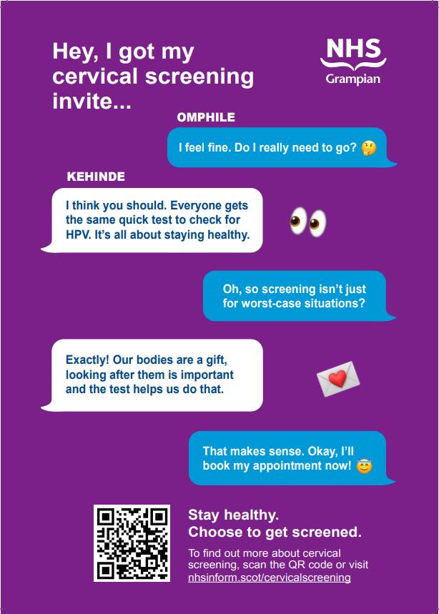
Black African

Slide 2
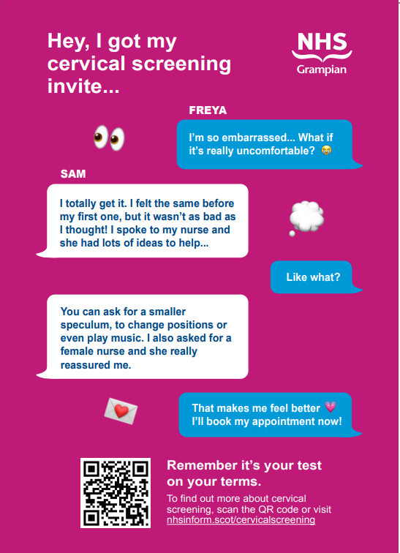
SIMD 1 & 2

Slide 3
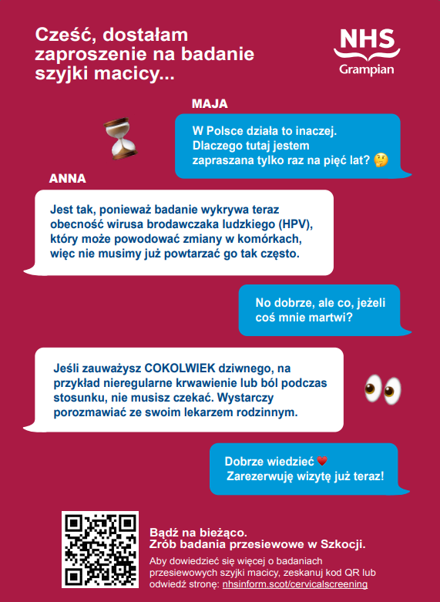
Polish
Hey, I got my cervical screening invite...
Maja: It’s different in Poland. Why do I only get invited here every five years? 🤔
Anna: That’s because the test now checks for human papillomavirus (HPV), the virus that can cause cell changes, so we don’t need to test as often.
Maja: Hmm okay, but what if I’m worried about something?
Anna: If you notice ANYTHING weird, like irregular bleeding or pain during sex, you don’t have to wait. Just speak to your GP.
Maja: Good to know ❤️ I’ll book my appointment now!
Stay informed. Get screened in Scotland.
To find out more about cervical screening, scan the QR code or visit nhsinform.scot/cervicalscreening

