Slide 1

TRAVEL HEALTH SERVICE TRAINING 30/09/2025
Dr Jenny Wares, Consultant in Public Health Medicine (Health Protection) and Immunisation Coordinator
Gayle MacDonald, Vaccination and Immunisation Pharmacist

Slide 2
Aims and Objectives
Travel Health
Overview of the NHS Highland Travel Health Service
What to consider when carrying out a risk assessment
How and when to refer to NHS Health Protection (Public Health)
Refresher on infectious diseases
Travel health advice – beyond vaccines

Slide 3

Travel Health
Refers to the health aspects of international travel, including the risks and preventative measures that travellers should consider
The precautions and health considerations for travellers to take to minimise risks to health include:
Infection diseases
Environmental hazards
Impact of travel on health e.g. stress, cultural differences
Pre and post travel care

Slide 4
NHS Highland Travel Health Service Overview
Service Level Agreement (SLA)
26 sites across NHS Highland involved ​
Service Aim: To provide a patient centred, accessible, consistent and comprehensive travel services for patients
To provide a “one-stop” service – NHS and non-NHS supply

Slide 5
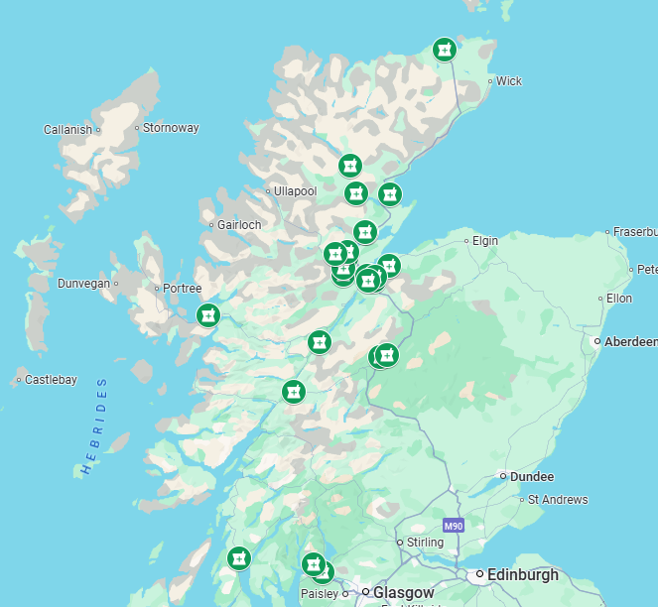
NHS Highland Travel Health Sites

Slide 6
NHS Highland Travel Health Service
Full travel health risk assessment carried out by vaccinator (registered pharmacy technician, pharmacist, nurse)​
Includes adults and children
Can supply NHS vaccines under PGD → Hepatitis A​, Typhoid​, Cholera​, Revaxis (diphtheria / polio / tetanus)​
Private service to be offered for those elements not available through the NHS
Provide accurate and up to date information about travel health risks
Counsel patients on other related travel health and first aid messages including but not limited to personal safety and environmental risks.
Travel health advice given / anti-malarials

Slide 7
Travel Health Risk Assessment Considerations
Patient details
Full medical history
Medications including OTC and herbal
Allergies – drug and non drug
Previous allergies to vaccines
Pregnant / Breast feeding
Previous vaccination history including dates, number of doses
Travel details
Date of departure
Total duration of travel
Destination(s) – include all
Purpose of trip
Type of destination
Accommodation
Length of stay in each destination
Activities during travel
Travel health advice

Slide 8
Travel Health Risk Assessment Outcome
TravelHealthPro website
Up to date information
Country information
Factsheets and resources
Advice line for health professionals to specialist nurse advisor
Recommendations:
Vaccines
Malaria prophylaxis
Travel health advice
Disease risks
Food and water hygiene
Medicines and travel
Sun protection
Travel insurance
Personal safety
Risks posed by environment

Slide 9
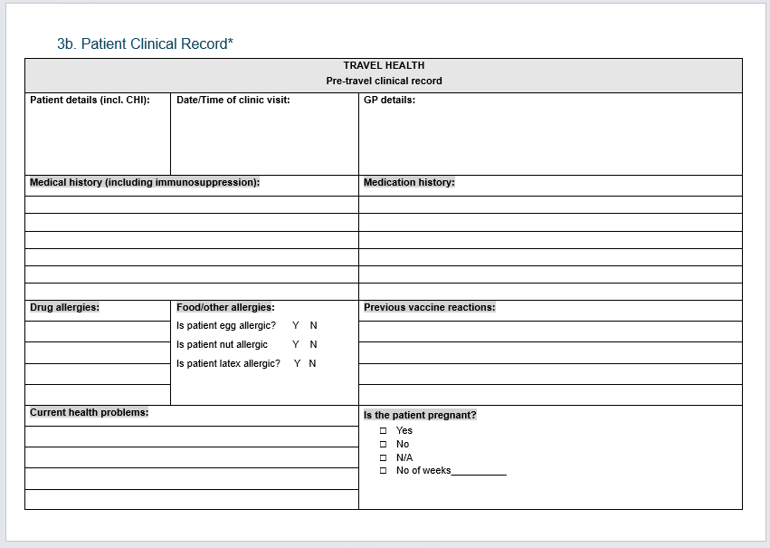

Slide 10
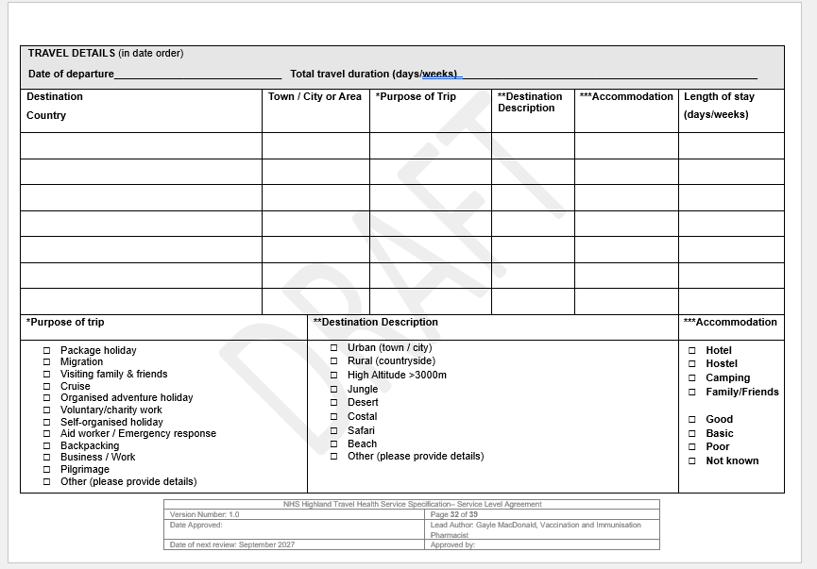

Slide 11
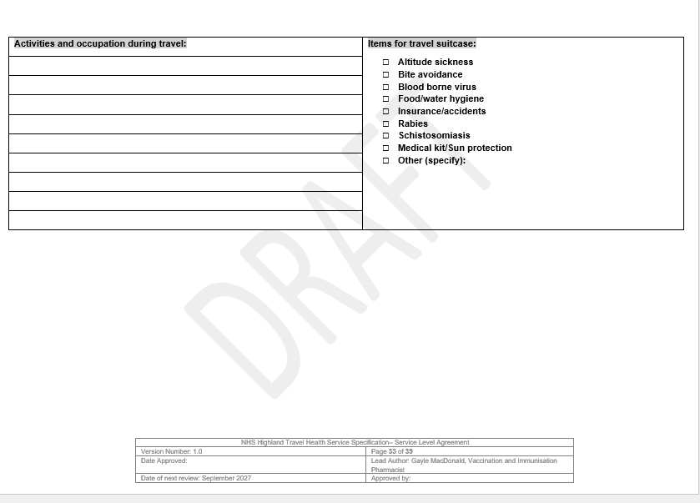

Slide 12
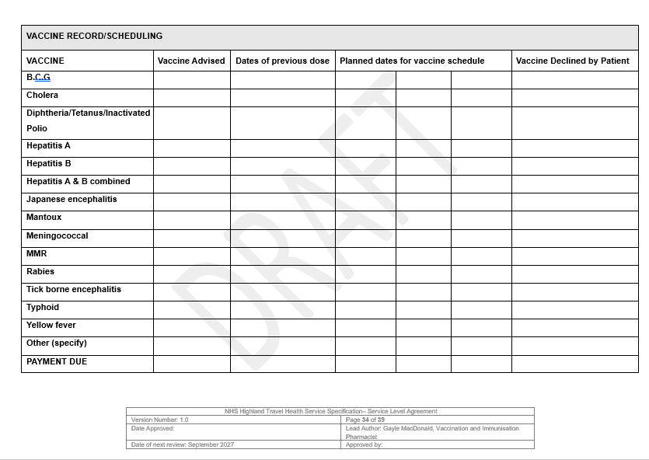

Slide 13
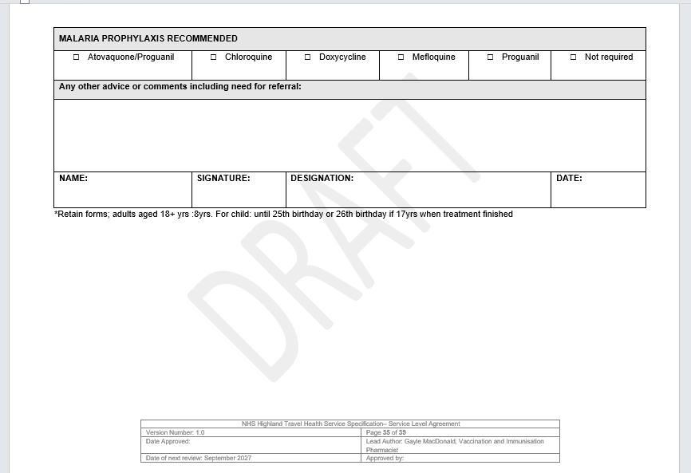

Slide 14
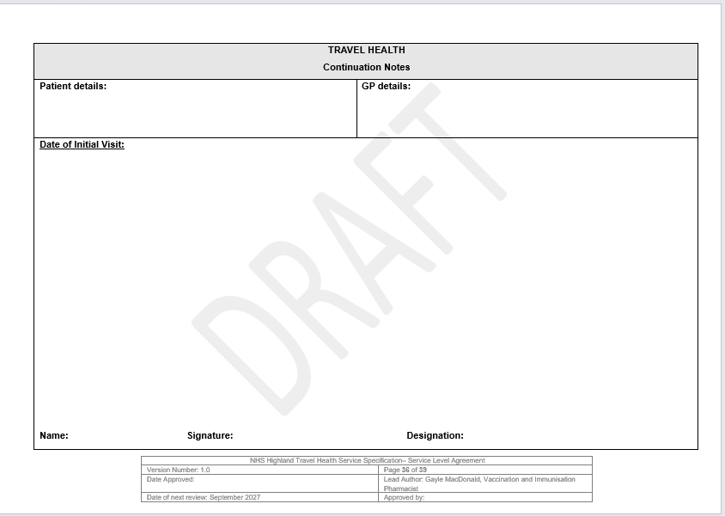

Slide 15
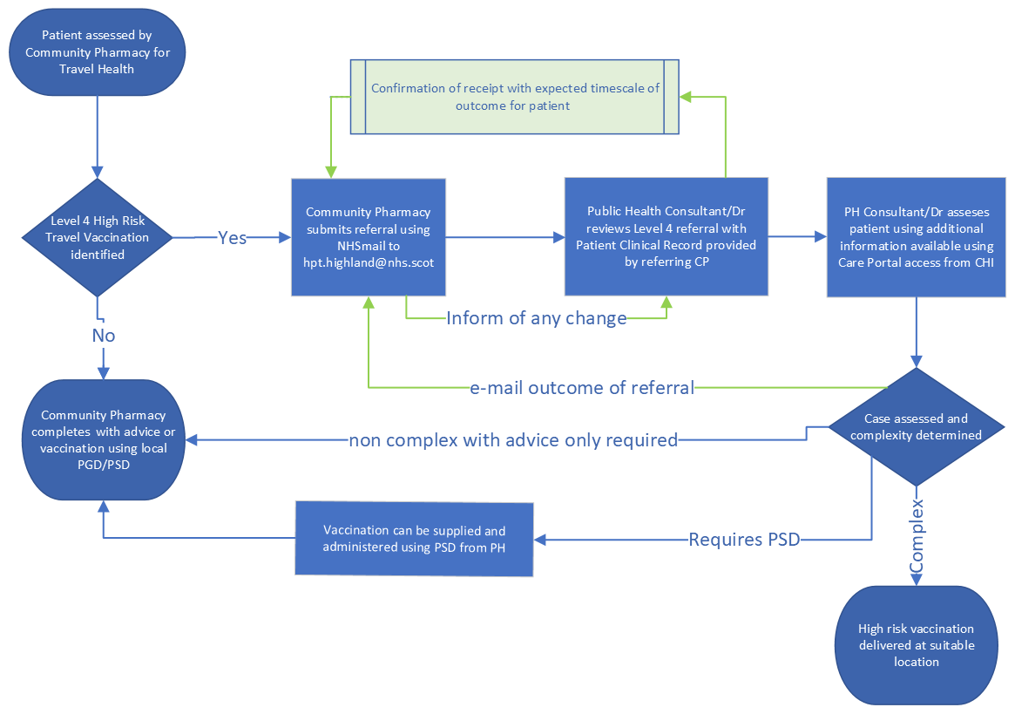
Level 4 Pathway referral to Health Protection Team

Slide 16
Resources
National Travel Health Network and Centre – NaTHNAc
NaTHNaC
Travel Health Pro website
Welcome to TravelHealthPro video - Welcome to TravelHealthPro on Vimeo
NHS Inform
Travel health and vaccinations | NHS inform
NHS Highland
Vaccinations for international travel | NHS Highland
Travel Vaccines & PGD’s – NHS Highland
NES TURAS
Travel Health Programme | Turas | Learn
UKHSA
Guidelines for malaria prevention in travellers from the UK 2024
Vaccination of individuals with uncertain or incomplete immunisation status
Vaccine incident guidance: Responding to errors in vaccine storage, handling and administration

