Slide 1



About Smoking
Quit Your Way Training
For Community Pharmacies

Slide 2

Background Information:
The Scottish Government set the target of reducing smoking prevalence in Scotland to 5% by 2034.
Priority groups include:
Smoking contributes to and increase poverty: smoking is a cause of childhood and adult poverty in the UK.
example: 20 cigarettes a day at £12.67 per packet of prerolled cigarettes, cost around £4618 a year.
Stopping smoking is associated with improvements in depression, anxiety, stress – meaning a better quality of life. It has been proven to increase your health in the matter of days when you quit smoking.
Children and young people Looked after Children (LAC) Pregnant women and their families Prisoners People living in deprived areas People with mental health illnesses | People with long term conditions and disabilities People who are unemployed/ low income People experiencing homelessness All smokers, on admission to hospital, with issues relating to respiratory, vascular and cardiac conditions, diabetes, mental ill health, pregnancy and cancer.

Slide 3
Notes:
Reference: Scottish Survey Core Questions, 2022 – this is the most up to date information.
Graph: Scottish Survery Core Questions (SSCQ) 2022

Slide 4
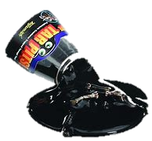
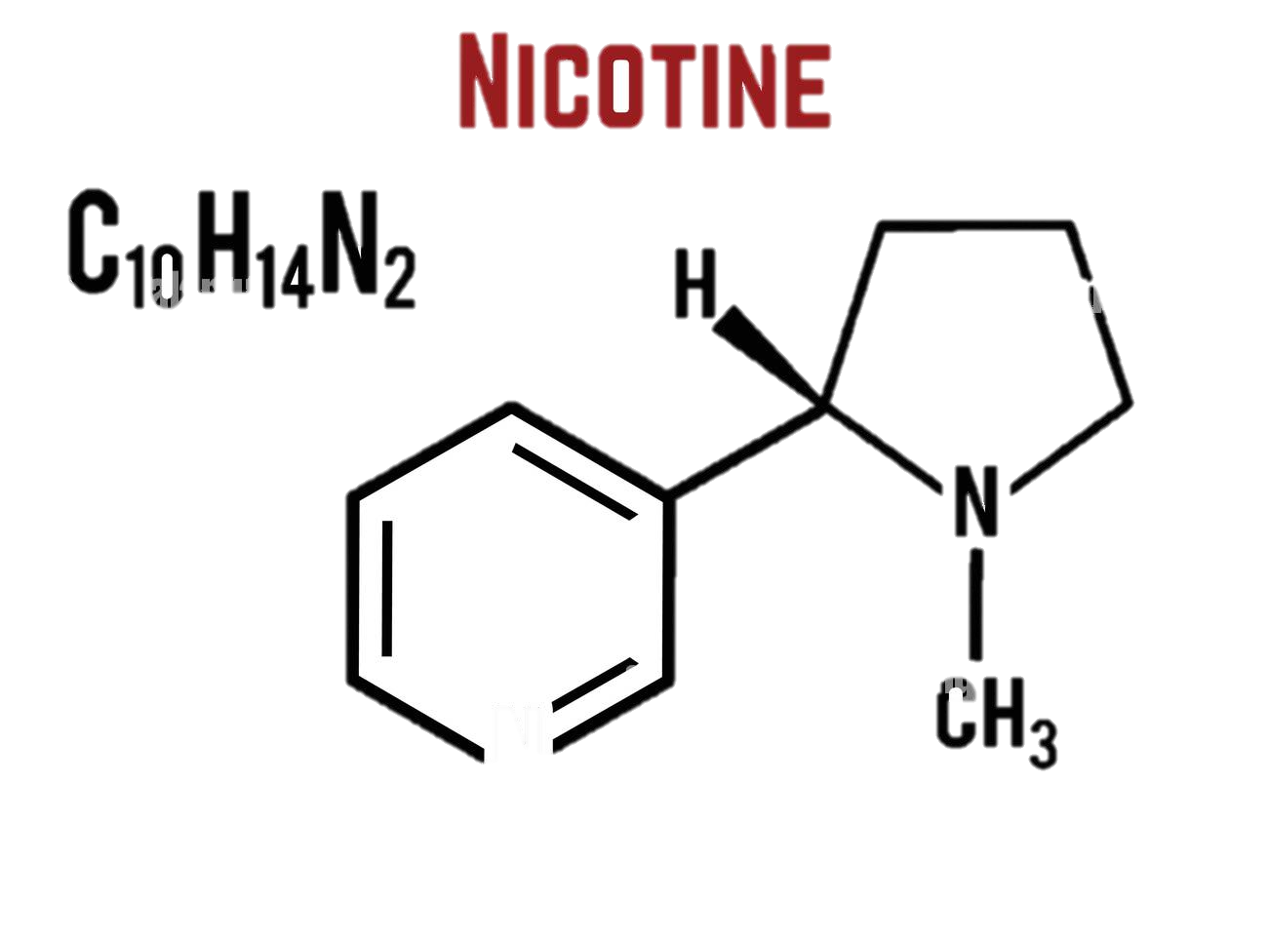
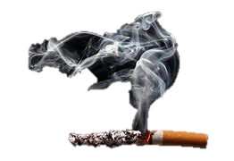
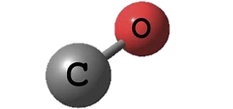
Smoking Contains:
Tar | Causes cancer of the lungs, mouth and throat. Coats the inside of the lungs, causing coughing. Damages to the lungs and inner cavities, makes it more difficult for gas exchange to happen.
Nicotine | Nicotine is addictive it causes someone who smokes to want more cigarettes. Can increases the heart rate and blood pressure. Makes blood vessels narrower than normal which can lead to heart disease.
Smoke | Cells with tiny hair-like parts, move mucus in the body, that traps dirt and microbes, out of the lungs towards the windpipe. Hot smoke and tar damage these cells. As a result, people who smoke cough to move the mucus. This then increasing risks of getting respiratory conditions.
Carbon monoxide | Takes the place of oxygen in red blood cells. This reduces the amount of oxygen that the blood can carry. Circulation system has to work harder, causing heart disease.
Notes:
Reference:
Words: “Smoking.” BBC Bitesize, www.bbc.co.uk/bitesize/articles/zb62jsg#zqq3vwx.

Slide 5
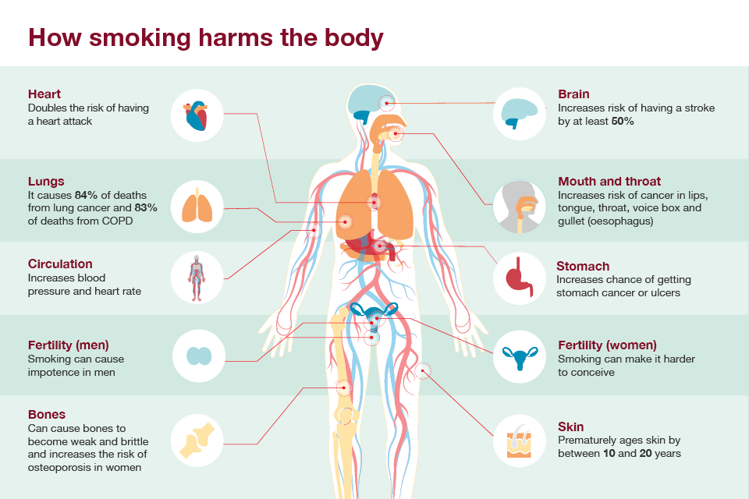
Impact of smoking on the body:
Notes:
Reference:
Picture: Public Health England (2016). Health matters: Tobacco Standard Packs. [online] gov.uk. Available at: https://www.gov.uk/government/publications/health-matters-tobacco-standard-packs/health-matters-tobacco-standard-packs.
‌

Slide 6
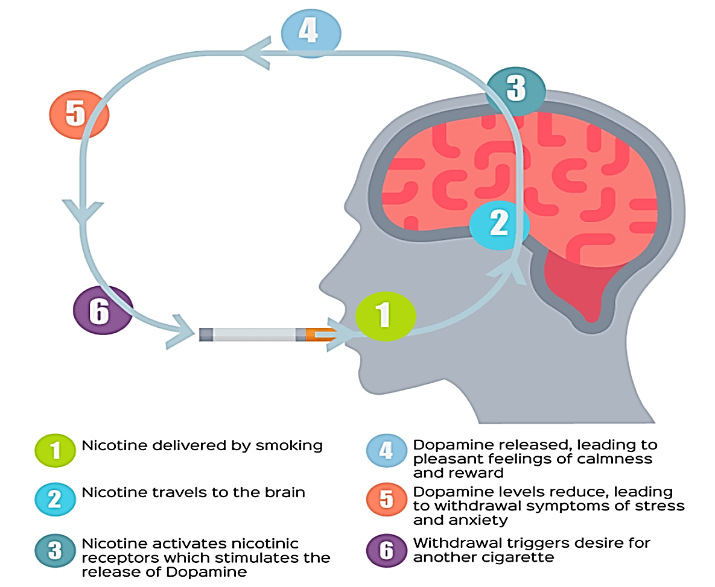
Tobacco Addiction
& Withdrawal:
ADDICTION:
Cannot stop smoking despite quit attempts
Must smoke or chew after every meal or after long periods of time without using
Users think it reduces stress and anxiety
WITHDRAWL:
Urges OR craving to smoke
Irritated
Trouble sleeping
Anxious
Hungrier OR weight gain
Loss in concentration
Notes:
Reference:
Words: Tyler, Mara. “Tobacco and Nicotine Addiction.” Healthline, Healthline Media, 3 July 2014, www.healthline.com/health/addiction/tobacco#symptoms.
CDC. “7 Common Withdrawal Symptoms | Quit Smoking | Tips from Former Smokers | CDC.” Www.cdc.gov, 9 July 2021, www.cdc.gov/tobacco/campaign/tips/quit-smoking/7-common-withdrawal-symptoms/index.html.
Picture: "Mind over matter - why quitting smoking could improve your mental ...." N.p., n.d. Web. 2 Apr. 2024 <https://ash.wales/mind-over-matter-why-quitting-smoking-could-improve-your-mental-health>.

Slide 7
Improvements on the body:
Within DAYS of quitting:
Heart rate drops
Sense of smell and taste start improved
Within WEEKS of quitting:
Risks of sudden death from cardiac/heart attack begin to reduce.
Reduced risks of asthma attacks
Within MONTHS of quitting:
Symptoms of chronic bronchitis improve. i.e. coughing and wheezing.
Risks of ulcers decline
Within YEARS of quitting:
Reduce risk of CV and respiratory disease
Approximately 35% reduction in risk of a heart attack or death to those who have CHD.
Notes:
Reference:
Words: https://www.facebook.com/WebMD. “What Happens to Your Body When You Quit Smoking?” WebMD, WebMD, 23 Aug. 2016, www.webmd.com/smoking-cessation/what-happens-body-quit-smoking.

Slide 8
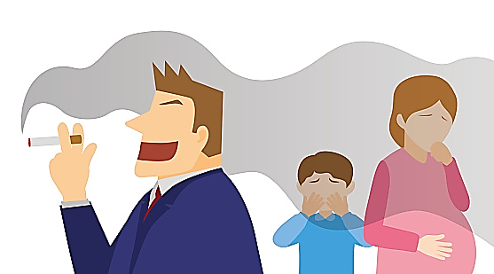
Second-Hand Smoke:
Second-hand smoke (SHS) is a mixture of the smoke given off by the burning end of a cigarette and the smoke breathed out by someone who smokes.
SHS lingers in the air for up to 5 hours and the particles are that small you cant detect them as they pass into the lungs.
Living with someone who smokes, increases someone who doesn’t smoke chances of developing lung cancer by 20-30%.
Notes:
Reference:
Words:ASH. “Secondhand Smoke.” Pediatric Patient Education, 1 Jan. 2021, https://doi.org/10.1542/peo_document394.
Former Smokers: What’s Your Risk for Lung Cancer? 2013, www.hopkinsmedicine.org/health/conditions-and-diseases/lung-cancer/former-smoker-whats-your-risk-for-lung-cancer.
Picture: secondhand smoke clipart - Search Images (bing.com)

Slide 9

E-Cigarettes & Vaping:
What?
Chemicals
Who?
Young People
Why?
Environment
Notes:
Reference:
Words:
---. “Using E-Cigarettes to Stop Smoking - Quit Smoking.” NHS, 29 Mar. 2022, www.nhs.uk/live-well/quit-smoking/using-e-cigarettes-to-stop-smoking/.
Use of Vapes (E-Cigarettes) among Young People in Great Britain.
“The Environmental Impact of Single-Use Vapes.” Www.zerowastescotland.org.uk, 30 June 2023, www.zerowastescotland.org.uk/resources/environmental-impact-single-use-e-cigarettes.
Picture: Pivape clip art - Search Images (bing.com)

Slide 10

Thanks for listening!
Remember to continue your learning to benefit not only yourself with knowledge but to keep the pledge of Quit Your Way and help support clients on their journey.
We are here to help! You can get in touch with the Pharmacy Support Team on the following:
Helpdesk Telephone: 01698 754 888 (Monday – Friday 9-5pm)
Email: pharmacytobaccocontrol@lanarkshire.scot.nhs.uk

