Slide 1



Pharmacotherapies
Quit Your Way Training
For Community Pharmacies

Slide 2

Pharmacotherapy Formulary
Nicotine Replacement Therapy (NRT) and Varenicline are joint first line products.
Nicotine dependence
P | Nicotinell® patches* | Nicotinell® 24-hour patches are the nicotine replacement therapy (NRT) formulation of choice. If patches are unsuitable or if combination NRT is deemed appropriate, only alternative products from the Nicotinell® range should be considered (i.e. gum or lozenge).
P | Varenicline tablets* | Available through community pharmacies via a Patient Group Direction.
Smoking cessation support is available through local Stop Smoking services, including community pharmacies, and via ‘Quit Your Way Scotland’(https://www.nhsinform.scot/campaigns/quit-your-way-scotland). Product choice should be determined by patient circumstance and professional judgement. NiQuitin® and Nicorette® products are non-formulary in NHS Lanarkshire, with the exception of NiQuitin minis lozenge.
More information on the formulary can be found on the Community Pharmacy Scotland NHS Lanarkshire page https://www.communitypharmacy.scot.nhs.uk/nhs-lanarkshire/pages/pharmacy-services/stop-smoking-service/
Notes:
Smoking cessation support is available through local Stop Smoking services, including community pharmacies. As part of the formulary Nicotine Replacement Therapy (NRT) and Varenicline are joint first line products.
Product choice should be determined by patient circumstance and professional judgement.
Single NRT products deliver roughly half of the nicotine that clients obtain from smoking which is why combination NRT, or dual therapy, is recommended. Nicotine patch AND one of the faster acting nicotine products is more effective than single product NRT. In Lanarkshire again the Nicotinell products are first line ie gum or lozenge, along with NiQuitin Mini Lozenges.
An updated community pharmacy Patient Group Direction for the supply of varenicline for smoking cessation is expected soon and more information will be disseminated when available
This presentation will look at NRT products in detail, once Varenicline is available again it will be updated to incorporate guidance for the use of varenicline.

Slide 3
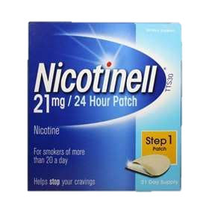
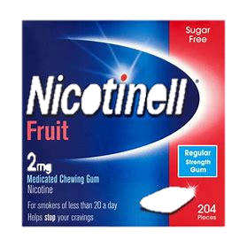
NRT Products & Counselling Tips
Patches
Nicotinell 24 hour patch First Line in Formulary
24 or 16 hours
Apply to hairless part of upper body.
Do not remove – wear consistently for the required time.
Use for at least 8-12 weeks.
May cause skin irritation – vary site of application daily.
24 hour patch may cause wakefulness or weird dreams.
Gum
Nicotinell First Line – Mint, Fruit & Liquorice flavours
Advise on chewing technique: chew and park technique
Counsel on peppery taste
Every hour on the hour – use regularly to prevent cravings
Use for at least 8-12 weeks
May cause heartburn or hiccups if used incorrectly
Notes:
PATCHES
Patches deliver about half the nicotine a smoker would get from cigarettes but provide a steady stream of nicotine into the bloodstream throughout the period of application, helping to keep cravings at bay.
Remind the patient they are a medicine and have to be cut open.
Patches should be applied to a hairless part of the upper body and pressure applied to make sure all the edges are firmly attached.
Patches should not be removed even if the client slips up and smokes a cigarette and can be worn during bathing, swimming etc. Patches should be worn for the full required time to allow for absorption of the full dose.
Recommend your client uses in combination with another faster acting NRT product to increase their chances of stopping for good.
Patches have few side effects but around 5% of patients experience skin reactions. Advise your client to vary the site of application on a daily basis. If this doesn’t help, try another brand of patch (making a note on the PMR and PCR) before exploring other NRT options.
Some smokers using the 24 hour patch often experience wakefulness or weird dreams at night. If problematic, take patch off at bedtime OR switch to 16 hour patch and Have another form of NRT by the bed to use if they experience night cravings.
GUM
Nicotine gum is a medicine not confectionery and patients should be counselled on proper use.
The gum should be “chewed” using a biting action and its peppery taste will become stronger.
Nicotine is absorbed across the lining of the mouth when the gum is parked in the cheek. As the flavour fades away, start to chew again until the strong flavour comes back.
Each piece will last about 30 minutes until all the nicotine has been absorbed. The patient should spit out the gum and use a new piece the following hour.
Heartburn or hiccups indicate too much chewing and swallowing the nicotine instead of it being absorbed through the lining of the mouth. Park more, chew less!

Slide 4
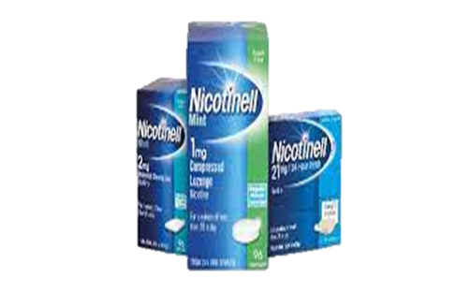
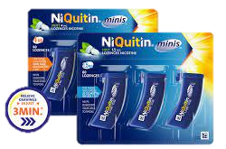
NRT Products & Counselling Tips
Lozenges
Nicotinell First Line – Mint flavour
Advise on technique: suck and park technique
Counsel on peppery taste
Every hour on the hour – use regularly to prevent cravings
Use for at least 8-12 weeks
May cause heartburn or hiccups if used incorrectly
Mini Lozenges
NiQuitin First Line – Mint flavour
Handy pocket size container
Easy to carry around
Dissolve in the mouth in 10-15 minutes
Counsel as for full size lozenges
Notes:
As with gum, patients should be advised that lozenges and mini lozenges are a medicine designed to help them stop smoking and not a sweetie!
Patients should be counselled on suck and park technique and encouraged to use the product regularly, every hour on the hour to stave off cravings.
Patients may experience heartburn or hiccups if they are swallowing too much nicotine.
If this is a problem, advise the client to park the lozenge more frequently in the side of the cheek and suck less.
Big lozenges usually last about 30 minutes and Mini Lozenges 10-15 minutes.
Neither type of lozenge cause mouth ulcers!!!
Stopping smoking is stressful and during quit attempts, clients are more prone to cold sores, mouth ulcers and upper respiratory infections.

Slide 5

Thanks for listening!
Remember to continue your learning to benefit not only yourself with knowledge but to keep the pledge of Quit Your Way and help support clients on their journey.
We are here to help! You can get in touch with the Pharmacy Support Team on the following:
Helpdesk Telephone: 01698 754 888 (Monday – Friday 9-5pm)
Email: pharmacytobaccocontrol@lanarkshire.scot.nhs.uk

