Slide 1



Pregnancy
Quit Your Way Training
For Community Pharmacies

Slide 2

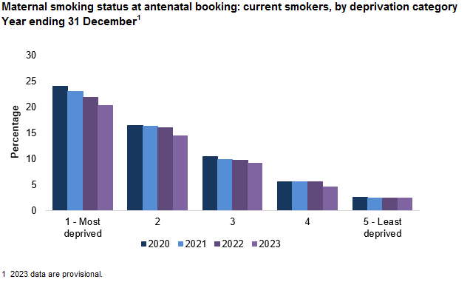
Prevalence of Smoking in Pregnancy:
Scotland December 2023, 11% of pregnant women were current smokers at booking
Lanarkshire December 2023, 10.5% of pregnant women were current smokers at booking
[Variations in Smoking Prevalence]
Pregnant woman at antenatal booking in Scotland
(31st Dec 2023)
By Deprivation;
SIMD 1 (most deprived) 20.4% were current smokers
SIMD 5 (least deprived) 2.4% were current smokers
By Local Authority;
North Lanarkshire; 12.7%
South Lanarkshire; 8.2%
By Maternal Age;
Women under 20yrs; 26.8% were current smokers
Woman 35-39yrs; 7.8%
Source: https://publichealthscotland.scot/publications/antenatal-booking-in-scotland/antenatal-booking-in-scotland-calendar-year-ending-31-december-2023/ Latest Published Mar 2024
Notes:
Positively the no. of woman smoking in pregnancy continues fall over all
You can see the downward trend
However what is significant is the differences, variations between groups based on age and where woman live
Higher rates amongst younger woman and those living in deprived areas
So it matters that we help and support younger woman and those in deprived areas to stop smoking to improve maternal and infant health
Data: : https://publichealthscotland.scot/publications/antenatal-booking-in-scotland/antenatal-booking-in-scotland-calendar-year-ending-31-december-2023/ Latest Published Mar 2024

Slide 3
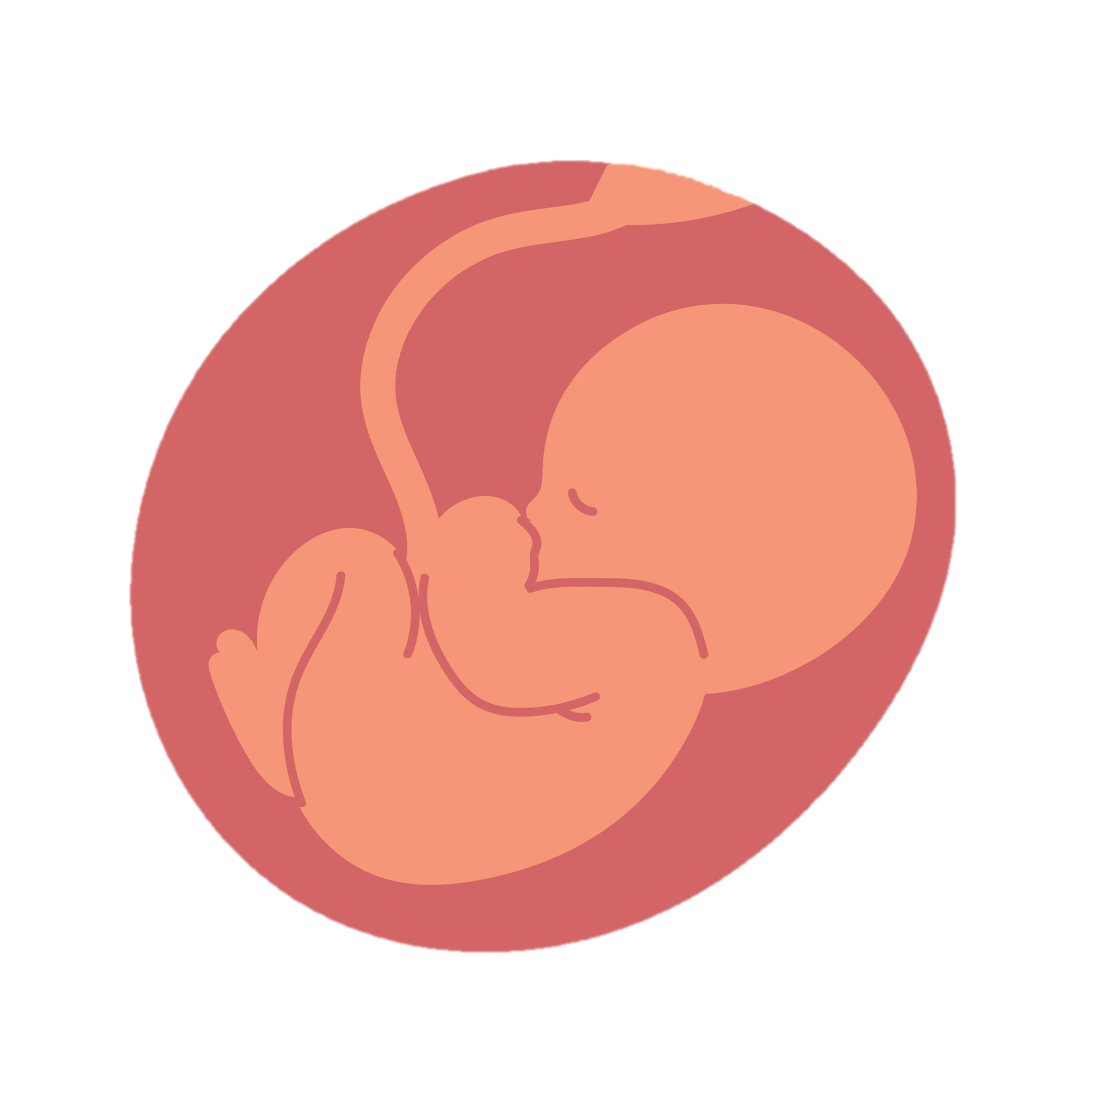
Smoking during pregnancy:
Smoking when pregnant:
Lowers the amount of oxygen available mum and baby.
Increases your baby's heart rate.
Increase risk of a miscarriage.
Growth and health being affected.
Bleeding during the last months of pregnancy, which is known as an abruption (when the placenta comes away from the wall of the womb) – this could be life threatening for you and your baby.
(RCOG)
Notes:
Reference:
Words: RCOG. “Smoking and Pregnancy | RCOG.” RCOG, Smoking and pregnancy | RCOG, 2019, www.rcog.org.uk/for-the-public/browse-our-patient-information/smoking-and-pregnancy/.
Picture: baby in womb clip art - Search Images (bing.com)

Slide 4
How smoking impacts mum and baby from birth to later life:
Birth | Pregnant Woman/Mother | Infancy, Childhood, Later in life
Low birth weight Pre-term birth Intrauterine growth restriction Birth defects e.g. cleft palate, heart defects Stillbirth Increased infant mortality Sudden Infant Death Syndrome (SIDS) | Complications in pregnancy and labour; Maternal deep vein thrombosis and pre-eclampsia Preterm birth Premature rupture of membranes Placental abruption Placenta praevia Ectopic pregnancy Miscarriage Postnatal; Delayed wound healing Prolonged Hospital Stay Repeated admissions after surgery | Problems with ear, nose and throat i.e. asthma, ear and respiratory infections, bacterial meningitis Reduced educational performance Child behavioural problems; Attention and hyperactivity problems/Learning difficulties Teenagers; 4 times as likely to become regular smokers (if main carer smokes) themselves, more than twice as likely to have tried smoking Increased risk of developing diabetes or obesity in later life
There is no safe level of smoking; to reduce risks of stillbirth, low birth weight and small for gestation age to that of a non smoker – stopping smoking and quitting early (before 15wks) is advised – quitting at any stage is still better than not at all
/
Notes:
Reference:
Words: Smoking cessation: What are the harms caused by smoking? NICE September 2021
https://cks.nice.org.uk/topics/smoking-cessation/background-information/harms-caused-by-smoking

Slide 5
Notes:
Picture: public health england the harms of smoking in pregnancy - Search Images (bing.com)

Slide 6

Second-Hand Smoke:
Second-hand smoke (SHS) is a mixture of the smoke given off by the burning end of a cigarette and the smoke breathed out by someone who smokes.
SHS lingers in the air for up to 5 hours and the particles are that small you cant detect them as they pass into the lungs.
Living with someone who smokes, increases someone who doesn’t smoke chances of developing lung cancer by 20-30%.
Second-hand smoke can have an impact on the baby before and after birth:
23% increased risk of still birth
13% increased risk of congenital malformation
(World Health Organisation)
Notes:
Reference:
Words:ASH. “Secondhand Smoke.” Pediatric Patient Education, 1 Jan. 2021, https://doi.org/10.1542/peo_document394.
Former Smokers: What’s Your Risk for Lung Cancer? 2013, www.hopkinsmedicine.org/health/conditions-and-diseases/lung-cancer/former-smoker-whats-your-risk-for-lung-cancer.
Picture: secondhand smoke clipart - Search Images (bing.com)

Slide 7
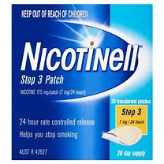
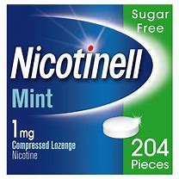
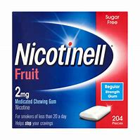
Supporting Pregnant Women Who Smoke
Identifying and supporting pregnant women who smoke is a high priority.
Pregnant women can self refer to the Quit Your Way Pharmacy Service for support to stop smoking and ideally seen without delay.
Pharmacy staff can also refer to or contact the QYW Pregnancy Service for more information and advice via the Helpline – Tel: 01698 754 888
Combination NRT (two products i.e. 16 hour patch plus oral NRT) is the most effective medication option and is suitable for pregnant women (NCSCT, 2019)
Notes:
Standard Treatment Programme for Pregnant Women (2019): A guide to providing behavioural support for smoking cessation during pregnancy and the postpartum period. National Centre for Smoking Cessation and Training (NCSCT), 2019.
Reference:
Words: Mcewen, Andy, et al. Combination Nicotine Replacement Therapy (NRT) 1.
Picture 1 (Patch): nicotine patch - Search Images (bing.com)
Picture 2 (Gum): nicotine gum - Search Images (bing.com)
Picture 3 (Lozenge): nicotine lozenge - Search Images (bing.com)

Slide 8
Additional Learning:
Provider: | Where to Access:
Public Health Scotland: Very Brief Advice on Smoking | Home | PHS Learning (publichealthscotland.scot)
National Centre for Smoking Cessation Training Brief Videos: Video 1 - Harms from exposure to tobacco smoke during pregnancy Video 2 – Carbon monoxide screening and ‘Very Brief Advice’ Video 3 - How stop smoking specialists help pregnant women to quit | Video 1: https://youtu.be/SIEffPkyugI Video 2: https://youtu.be/uN70NtyFNxg Video 3: https://youtu.be/mUkfLUG2oOY
ASH Scotland: Understanding Tobacco and Second-hand Smoke Modules | https://www.ashscotlandmoodle.org.uk/

Slide 9

Thanks for listening!
Remember to book into future training session to benefit not only yourself with knowledge but to keep the pledge of Quit Your Way and help support clients on their journey.
We are here to help! You can get in touch with the Pharmacy Support Team on the following:
Helpdesk Telephone: 01698 754 888 (Monday – Friday 9-5pm)
Email: pharmacytobaccocontrol@lanarkshire.scot.nhs.uk

